Slide 1
Patterns and trends in child obesity in Croydon
A presentation of 2024 to 2025 NCMP data at local authority level
PHA-OHID@dhsc.gov.uk
November 2025

Slide 2
National Child Measurement Programme
The National Child Measurement Programme (NCMP), established in 2006, collects annual measurements of the height and weight of over one million children in reception (aged 4 to 5 years) and year 6 (aged 10 to 11 years) in primary schools across England.
This slide set presents data from the 2024 to 2025 academic year showing the patterns and trends in the prevalence of overweight and obesity among reception and year 6 children in Croydon.
The number of children measured in Croydon in 2024 to 2025 was 4,285 in reception, and 4,295 in year 6. The participation rate in Croydon in 2024 to 2025 was 94.6% in reception children and 93.8% for children in year 6.
Trend data for participation rates, total participation and split by school year group, in the NCMP from academic years ending 2011 to 2025 is available in
the Obesity, physical activity and nutrition profile.
2

Slide 3
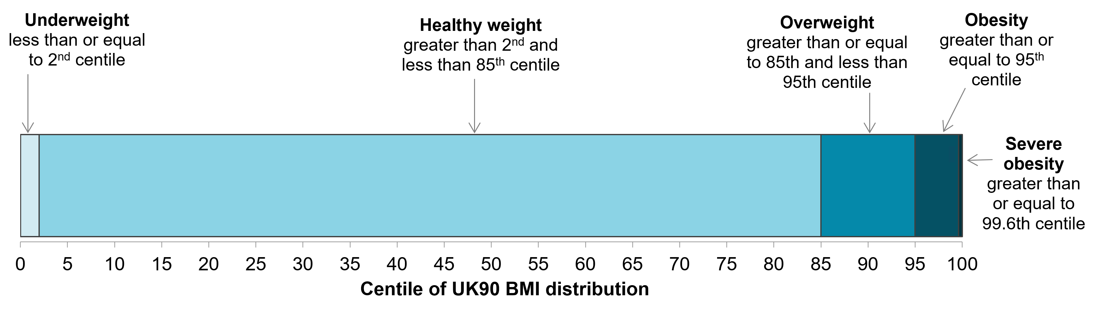
Child body mass index classification
Definitions for population monitoring
For population monitoring purposes, a child’s body mass index (BMI) is classed as overweight or obese where it is on or above the 85th centile or 95th centile, respectively, based on the British 1990 (UK90 ) growth reference data. The population monitoring cut offs for overweight and obesity are lower than the clinical cut offs (91st and 98th centiles for overweight and obesity) used to assess individual children; this is to capture children in the population in the clinical overweight or obesity BMI categories and those who are at high risk of moving into the clinical overweight or clinical obesity categories. This helps ensure that adequate services are planned and delivered for the whole population to treat and prevent obesity and promote healthy growth for all children. The chart below shows the population monitoring thresholds that are used for the analysis of the data presented in this slide set.
1
1. Cole TJ, Freeman JV, Preece MA. Body mass index reference curves for the UK, 1990. Archives of Disease in Childhood 1995 73:25-29.
3

Slide 4


Prevalence of overweight (including obesity) in Croydon by age
National Child Measurement Programme 2024 to 2025
In 2024 to 2025, 22.4% of children in reception (aged 4 to 5 years) were overweight or living with obesity
In 2024 to 2025, 38.3% of children in year 6 (aged 10 to 11 years) were overweight or living with obesity
4

Slide 5


Prevalence of obesity in Croydon by age
National Child Measurement Programme 2024 to 2025
In 2024 to 2025, 10.6% of children in reception (aged 4 to 5 years) were living with obesity
In 2024 to 2025, 24.2% children in year 6 (aged 10 to 11 years) were living with obesity
5

Slide 6
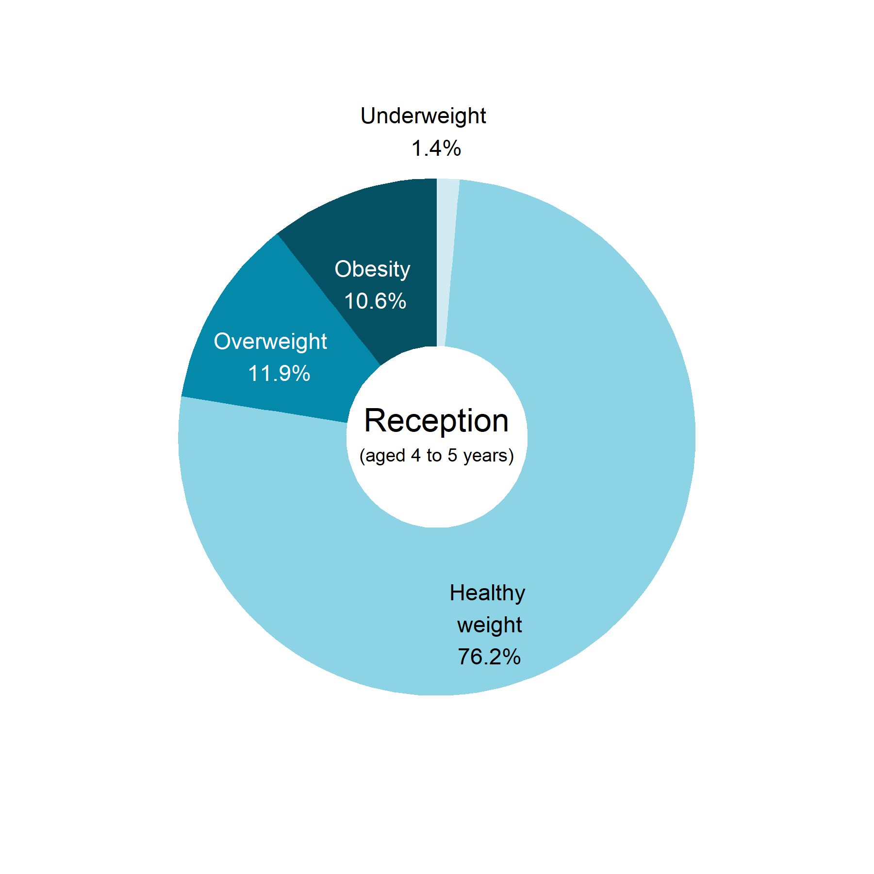
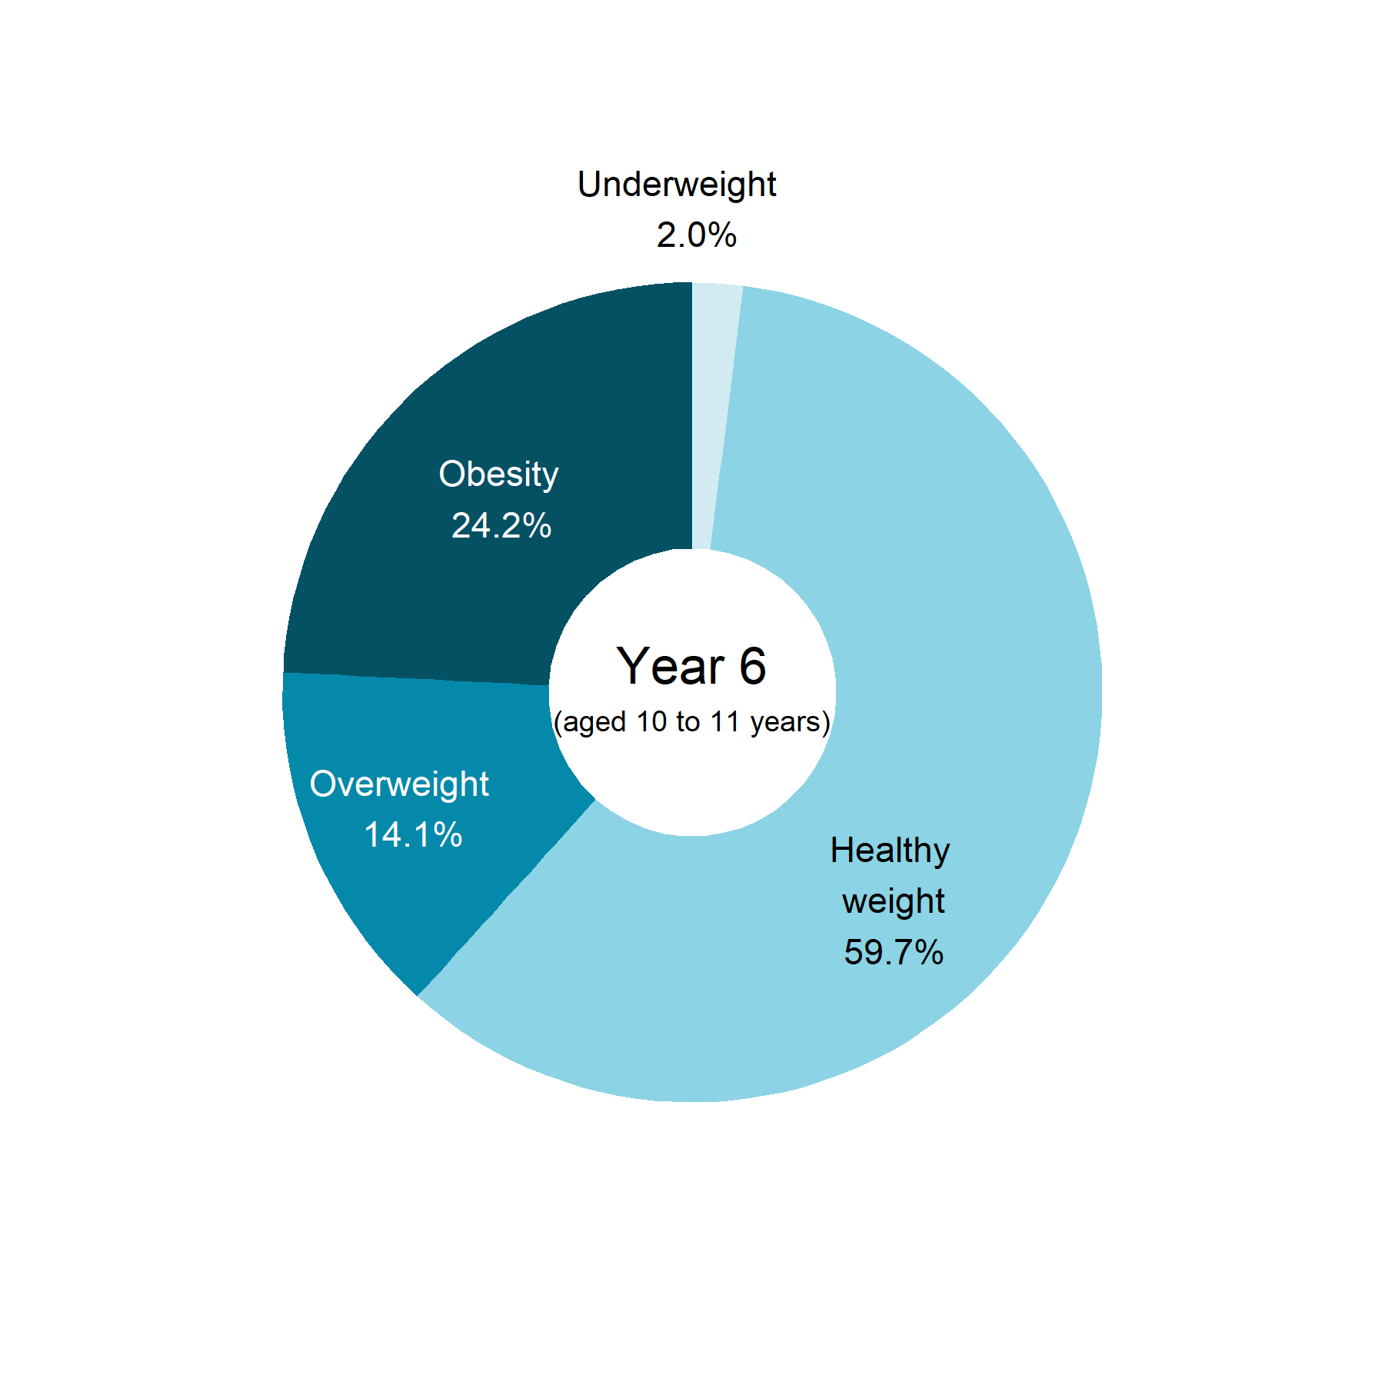
BMI status of children by age in Croydon
National Child Measurement Programme 2024 to 2025
Totals may not sum due to rounding
6

Slide 7
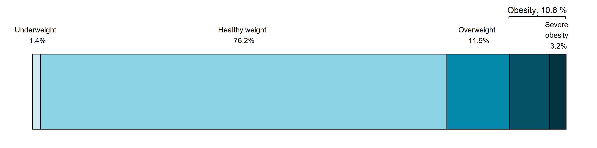
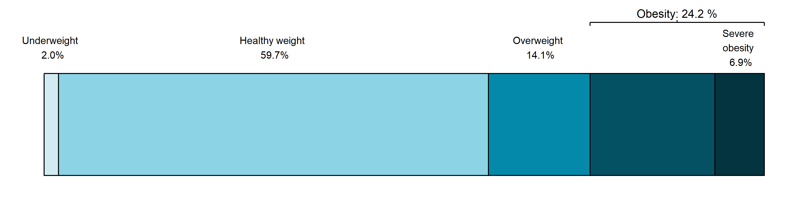
BMI status of children by age in Croydon
National Child Measurement Programme 2024 to 2025
Reception
(aged 4 to 5 years)
Year 6
(aged 10 to 11 years)
Totals may not sum due to rounding
7

Slide 8
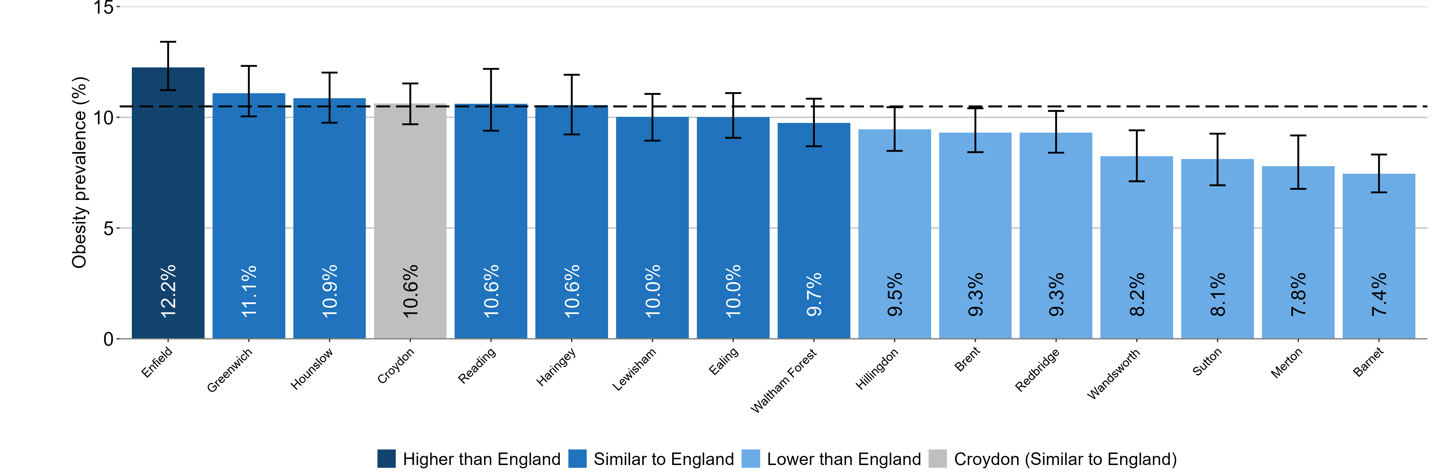
Child obesity in Croydon
Prevalence of obesity, National Child Measurement Programme 2024 to 2025
Croydon compared to its statistical nearest neighbours (NHS England)
Children in reception (aged 4 to 5 years)
England: 10.5%
Nearest statistical neighbour method developed by NHS England
Local authorities are compared to England value shown as a dashed line on the chart
95% confidence intervals are shown
8

Slide 9
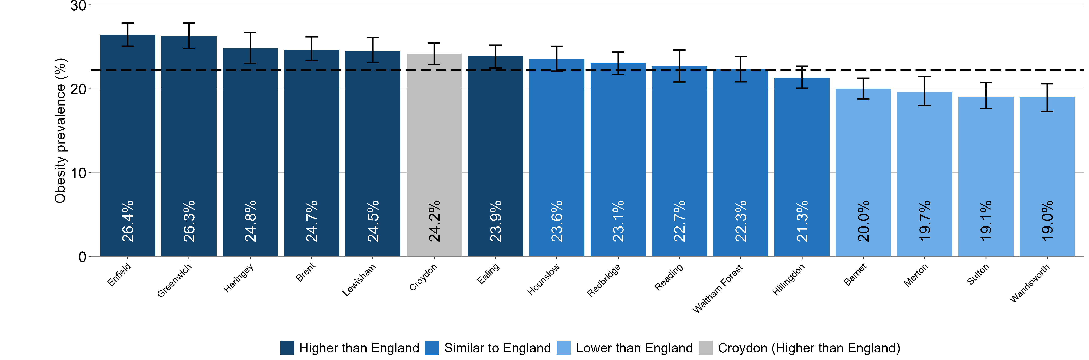
Child obesity in Croydon
Prevalence of obesity, National Child Measurement Programme 2024 to 2025
Croydon compared to its statistical nearest neighbours (NHS England)
Children in year 6 (aged 10 to 11 years)
England: 22.2%
Nearest statistical neighbour method developed by NHS England
Local authorities are compared to England value shown as a dashed line on the chart
95% confidence intervals are shown
9

Slide 10
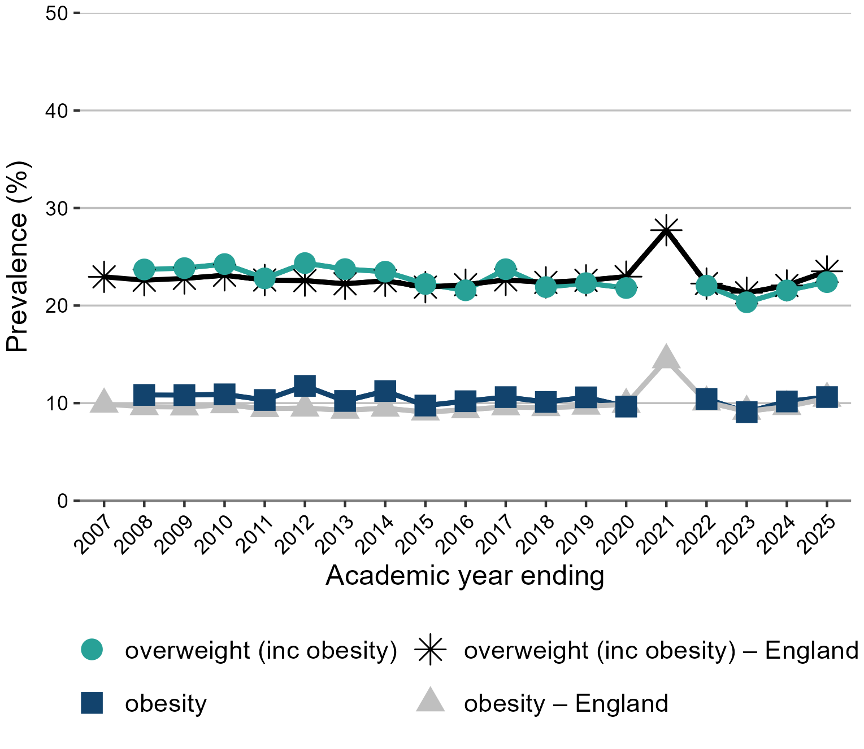
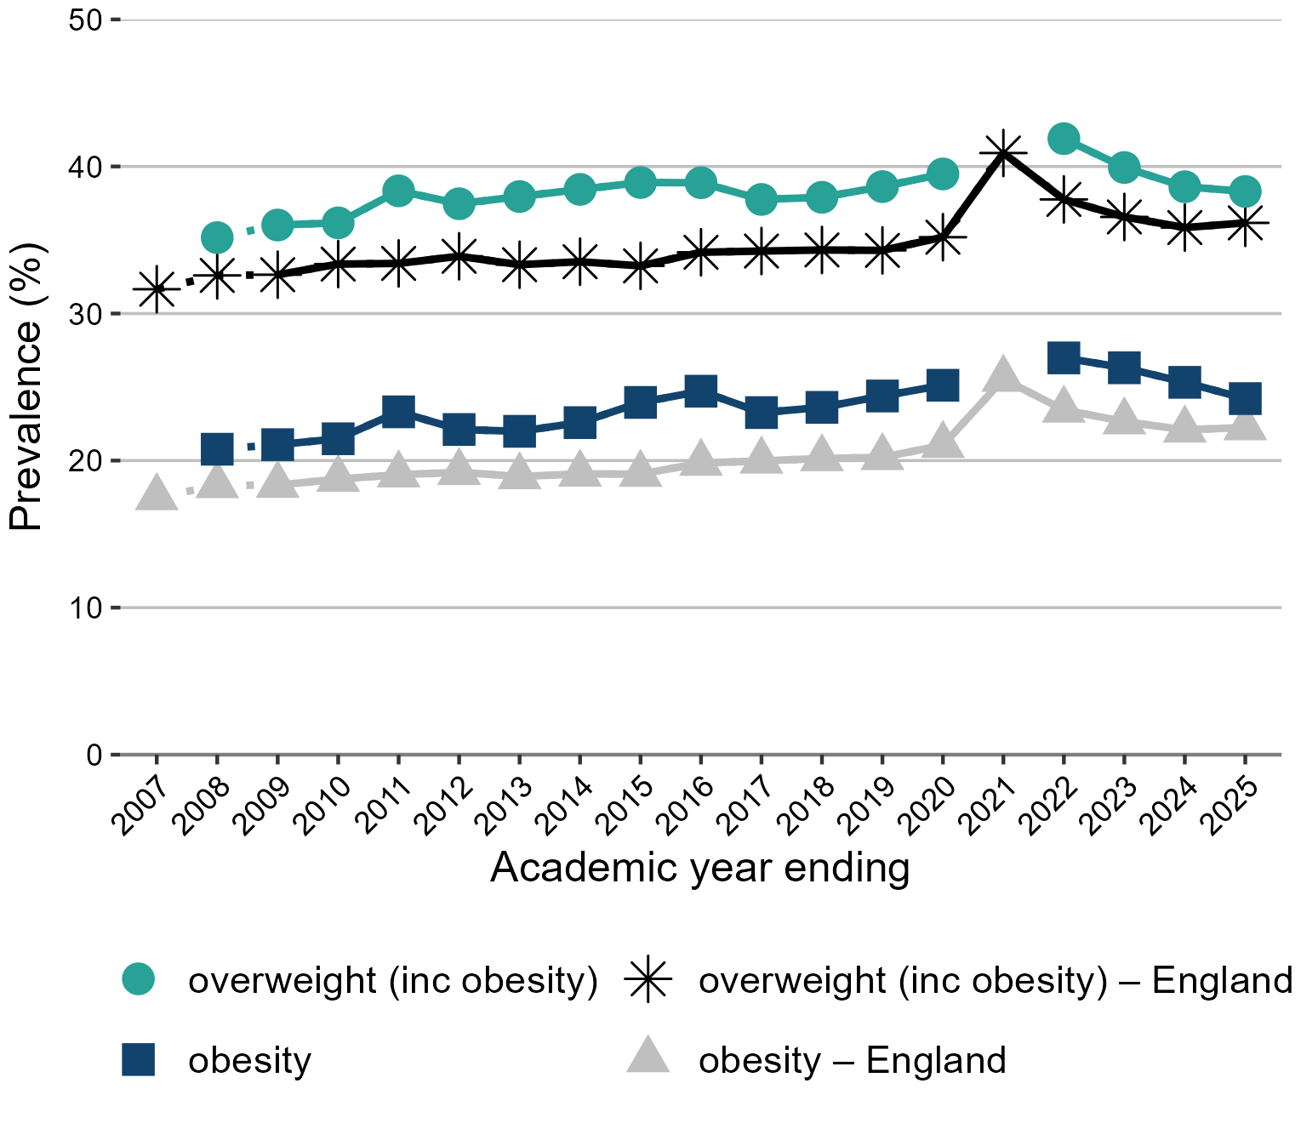
Trend in the prevalence of obesity and overweight (including obesity) by age in Croydon
National Child Measurement Programme between 2006 to 2007 and 2024 to 2025
Children in reception (aged 4 to 5 years)
Children in year 6 (aged 10 to 11 years)
Missing data point denotes missing data for 2006 to 2007, 2020 to 2021
Note: for Year 6, comparisons are not possible with the first years of the NCMP (2006 to 2007 and 2008 to 2009) as low participation levels led to underestimation of obesity prevalence
10

Slide 11
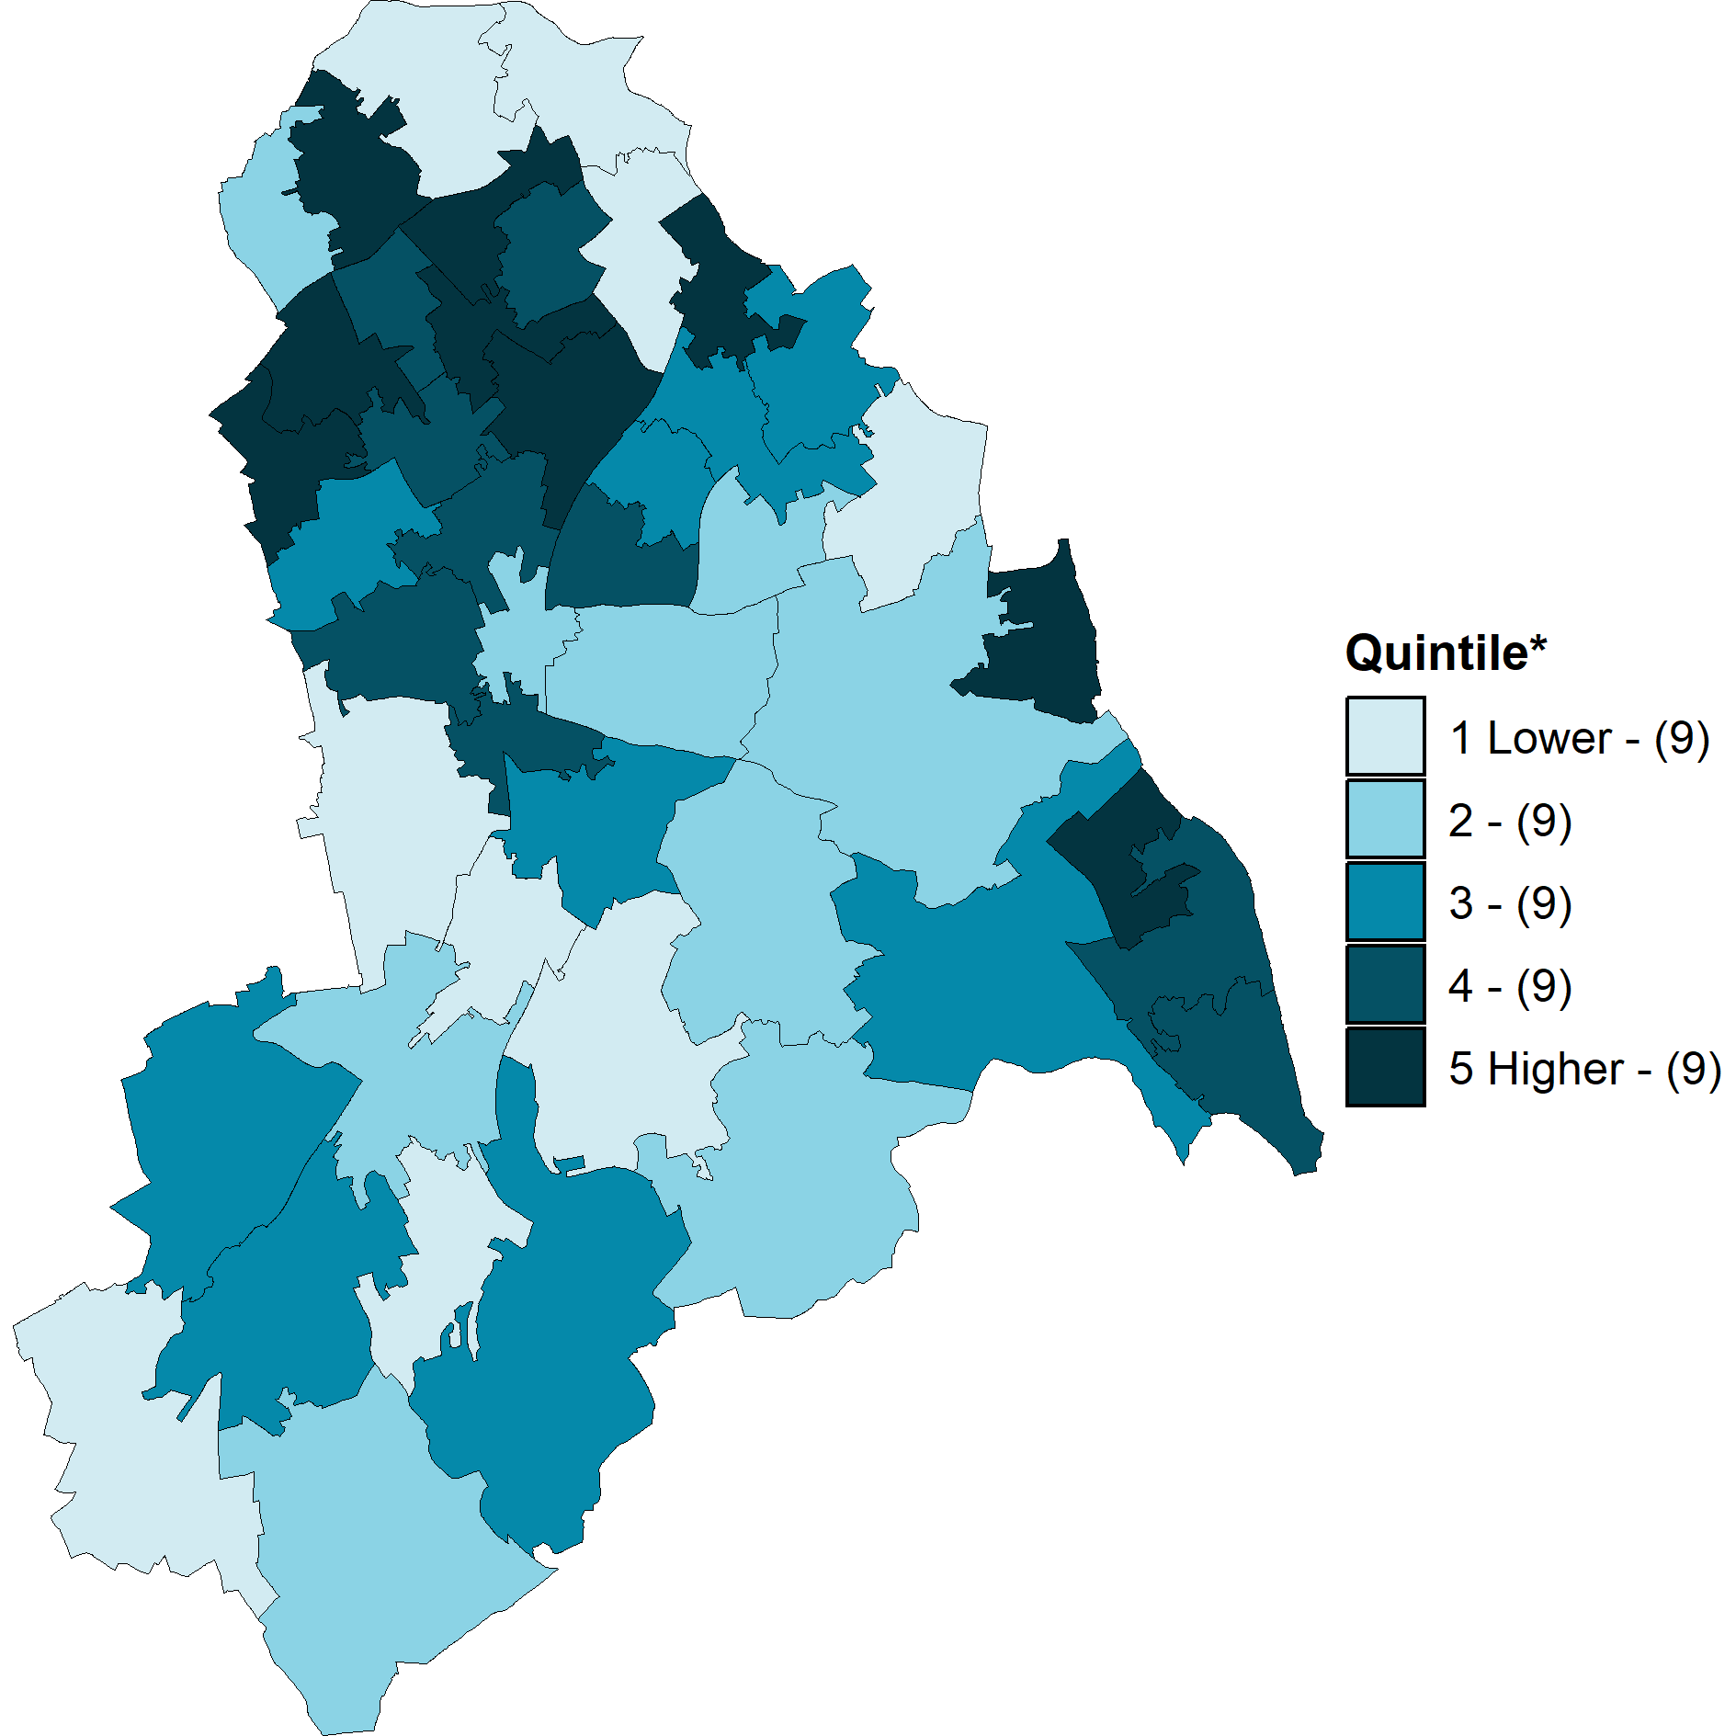
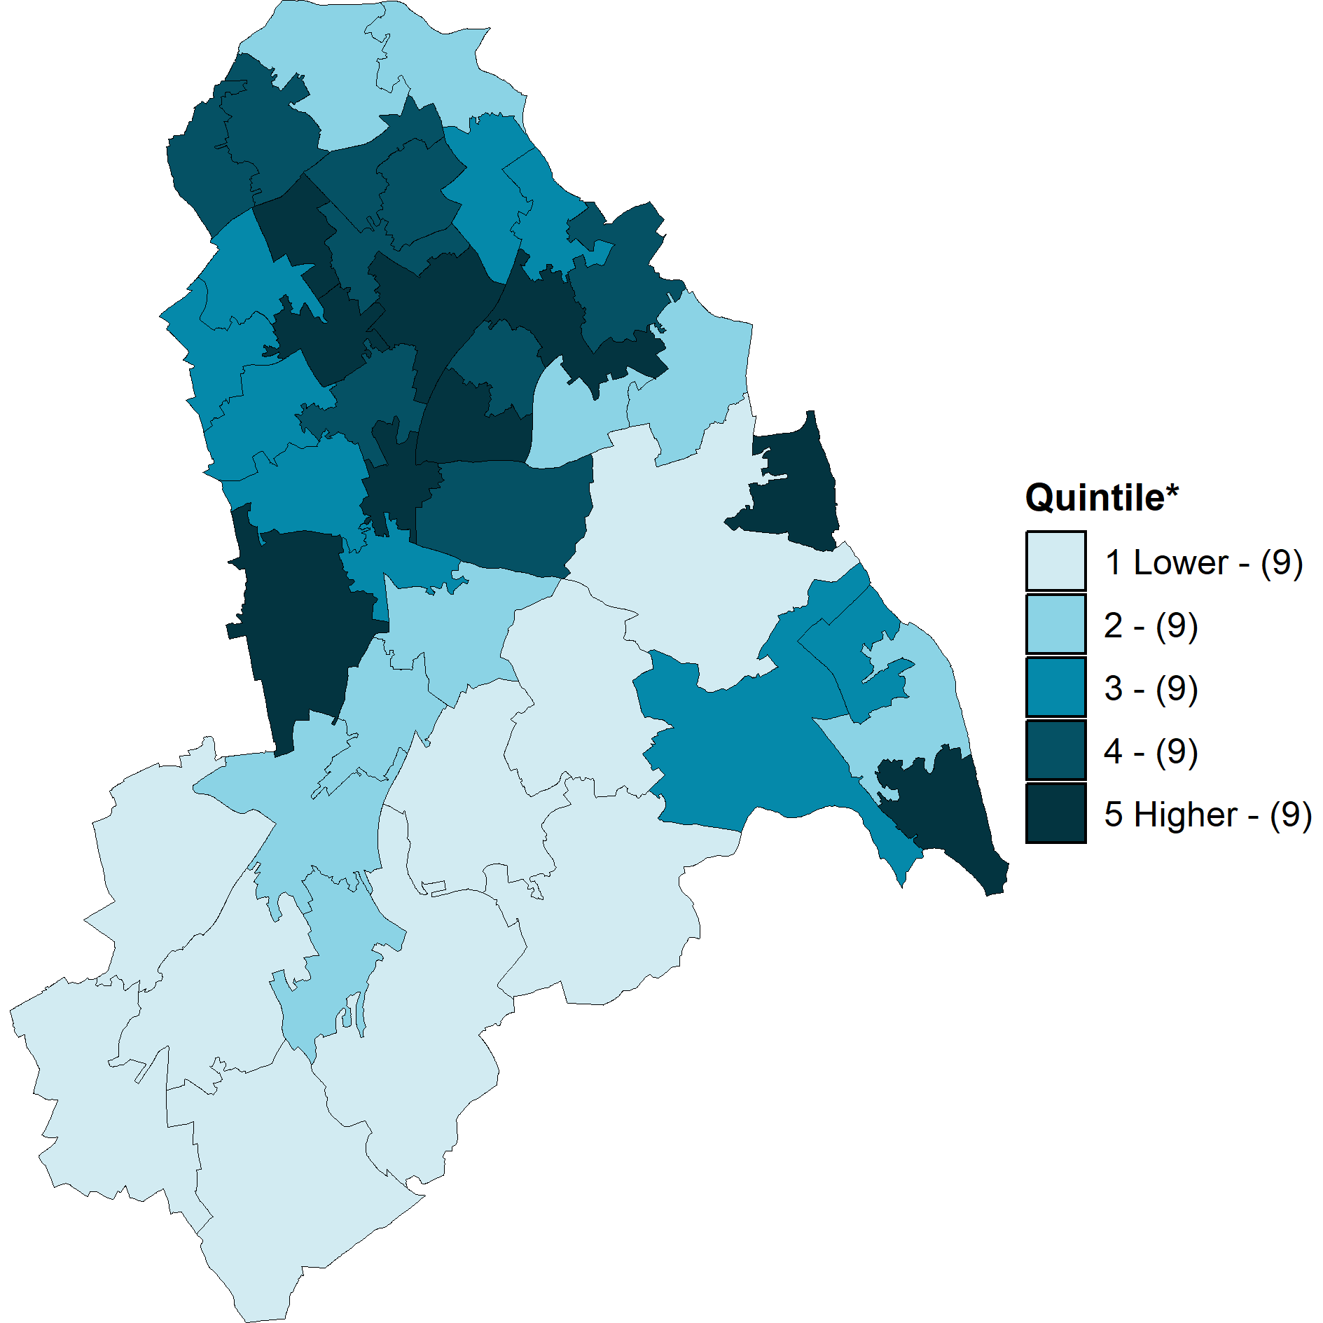
Prevalence of obesity in Croydon MSOAs
National Child Measurement Programme
Children in reception (aged 4 to 5 years)
Children in year 6 (aged 10 to 11 years)
Contains Ordnance Survey data © Crown copyright and database right 2025. Contains National Statistics data © Crown copyright and database right 2025.
Contains Ordnance Survey data © Crown copyright and database right 2025. Contains National Statistics data © Crown copyright and database right 2025.
* Number of MSOAs in each quintile is shown in brackets in the map legends
Data combined 3-years, (2022 to 2023, 2023 to 2024, and 2024 to 2025), see note on slide 16 Middle Layer Super Output Area (MSOA) boundaries 2021
11

Slide 12
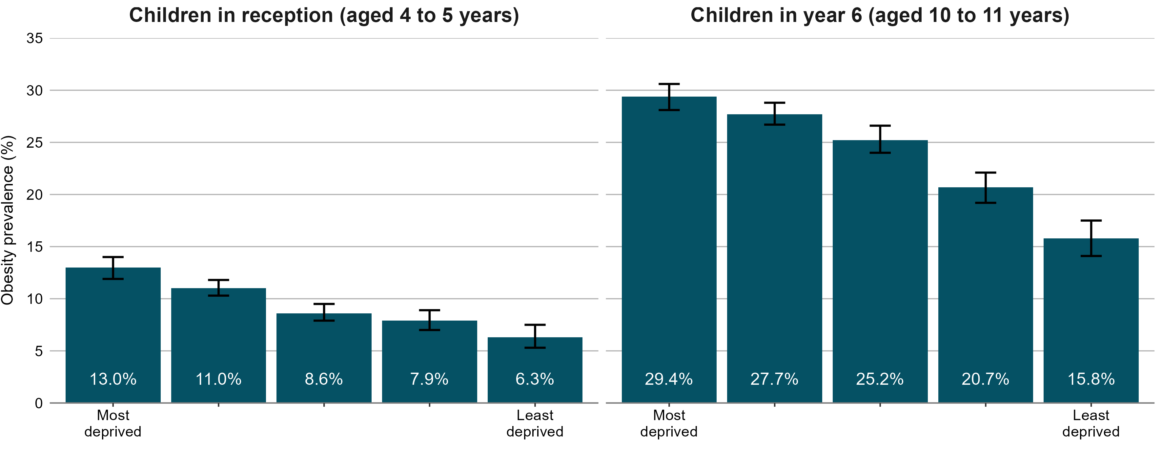
Obesity prevalence by deprivation and age in Croydon
National Child Measurement Programme
Index of Multiple Deprivation 2019
Index of Multiple Deprivation 2019
Data combined 5-years, (2019 to 2020, 2021 to 2022, 2022 to 2023, 2023 to 2024, and 2024 to 2025), see note on slide 16 95% confidence intervals are displayed on the chart
12

Slide 13
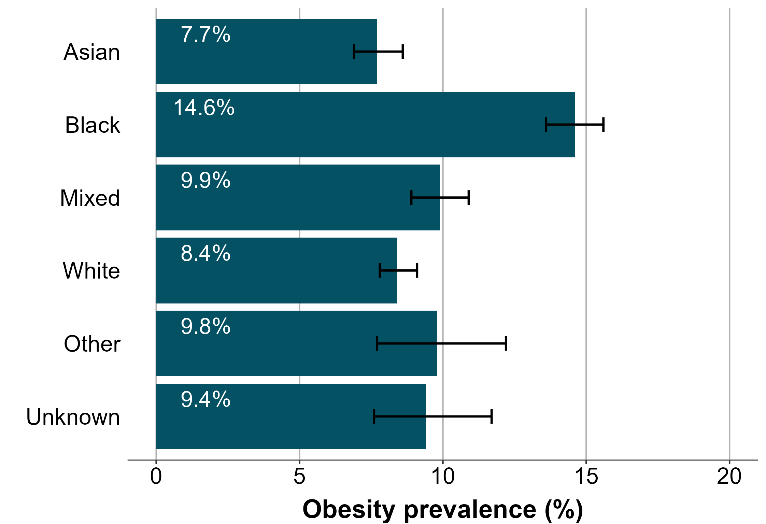
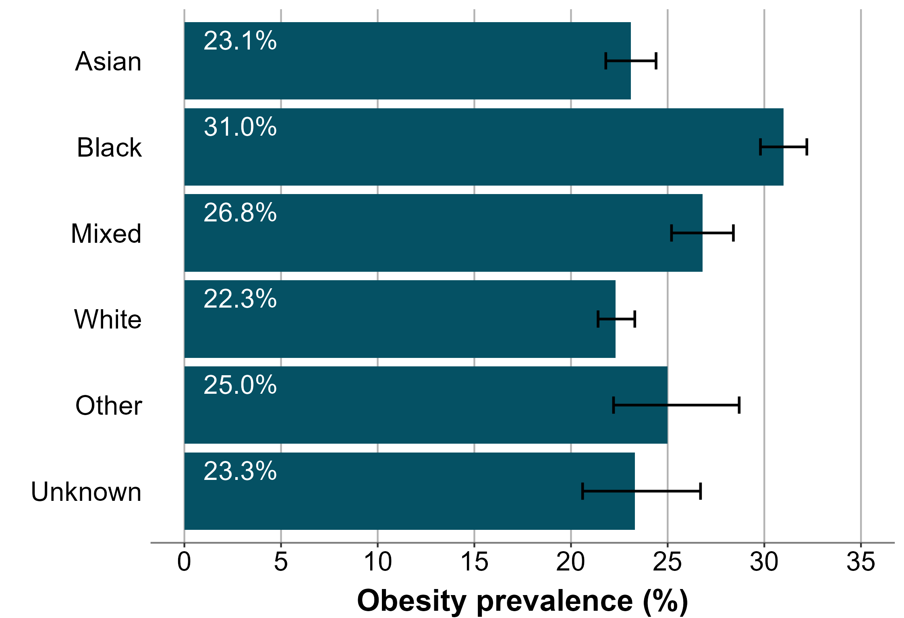
Obesity prevalence by ethnic group in Croydon
National Child Measurement Programme
Children in reception (aged 4 to 5 years)
Children in year 6 (aged 10 to 11 years)
Some local authorities have data presented for all 17 ethnic groups in the
Obesity, physical activity and nutrition profile
Data combined 5-years, (2019 to 2020, 2021 to 2022, 2022 to 2023, 2023 to 2024, and 2024 to 2025), see note on slide 16 95% confidence intervals are displayed on the chart
13

Slide 14
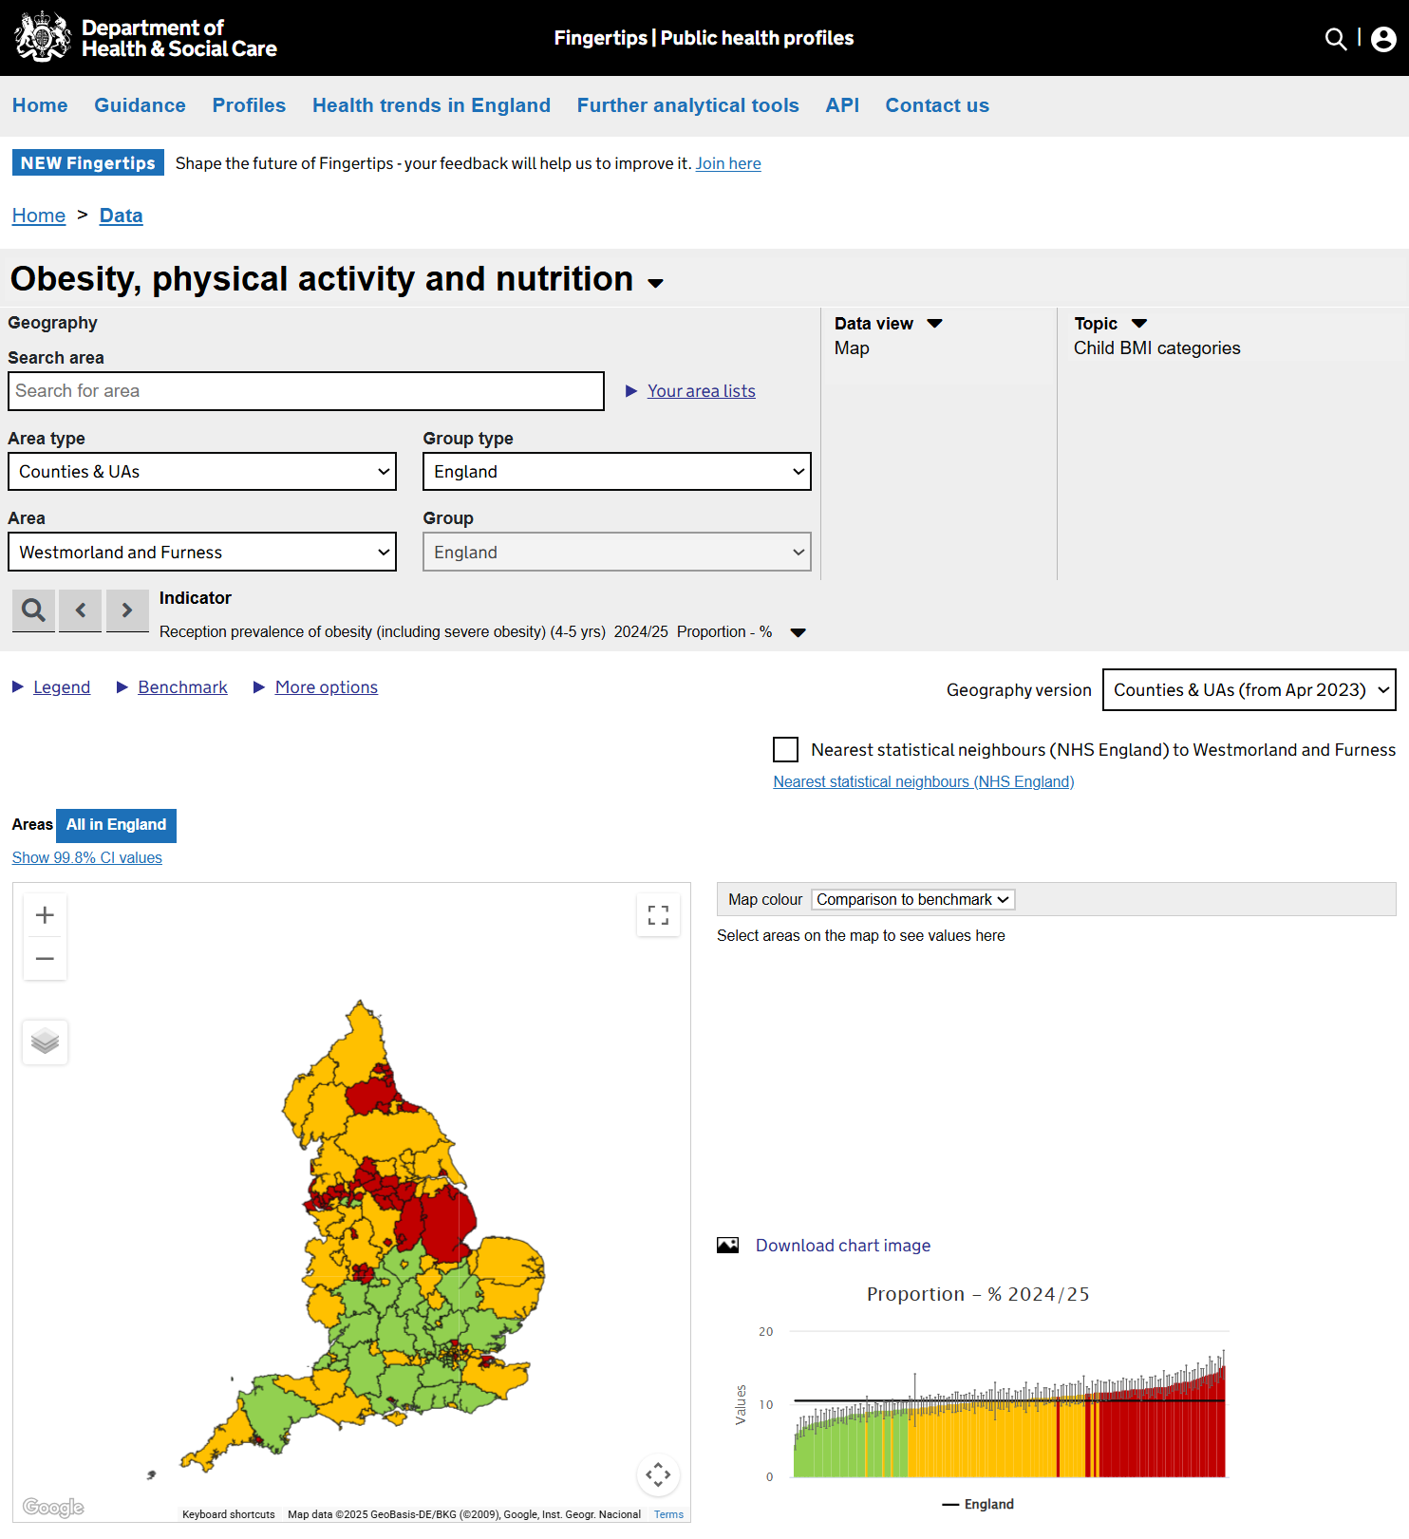
Obesity, physical activity and nutrition profile on Fingertips
The Obesity, physical activity and nutrition profile on Fingertips displays data from the National Child Measurement Programme. All data used in this slide pack is available to download from the Fingertips tool. Indicators on the prevalence of underweight, healthy weight overweight, obesity, and severe obesity are shown for England, regions, upper and lower tier local authorities, integrated care boards, electoral wards, and middle super output areas. Inequalities data is also displayed showing differences in prevalence by sex, ethnic group, and deprivation.
https://fingertips.phe.org.uk/profile/obesity-physical-activity-nutrition
Screenshot of webpage
14

Slide 15
Impact of the COVID-19 pandemic on NCMP data collection
The 2019 to 2020 NCMP data collection stopped in March 2020 when schools were closed due to the Covid-19 pandemic. In a usual NCMP collection year, national participation rates are around 95% (over a million) of all eligible children, however in 2019 to 2020 the number of children measured was around 75% of previous years. Despite the lower than usual number of measurements, analysis by NHS England confirms that figures at national and regional level are directly comparable to previous and future years.
The 2020 to 2021 NCMP had a delayed start due to the COVID-19 pandemic. Local authorities were still able to collect enough data to enable the production of national and regional estimates of prevalence by body mass index (BMI) category. Around 300,000 children (25% of previous full measurement years) were measured but the sample was not fully representative of the child population. Therefore weighting was used in the analysis to produce valid estimates of prevalence that could be compared to data from previous and future years. Further information on the 2020 to 2021 data collection and weighting methods
The 2021 to 2022 NCMP was the first data collection since the COVID-19 pandemic that was unaffected by school closures and other public health measures. Over 1.17 million children were measured in which is 92% of all children that were eligible to take part. This participation rate, though high, is lower than pre-pandemic years where participation had been at 95% since the data collection in 2014 to 2015. This is likely to be due to resourcing issues within some local authorities during the pandemic recovery process.
From the 2022 to 2023 NCMP onwards data collection was unaffected by issues linked to the COVID-19 pandemic.
is available in the NHS England report.
15

Slide 16
NCMP methodology note
Describing an area as similar, higher or lower
For the data in this slide pack a local authority value is described as similar, higher or lower based on statistically significant differences from the England value. Statistical comparisons are undertaken by comparing the confidence intervals of a local authority value to see if they overlap with the England value, with non-overlapping confidence intervals being considered as statistically significantly different. Where the England value lies within the confidence interval of a local authority it is described as similar. Where the England value is higher than the confidence interval, local authorities values are described as higher and where the value is lower than the confidence interval, local authorities values are described as lower.
Data quality issues for three and five year grouped data
In the three and five year grouped NCMP data, for ward level and local authority inequalities data, we would expect around 33% and 20% respectively of data from each contributing year. Data points are flagged if less than 20% (for 3-year data) or less than 10% (for 5-year data) of data is from 2019 to 2020. The data is still considered to be reliable even with a small amount of data from 2019 to 2020. Further information on the contribution of 2019 to 2020 data to three and five year combined data is available As only a small number of areas collected robust data in 2020 to 2021, no data from 2020 to 2021 is included in the three and five year grouped data analysis.
from the Obesity, physical activity and nutrition profile.
Missing data in the first year of NCMP
2006 to 2007 data is missing for some local authority areas in the trend data due to low completion of child postcode in the first year of NCMP measurement which results in a child record not being allocated to a local authority of residence.
16

