Slide 1
Policy, Programmes &
Performance Division
Team meeting : 10th February 2023
Time : 10.30am to 12.00 noon

Slide 2
ONS Census 2021 –
Data on Croydon
Edmund Fallon – Senior Corporate Intelligence Officer
Business Intelligence & Performance
Policy, Programmes & Performance Division

Slide 3
Mayor’s Business Plan 2022-2026

Slide 4
Finance
Workforce
Community

Slide 5
Finance
Workforce
Community
Economy
Employment
Diversity

Slide 6
Finance
Workforce
Community
Economy
Children & Young People
Education
Employment
Deprivation
Diversity
Crime

Slide 7
Finance
Workforce
Community
Economy
Children & Young People
Environment
Education
Housing
Employment
Deprivation
Crime
Diversity
Crime

Slide 8
Finance
Workforce
Community
Economy
Children & Young People
Environment
Health
Education
Housing
Employment
Deprivation
Social Care
Crime
Diversity
Crime

Slide 9
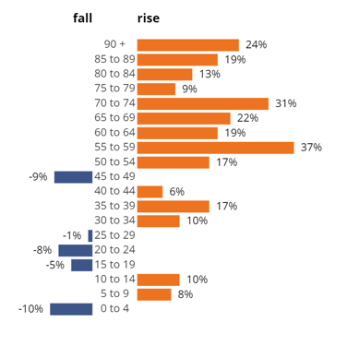
Croydon Population Increase
Population – Most populous in London !
From 2011 to 2021
People aged 65+ years up by 19.7%
People aged 15 to 64 years up by 7.0%
Children aged under15 years up by 1.9%
 | Census 2011 | Census 2021
Population | 363,400 | 390,000
 |  | +7.5%
Source: ONS Censuses 2011 and 2021
Edmund Fallon - Census 2021
A1

Slide 10
Croydon population by sex
Source: ONS Censuses 2011 and 2021
Edmund Fallon, Census 2021
A2

Slide 11
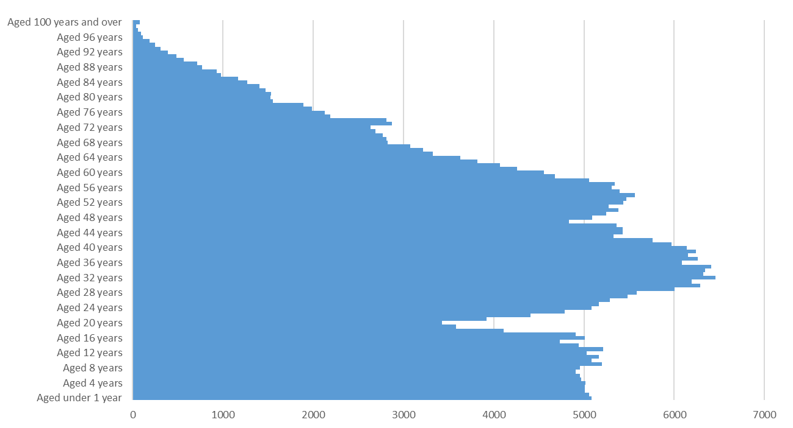
Croydon Population by age
Source: ONS Census 2021
Edmund Fallon - Census 2021
A3

Slide 12
Croydon Population by Service Age Bands
23.1% <=17 years in Croydon compared to the average for London of 21.6%. (Croydon 7th highest in London).
63.3% 18-64 years compared to the average for London of 66.6% (Croydon 12th lowest in London).
13.6% 65 years or over compared to the average for London of 11.9% (Croydon 11th highest in London).
Source: ONS Census 2021
Edmund Fallon - Census 2021
A4

Slide 13
2. Croydon is a place of opportunity for business, earning and learning
Economy
Employment
Diversity
Edmund Fallon - Census 2021

Slide 14
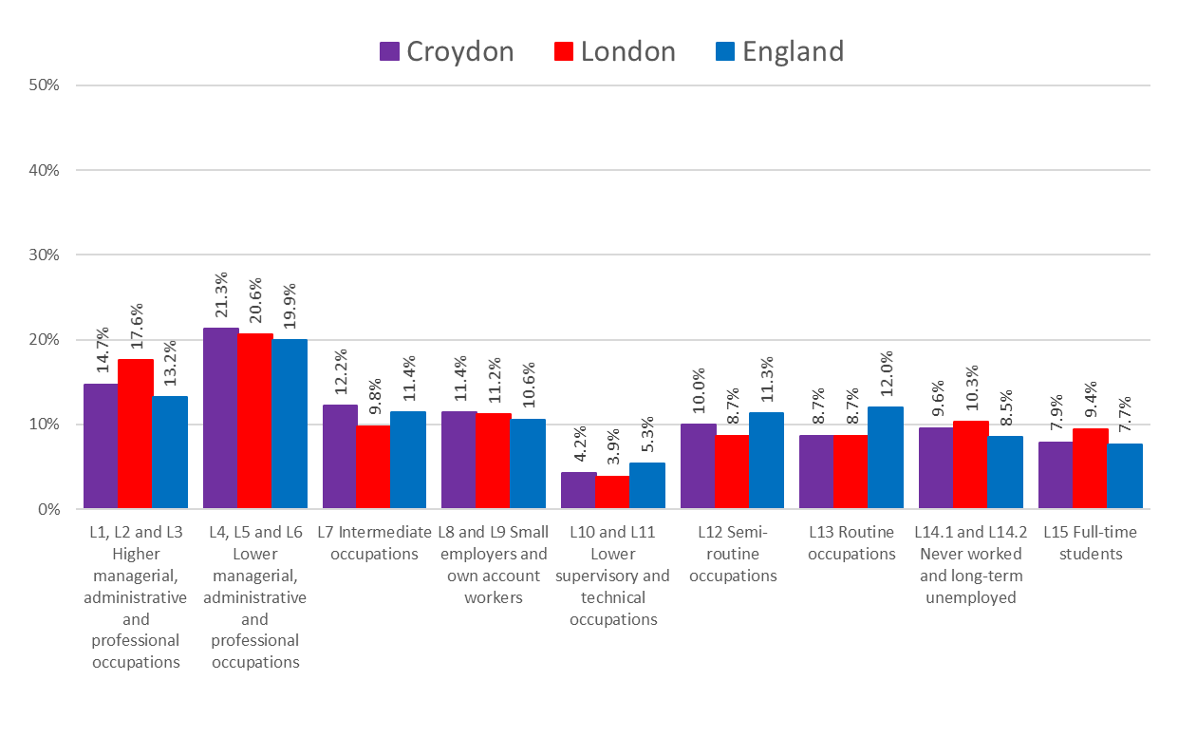
2. Croydon is a place of opportunity for business, earning and learning
Occupational Social Class (NS-SEC)
Economy
One in 3 (36%) of Croydon’s working residents are in managerial, administrative and professional occupations.
Nearly 1 in 5 (18.7%) are doing semi-routine or routine jobs.
Nearly 1 in 10 (9.6%) have never worked or have been long-term unemployed.
Source: ONS Census 2021
Edmund Fallon - Census 2021
B1

Slide 15
2. Croydon is a place of opportunity for business, earning and learning
Economy
INDUSTRY | Croydon | London | England
A: Agriculture, Forestry and fishing | 0.1% | 0.1% | 0.8%
B: Mining and quarrying | 0.1% | 0.1% | 0.2%
C: Manufacturing | 2.6% | 3.0% | 7.3%
D: Electricity, gas, steam and air conditioning supply | 0.3% | 0.3% | 0.6%
E: Water supply; Sewerage, Waste management and Remediation activities | 0.3% | 0.3% | 0.7%
F: Construction | 8.6% | 7.8% | 8.7%
G: Wholesale and retail trade; repair of motor vehicles and motorcycles | 13.1% | 12.2% | 15.0%
H: Transport and storage | 5.3% | 4.7% | 5.0%
I: Accommodation and food service activities | 4.6% | 5.5% | 4.9%
J: Information and communication | 5.9% | 7.6% | 4.7%
K: Financial and insurance activities | 5.8% | 6.6% | 3.8%
L: Real estate activities | 2.0% | 2.1% | 1.6%
M: Professional, scientific and technical activities | 7.7% | 10.5% | 6.7%
N: Administrative and support service activities | 6.3% | 6.0% | 5.3%
O: Public administration and defence; compulsory social security | 6.9% | 4.8% | 5.8%
P: Education | 9.9% | 9.6% | 9.9%
Q: Human health and social work activities | 15.7% | 12.9% | 14.6%
R, S, T, U Other | 4.9% | 5.8% | 4.6%
Total: All usual residents aged 16 years and over in employment the week before the census | 100% | 100% | 100%
Croydon has a smaller proportion of workers in the manufacturing industry and accommodation and food services industry compared to both London and England.
Croydon has a higher proportion of workers compared to both London and England in the following industries :
Transport and storage
Financial and insurance Administrative and support Public administration
Human health and social work
Source: ONS Census 2021
Edmund Fallon - Census 2021
B2

Slide 16
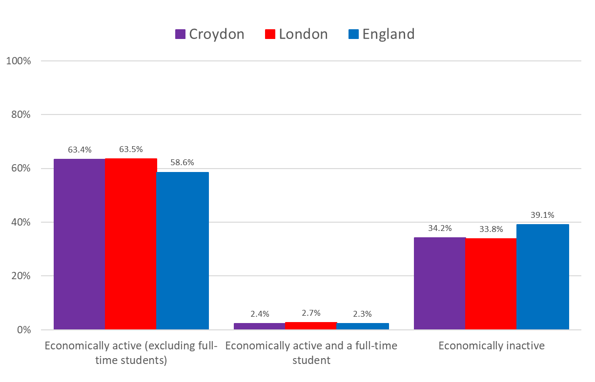
2. Croydon is a place of opportunity for business, earning and learning
Economically Active
Employment
In terms of Economic activity status, Croydon has a similar profile to London.
Both in Croydon and in London, the proportion of economically active people is higher than at the national level.
Source: ONS Census 2021
Edmund Fallon - Census 2021
B3

Slide 17
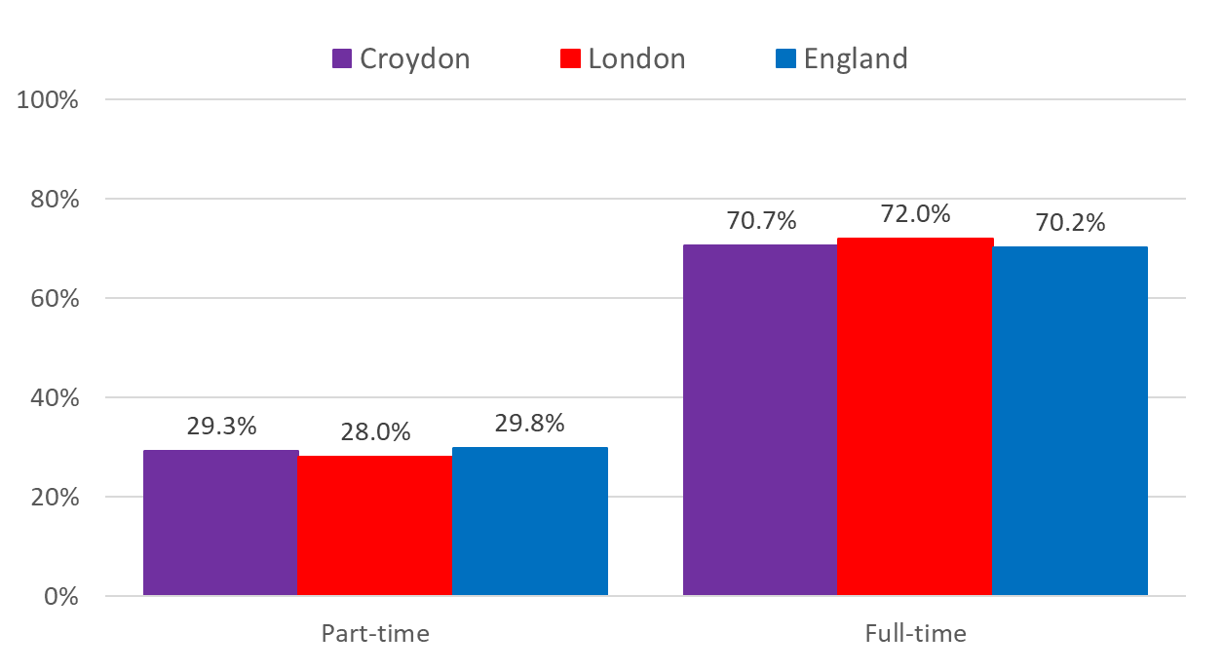
2. Croydon is a place of opportunity for business, earning and learning
Employment
Part-time and Full-time Split
16+ years (Worked <=15 hours per week)
Employment | Census 2011 | Census 2021
16+ years | 58.60% | 59.30%
Unemployed (16+ years) | 5.10% | 4.10%
Retired (economically inactive) | 15.90% | 15.50%
Source: ONS Census 2021
Edmund Fallon - Census 2021
B4

Slide 18
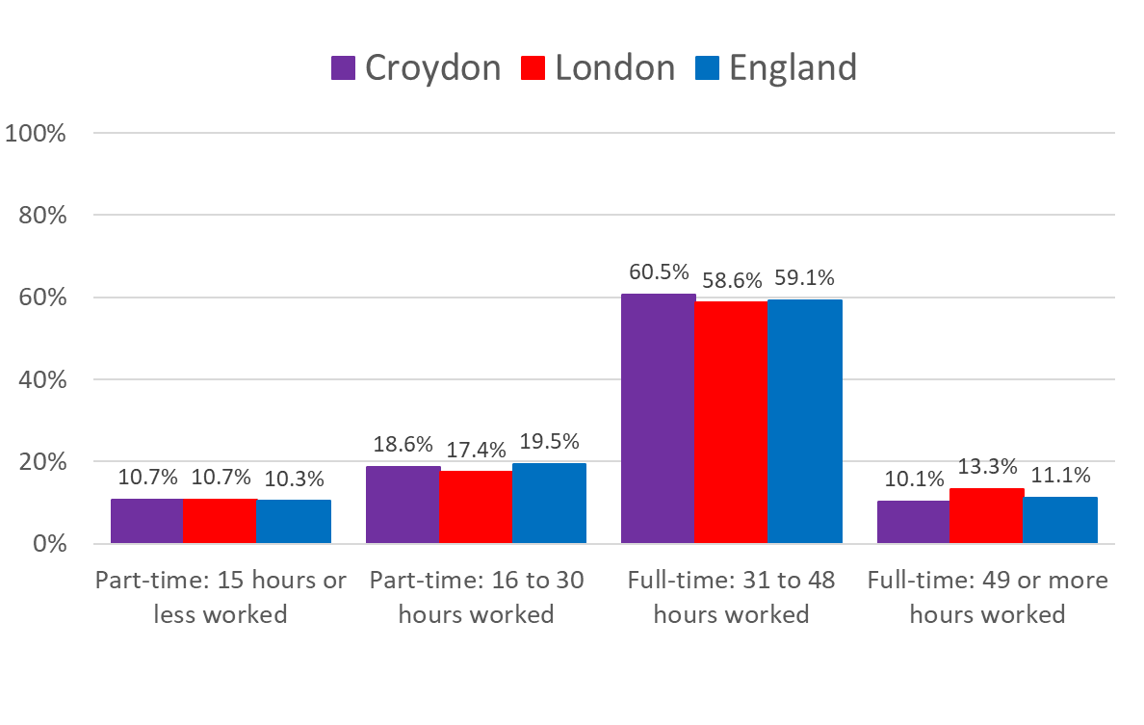
2. Croydon is a place of opportunity for business, earning and learning
Individuals Hours Worked
Employment
70.6% of the Croydon workforce work full-time for a minimum of 31 hours a week and some of this cohort work in excess of 49 hours a week.
This proportion is similar to the England average (70.2%) but slightly lower than the London average (72.0%).
29.3% of the Croydon workforce were working 30 hours or less a week in part-time jobs around the Census date.
Source: ONS Census 2021
Edmund Fallon - Census 2021
B5

Slide 19
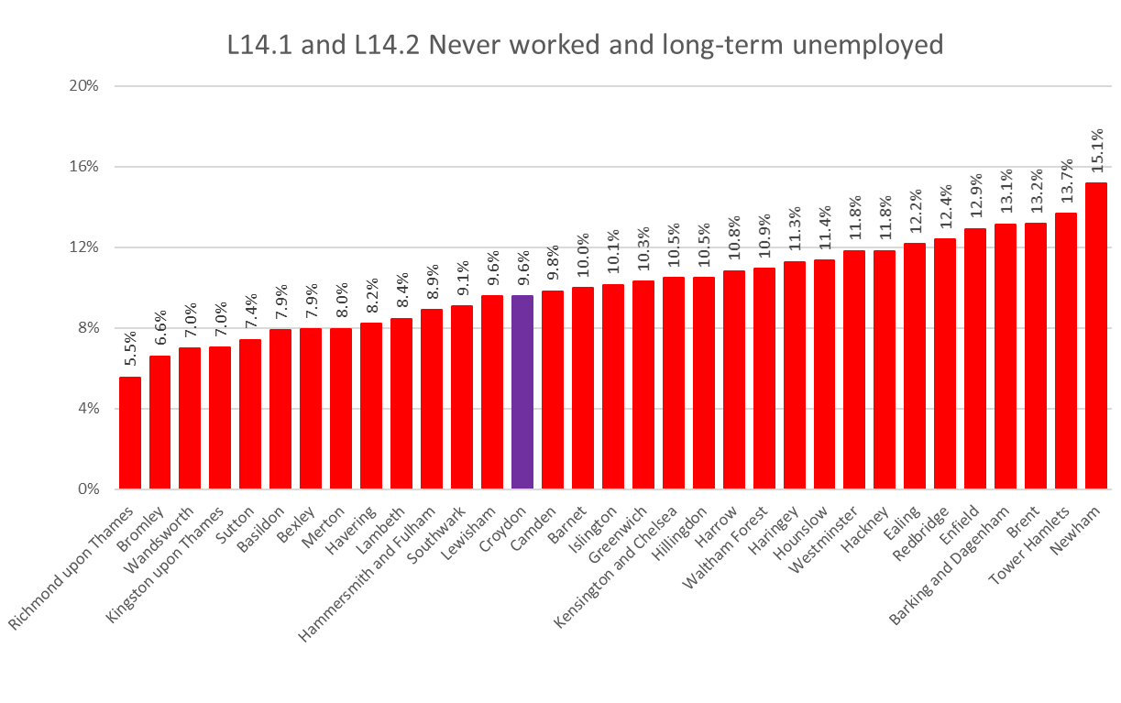
2. Croydon is a place of opportunity for business, earning and learning
Employment
1 in 10 (9.6%) of Croydon’s working age population have never worked or have been long-term unemployed.
The average for London is slightly more (10.1%) but still 1 in 10.
Richmond upon Thames has the smallest proportion of never worked or long-term unemployed – 1 n 18 (5.5%)
Newham has the biggest proportion of never worked or long-term unemployed – 1 in 7 (15.1%).
Source: ONS Census 2021
Edmund Fallon - Census 2021
B6

Slide 20
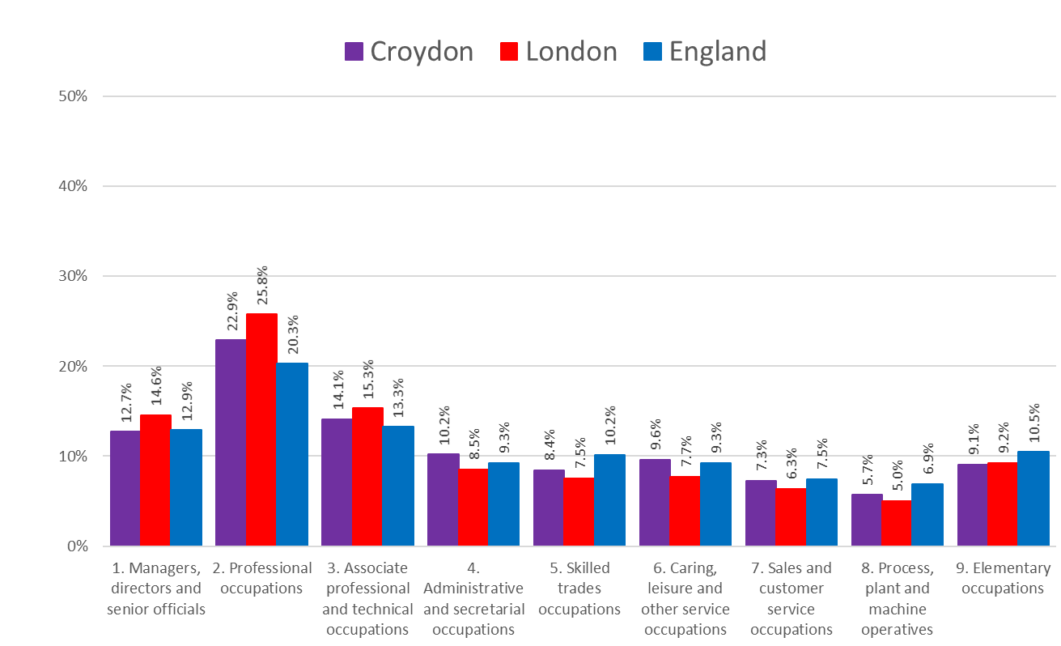
2. Croydon is a place of opportunity for business, earning and learning
Employment
Occupations
About 1 in 8 (12.7%) of Croydon’s workforce are managers, directors or senior officials. This is slightly lower than in London and England.
Nearly 4 in 10 (37.0%) work in professional, Associate professional and technical occupations.
One in 10 (10.2%) work in administrative or secretarial occupations which is a slightly higher proportion compared to London and England.
One in 10 (9.6%) also work in the caring, leisure and other service industry which is a slightly higher proportion than in London and England.
Source: ONS Census 2021
Edmund Fallon - Census 2021
B7

Slide 21
2. Croydon is a place of opportunity for business, earning and learning
Diversity
Top 10 Countries of birth
Top 5 Countries of birth
Source: ONS Census 2021
Edmund Fallon - Census 2021
B8

Slide 22
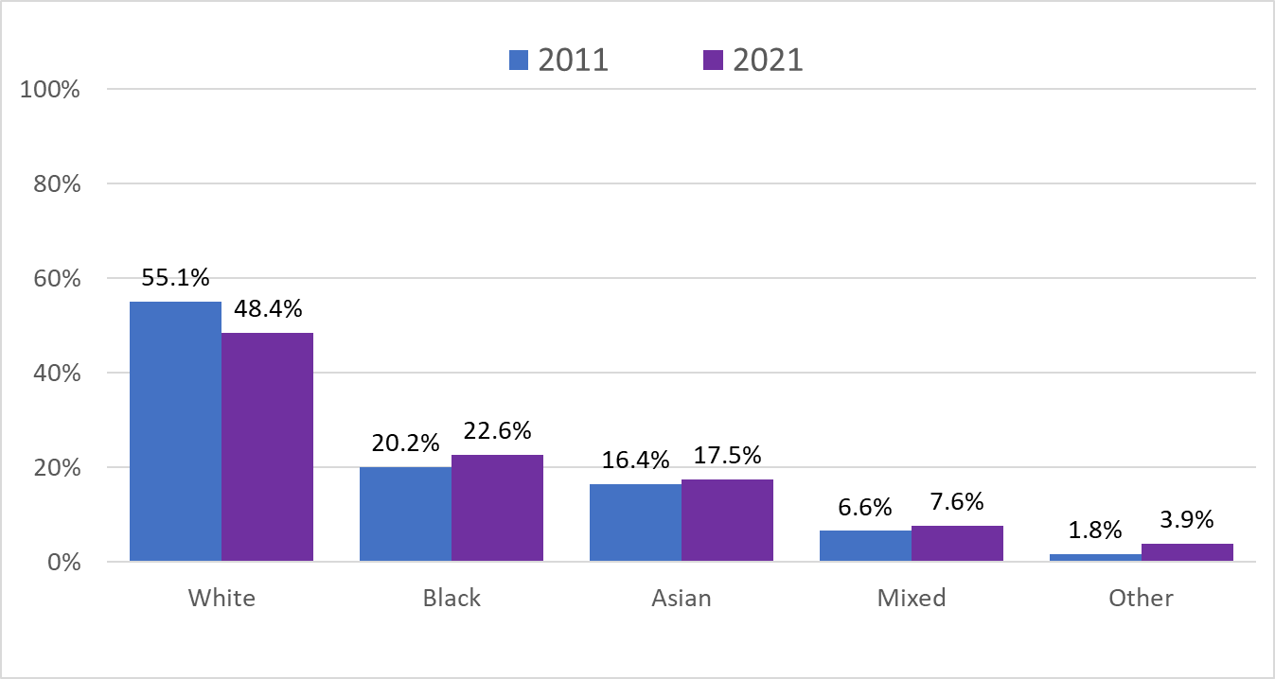
2. Croydon is a place of opportunity for business, earning and learning
Diversity
Broad Ethnic Groups
Over the 10 year period from 2011 to 2021, only the proportion of people from the White communities in Croydon has got smaller. A reduction of 6.7%
The number of residents from the Black communities has increased by 2.4%.
The number of residents from the Asian communities has increased by 1.1%.
Mixed up 1% and Other up 2.1%.
Source: ONS Census 2021
Edmund Fallon - Census 2021
B9

Slide 23
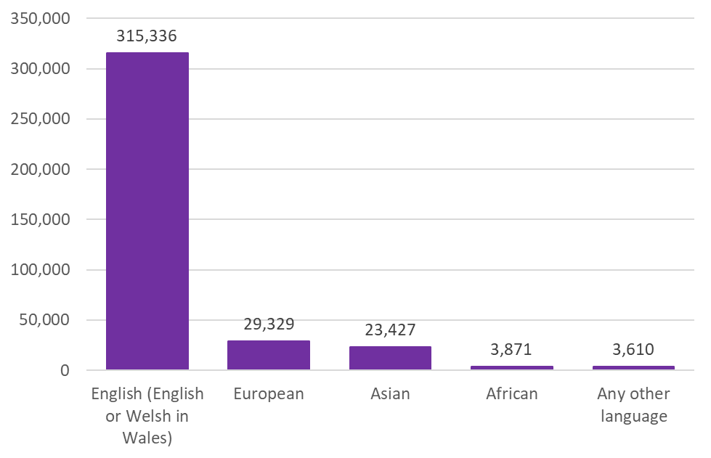
2. Croydon is a place of opportunity for business, earning and learning
Diversity
Main language (detailed) | 2021 | %
English (English or Welsh in Wales) | 315,336 | 84.0%
Welsh or Cymraeg (in England only) | 40 | 0.0%
Other UK language | 30 | 0.0%
French | 1,795 | 0.5%
Portuguese | 4,876 | 1.3%
Spanish | 3,813 | 1.0%
Other European language (EU) | 17,642 | 4.7%
Other European language (non EU) | 1,076 | 0.3%
Other European language (EU and non-EU) | 126 | 0.0%
Other European language (non-national) | 1 | 0.0%
Russian | 666 | 0.2%
Turkish | 1,264 | 0.3%
Arabic | 1,142 | 0.3%
West or Central Asian language | 2,717 | 0.7%
South Asian language | 17,871 | 4.8%
East Asian language | 2,839 | 0.8%
Oceanic or Australian language | 2 | 0.0%
North or South American language | 4 | 0.0%
Caribbean Creole | 74 | 0.0%
African language | 3,871 | 1.0%
Sign language | 224 | 0.1%
Other language | 164 | 0.0%
Total: All usual residents aged 3 years and over | 375,573 | 100%
Multiple Languages
84.0%
7.8%
6.2%
1.0%
1.0%
Source: ONS Census 2021
Edmund Fallon - Census 2021
B10

Slide 24
2. Croydon is a place of opportunity for business, earning and learning
Diversity
Religion
 | Census 2021 | Census 2011 | Change
Christian | 48.9% | 56.4% | -7.5%
No religion | 25.9% | 20.0% | 5.9%
Muslim | 10.4% | 8.1% | 2.3%
Hindu | 5.9% | 6.0% | -0.1%
Sikh/Jewish/Other | 1.4% | 1.2% | 0.2%
Buddhist | 0.6% | 0.7% | -0.1%
Not answered | 6.9% | 7.6% | -0.7%
TOTAL | 100% | 100%
Source: ONS Census 2021
Edmund Fallon - Census 2021
B11

Slide 25
2. Croydon is a place of opportunity for business, earning and learning
Relationship Status
Diversity
Relationship Status | 2011 | 2021
Single | 39.7% | 33.6%
Married or in a partnership | 43.2% | 53.0%
Separated | 3.5% | 2.4%
Divorced | 8.2% | 6.6%
Widowed | 5.5% | 4.4%
Source: ONS Census 2021
Edmund Fallon - Census 2021
B12

Slide 26
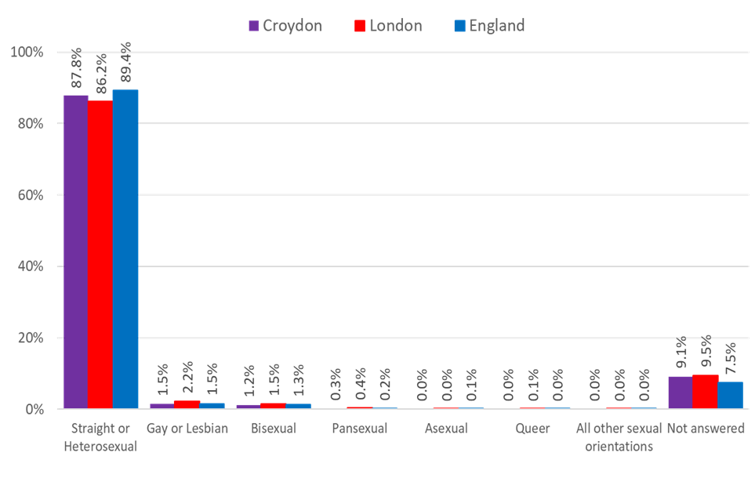
2. Croydon is a place of opportunity for business, earning and learning
Diversity
Sexual Orientation
According to Census 2021 data, just under 9 in every 10 people are straight or heterosexual in Croydon, London and England.
Just under 1 in 10 did not answer the sexual orientation question in Croydon (9.1%) and London (9.5%). In England generally, 7.5% did not answer the question.
Of those who answered the question, the LGBT+ community amounted to 3.1% in Croydon, 4.3% in London and 3.2% in England.
Source: ONS Census 2021
Edmund Fallon - Census 2021
B13

Slide 27
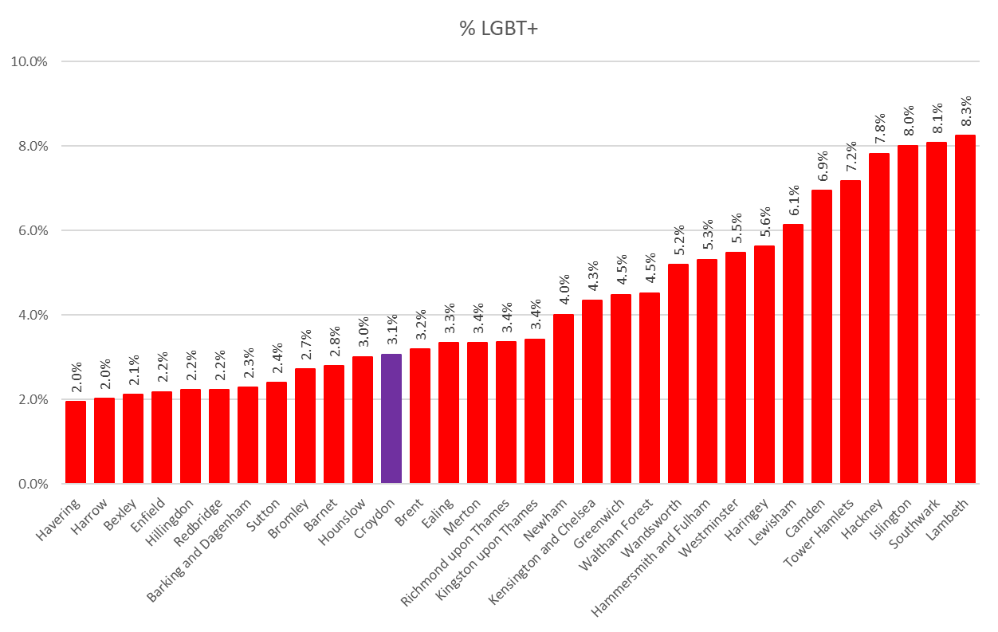
2. Croydon is a place of opportunity for business, earning and learning
LGBTQIA Across London
Diversity
Across London, Lambeth had the highest proportion (8.3%) of respondents from the LGBT+ community.
Havering had the smallest proportion (2.0%) of LGBT+ respondents.
The London average for LGBT+ was 4.3%.
Croydon was below the London average at 3.1%.
Source: ONS Census 2021
Edmund Fallon - Census 2021
B14

Slide 28
3. Children and young people in Croydon have the chance to thrive, learn and fulfil their potential
Children & YP
Education
Deprivation
Edmund Fallon - Census 2021

Slide 29
3. Children and young people in Croydon have the chance to thrive, learn and fulfil their potential
Children & Young people
 | Croydon | London | England
Total | 100.0% | 100.0% | 100.0%
Student | 21.7% | 22.2% | 20.4%
Not a student | 78.3% | 77.8% | 79.6%
 | Croydon | London | England
Total | 365,548 | 8,270,772 | 53,413,097
Student | 79,478 | 1,835,065 | 10,920,505
Not a student | 286,070 | 6,435,707 | 42,492,592
Source: ONS Census 2021
Edmund Fallon - Census 2021
C1

Slide 30
3. Children and young people in Croydon have the chance to thrive, learn and fulfil their potential
Children & Young people
Apprenticeships
3.8% of Croydon residents aged 16 years and over are on apprentice schemes.
The average for London is 3.2%.
Source: ONS Census 2021
Edmund Fallon - Census 2021
C2

Slide 31
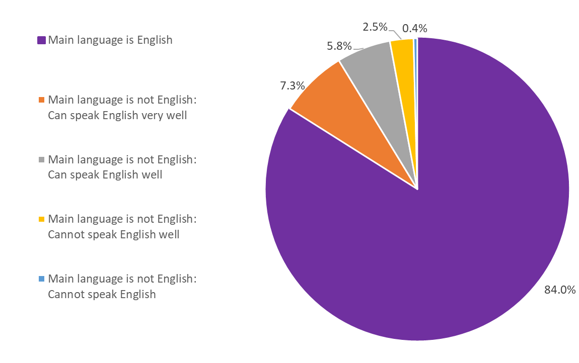
Language Competence in Croydon
84% of Croydon residents have English as their main language.
13.1% of residents whose first language is not English can speak English very well or well.
Less than 3% of the speaking residents either cannot speak English well or not speak English at all.
Source: ONS Census 2021
Edmund Fallon, Census 2021
C3

Slide 32
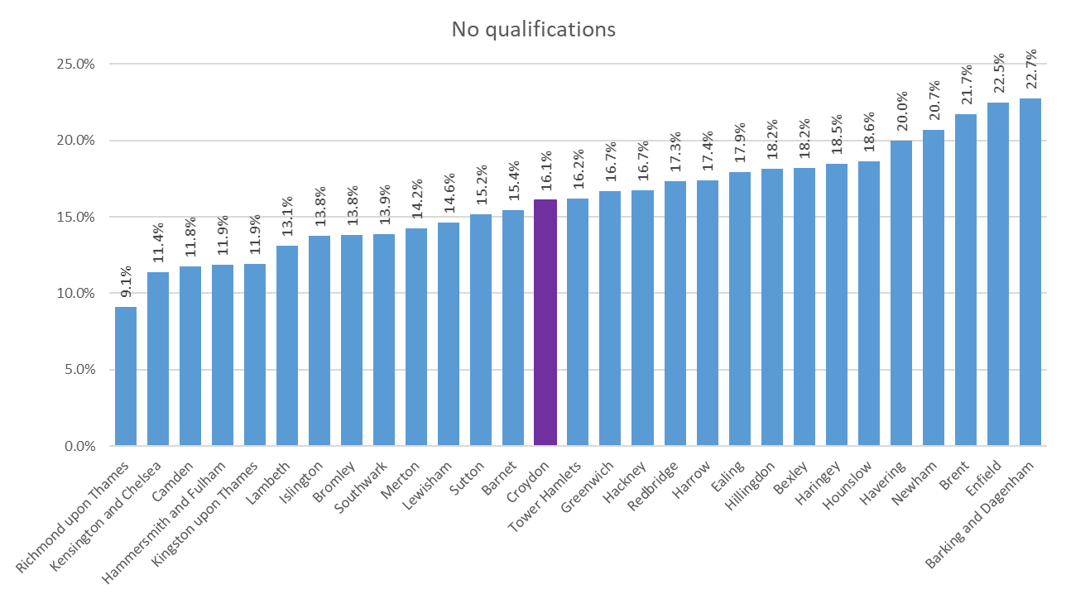
3. Children and young people in Croydon have the chance to thrive, learn and fulfil their potential
Education
No Qualifications
16.1% of Croydon residents aged 16 years and over have no qualifications.
The average for London is 16.0%.
Source: ONS Census 2021
Edmund Fallon - Census 2021
C4

Slide 33
3. Children and young people in Croydon have the chance to thrive, learn and fulfil their potential
Definition: The dimensions of deprivation used to classify households are indicators based on four selected household characteristics.
Education: A household is classified as deprived in the education dimension if no one has at least level 2 education and no one aged 16 to 18 years is a full-time student.
Employment: A household is classified as deprived in the employment dimension if any member, not a full-time student, is either unemployed or long-term sick.
Health: A household is classified as deprived in the health dimension if any member is disabled.
Housing: A household is classified as deprived in the housing dimension if the household's accommodation is either overcrowded, in a shared dwelling, or has no central heating.
Deprivation
Dimensions of Deprivation
Source: ONS Census 2021
Edmund Fallon - Census 2021
C5

Slide 34
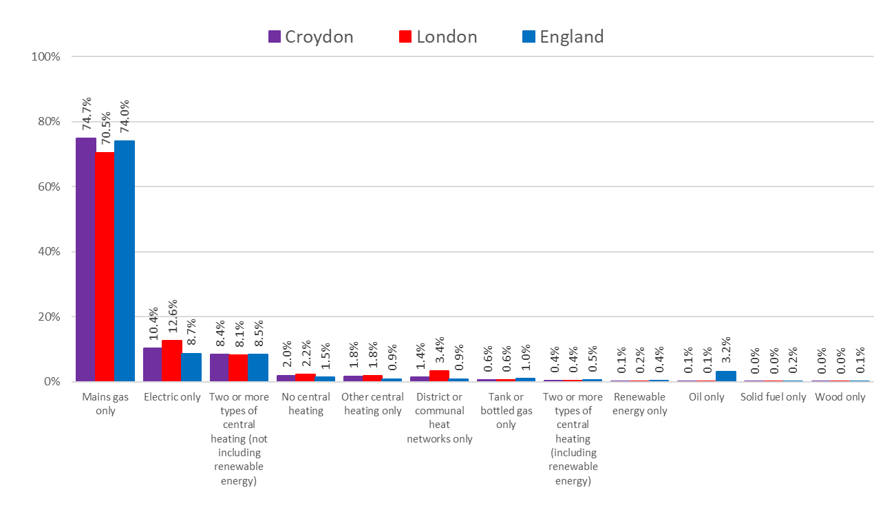
3. Children and young people in Croydon have the chance to thrive, learn and fulfil their potential
Deprivation
Central Heating
In Croydon, three quarters (74.7%) of households have central heating via the main gas only. This is a slightly higher rate than both London and England.
In Croydon 1 in 10 (10.4%) of households heat their homes with electric only. This is higher than in England (8.7%) but lower than in London (12.6%).
Just over 8% of households in Croydon, London and England have 2 or more types of central heating.
2.0% of households in Croydon have no central heating.
Source: ONS Census 2021
Edmund Fallon - Census 2021
C6

Slide 35
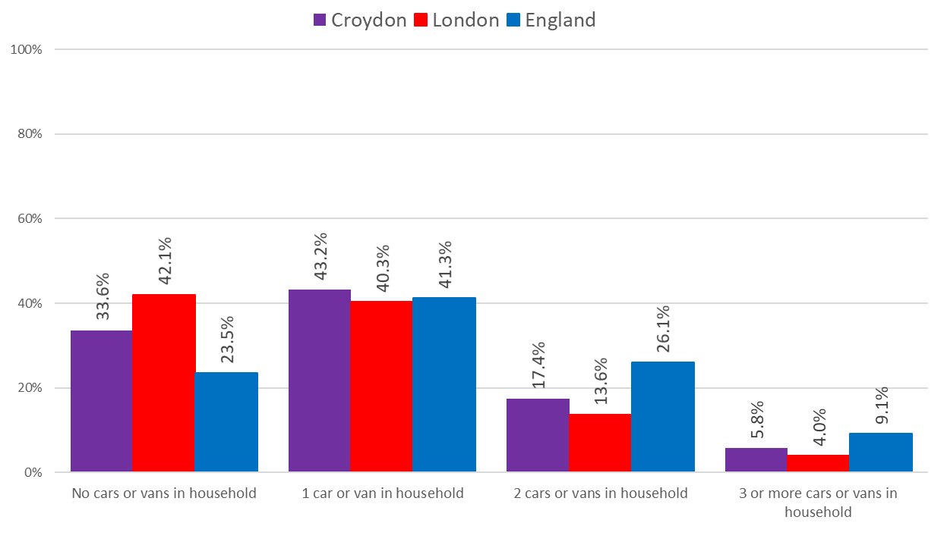
3. Children and young people in Croydon have the chance to thrive, learn and fulfil their potential
Deprivation
Car and van availability
One in 3 (33.6%) of households in Croydon have no car or van. This is a higher proportion than England (23.5%) but lower than in London (42.1%).
Similar proportions (around 4 in 10) of households in Croydon, London and England have 1 car or van in their household.
In England 1 in 4 (26.1%) of households have 2 cars or vans in their households. This is a higher proportion than in Croydon (17.4%) and London (13.6%).
Source: ONS Census 2021
Edmund Fallon - Census 2021
C7

Slide 36
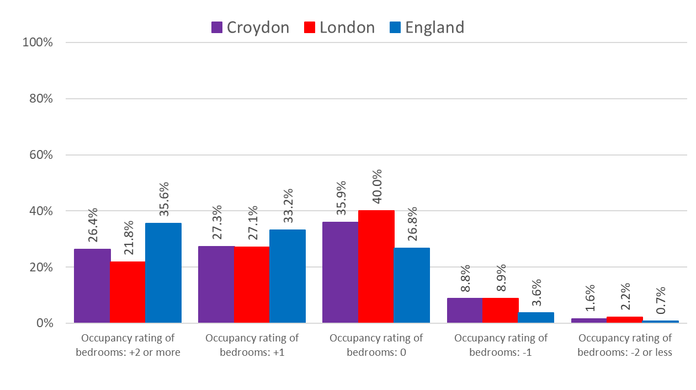
3. Children and young people in Croydon have the chance to thrive, learn and fulfil their potential
Deprivation
Bedrooms Overcrowding
Occupancy rating is a measure for under- or over- crowding.
• 10.4% of Croydon households have fewer bedrooms than required (overcrowded).
• 53.7% of Croydon households have more bedrooms than required (under-occupied).
• 35.9% of Croydon households have an ideal number of bedrooms.
Source: ONS Census 2021
Edmund Fallon - Census 2021
C8

Slide 37
4. Croydon is a cleaner, safer and healthier place, a borough we’re proud to call home
Environment
Housing
Edmund Fallon - Census 2021

Slide 38
4. Croydon is a cleaner, safer and healthier place, a borough we’re proud to call home
Environment
Population Density – People per 1 km area
Population density is the number of usual residents per square kilometre.
Croydon is the 10th lease densely populated of London’s 33 local authority areas.
Approx. 32 people living on each football pitch-sized area of land.
Source: ONS Census 2021
Edmund Fallon - Census 2021
D1

Slide 39
4. Croydon is a cleaner, safer and healthier place, a borough we’re proud to call home
Housing
Household Tenure
Source: ONS Censuses, 2011 and 2021
Edmund Fallon - Census 2021
D2

Slide 40
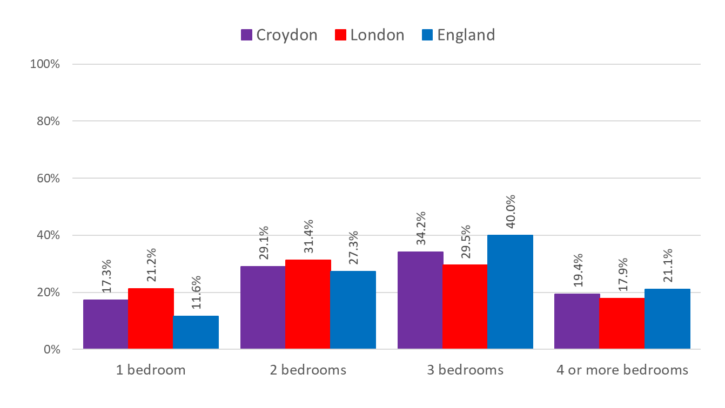
4. Croydon is a cleaner, safer and healthier place, a borough we’re proud to call home
Housing
Number of bedrooms
3 bedroom properties in Croydon make up the highest proportion (34.2%) of number of bedroom properties in the borough.
Nearly 1 in 5 (19.4%) of properties in Croydon have 4 or more bedrooms.
Nearly 3 in 10 properties (29.1%) of properties in Croydon have 2 bedrooms.
There are 17.3% of households in Croydon which have only 1 bedroom.
Source: ONS Census 2021
Edmund Fallon - Census 2021
D3

Slide 41
4. Croydon is a cleaner, safer and healthier place, a borough we’re proud to call home
Housing
Accommodation Types
29% of Croydon residents are living in a purpose-built block of flats or tenement.
24.7% live in semi-detached properties.
23.3% live in terraced properties.
12.2% live in detached properties.
8.5% live in part of a converted or shared house, including bedsits.
2.3% live in other types of accommodation.
Source: ONS Census 2021
Edmund Fallon - Census 2021
D4

Slide 42
5. People can lead healthier and independent lives for longer
Health
Social Care
Edmund Fallon - Census 2021

Slide 43
5. People can lead healthier and independent lives for longer
Health
General Health
The majority of Croydon residents (82.4%) who answered the general health question in the Census 2021 survey said they were in very good health or good health.
12.7% said they were in fair health.
5.0% said they were in bad health or very bad health.
Source: ONS Census 2021
Edmund Fallon - Census 2021
E1

Slide 44
5. People can lead healthier and independent lives for longer
Health
Health – 2011 vs 2021
The majority of Croydon residents (82.4%) who answered the general health question in the Census 2021 survey said they were in very good health or good health.
Around 1 in 8 (12.7%) said they were in fair health.
Only 5 in 100 (5.0%) said they were in bad health or very bad health.
Source: ONS Censuses 2011 and 2021
Edmund Fallon - Census 2021
E2

Slide 45
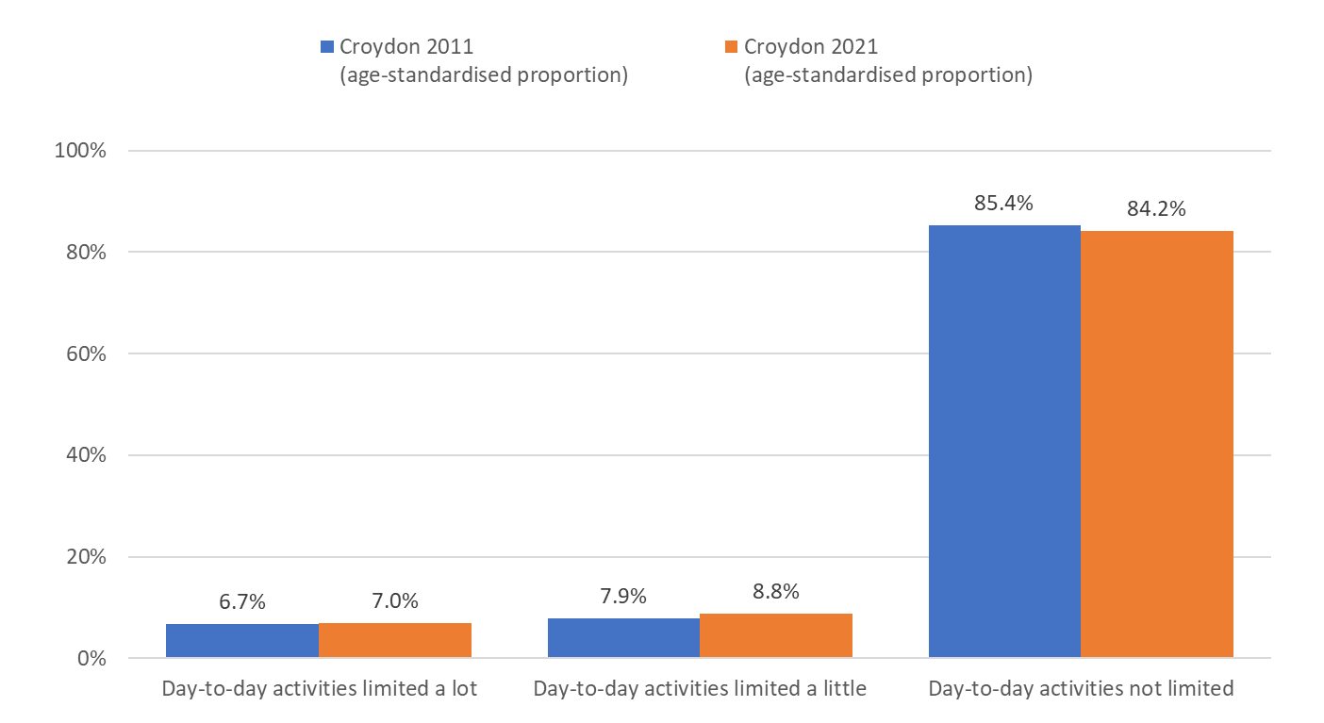
5. People can lead healthier and independent lives for longer
Health
Disability – 2011 vs 2021
From 2011 to 2021, there has only been a slight increase in the proportions of disabled people in Croydon whose day to day activities are limited a lot or a little.
Source: ONS Censuses 2011 and 2021
Edmund Fallon - Census 2021
E3

Slide 46
5. People can lead healthier and independent lives for longer
Social Care
Provision of Unpaid Care
Unpaid care (carers 5+ years) | Census 2011 | Census 2021
Providing up to 19 hours unpaid care | 7.0% | 4.1%
Providing up to 20-49 hours unpaid care | 1.5% | 1.8%
Providing up to 50+ hours unpaid care | 2.3% | 2.3%
Source: ONS Census 2021
Edmund Fallon - Census 2021
E4

Slide 47
THE END

