Slide 1
Business Intelligence, P Census 2021 & Improvement Service
19. Jan. 2023

Slide 2
Business Intelligence, P Health, Disability and Unpaid Care Census 2021Service
19. Jan. 2023

Slide 3
Business Intelligence, P DD
TS037 - General health
TS037ASP - General health – Age-standardised proportions
TS038 - Disability
TS038 ASP - Disability – Age-standardised proportions
TS039 - Provision of unpaid care
TS039 ASP - Provision of unpaid care – Age-standardised proportions
TS040 - Number of disabled people in the household
19 Jan. 2023

Slide 4
Business Intelligence, P DD
19 Jan. 2023

Slide 5
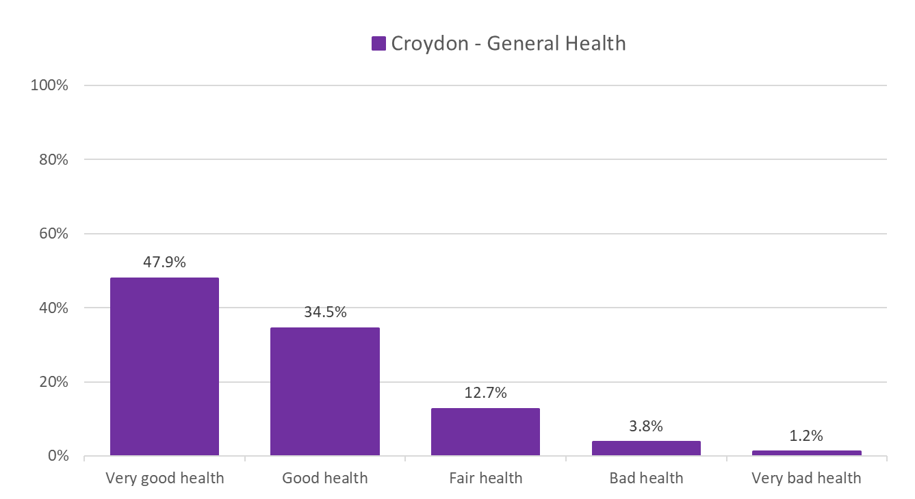
General Health
The majority of Croydon residents (82.4%) who answered the general health question in the Census 2021 survey said they were in very good health or good health.
Around 1 in 8 (12.7%) said they were in fair health.
Only 5 in 100 (5.0%) said they were in bad health or very bad health.
Source: ONS Census 2021
Edmund Fallon, Census 2021

Slide 6
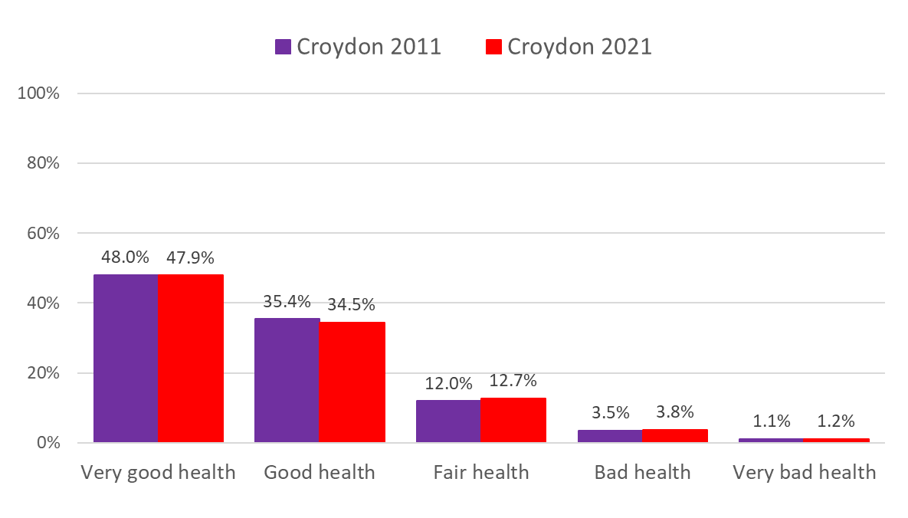
General Health – Croydon 2011 vs Croydon 2021
From Census 2011 to Census 2021 there does not seem to have been much difference in the proportion of people who said they had…
Very good health
Good health
Fair health
Bad health
Very bad health
A slightly lower proportion in 2021 (82.4%) said they had very good or good health compared to 2011 (83.4%).
Source: ONS Census 2021
Edmund Fallon, Census 2021

Slide 7
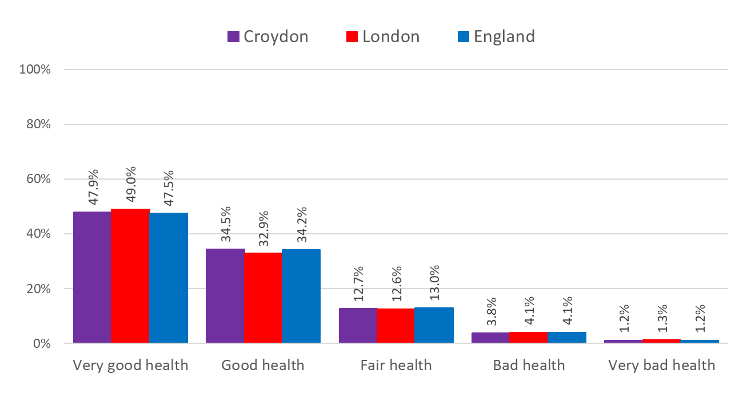
General Health – Croydon vs London vs England
The responses to the health question resulted in similar proportions of general health categories in Croydon, London and England.
Source: ONS Census 2021
Edmund Fallon, Census 2021

Slide 8
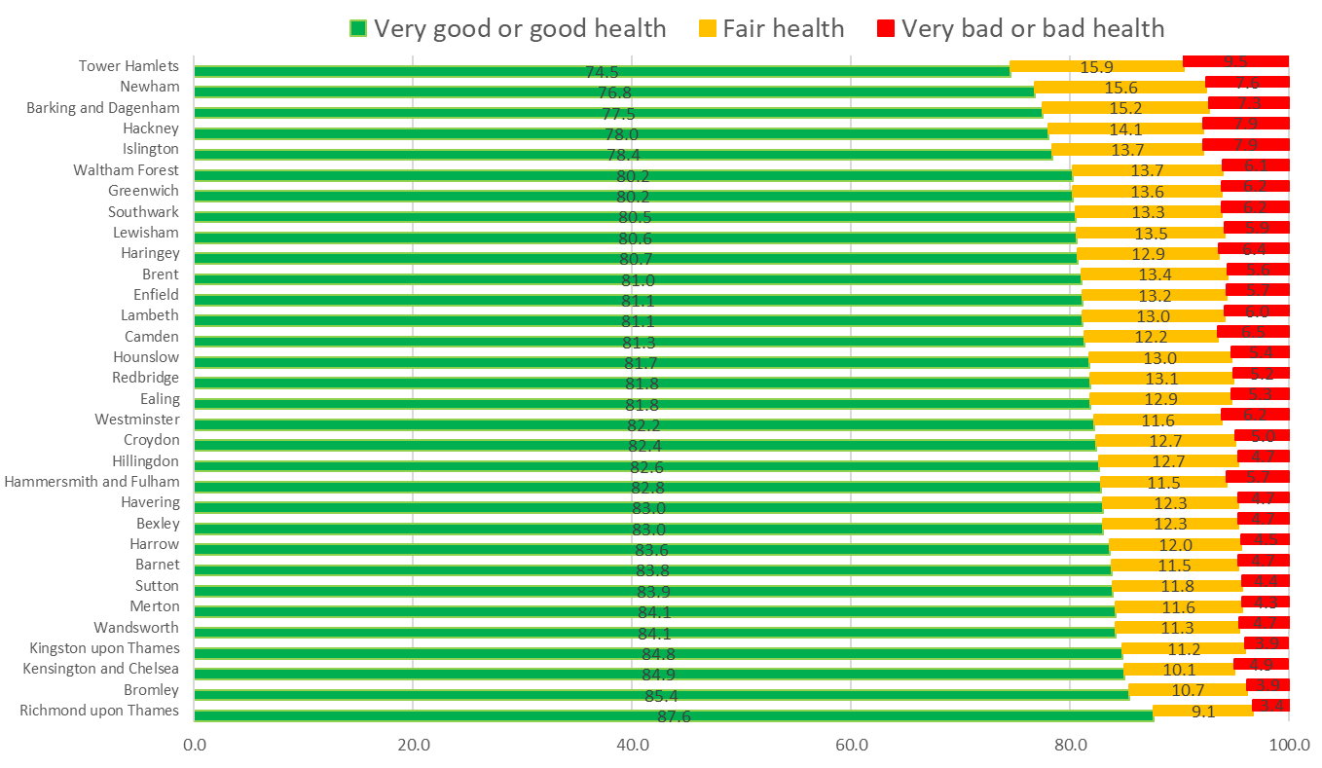
General Health – Across London
Richmond upon Thames had the highest proportion (87.6%) of residents in very good or good health.
Tower Hamlets had the lowest proportion (74.5%) of residents in very good or good health.
The rate for Croydon is 82.4%.
Source: ONS Census 2021
Edmund Fallon, Census 2021

Slide 9
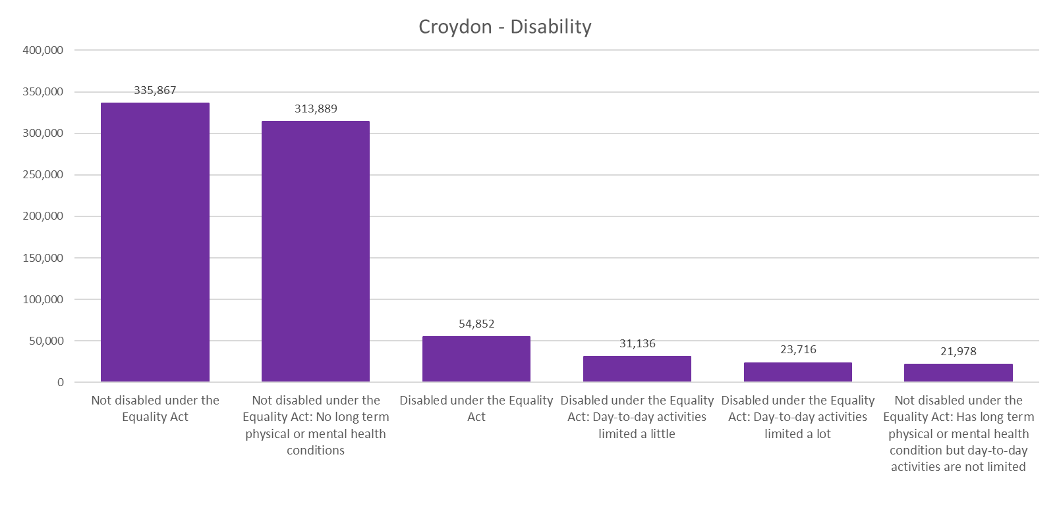
Disability
Source: ONS Census 2021
Edmund Fallon, Census 2021

Slide 10
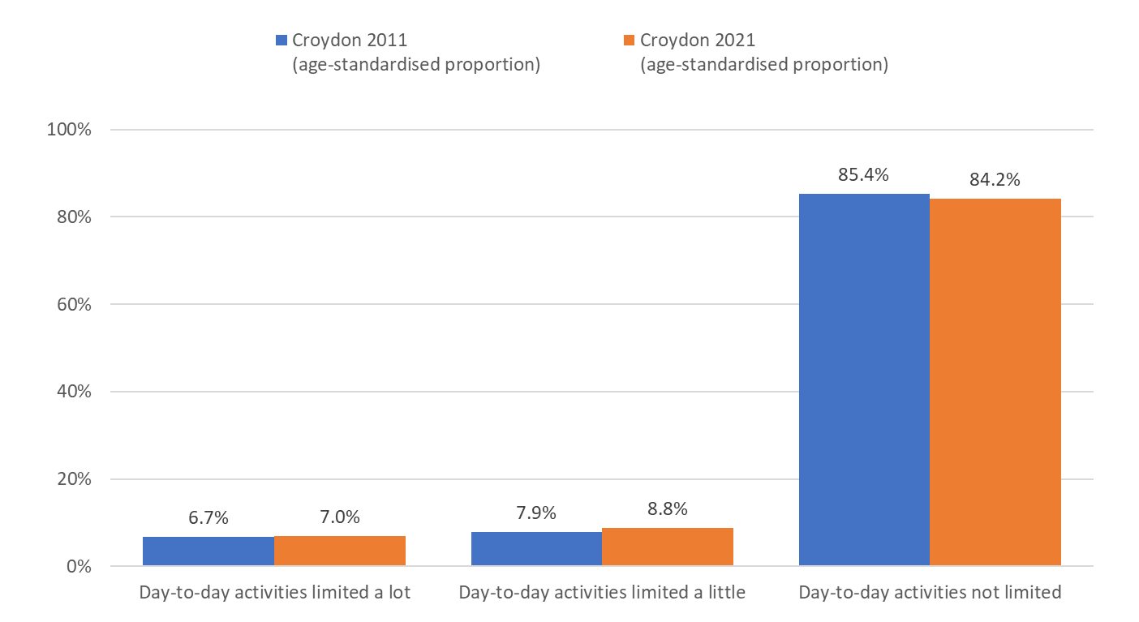
Disability – Croydon 2011 vs Croydon 2021
Frome 2011 to 2021, there has only been a slight increase in the proportions of disabled people in Croydon whose day to day activities are limited a lot or a little.
Source: ONS Census 2021
Edmund Fallon, Census 2021

Slide 11
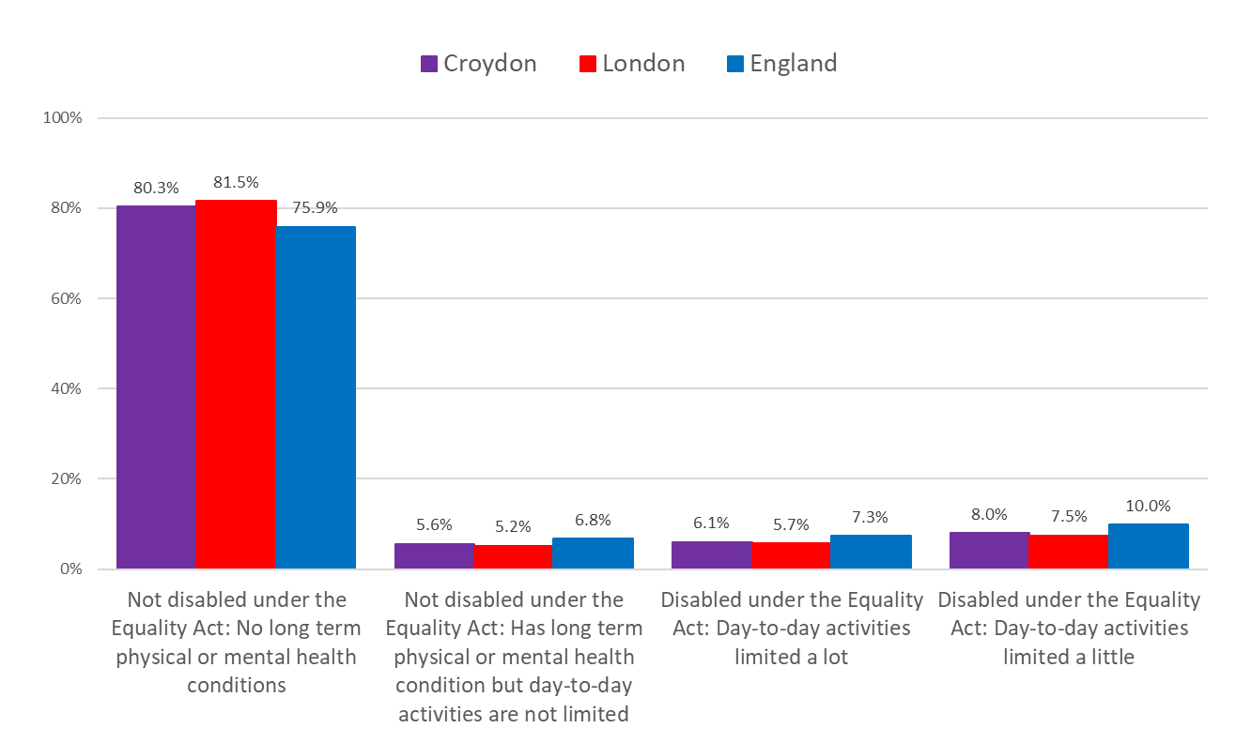
Disability – Croydon vs London vs England
In Croydon and London around 8 in 10 people are not classified as disabled under the Equality Act. These proportions are slightly higher than in England (75.9%).
In England there are slightly higher proportions of Disabled people who have day to day activities limited a lot or limited a little compared to Croydon and London.
Source: ONS Census 2021
Edmund Fallon, Census 2021

Slide 12
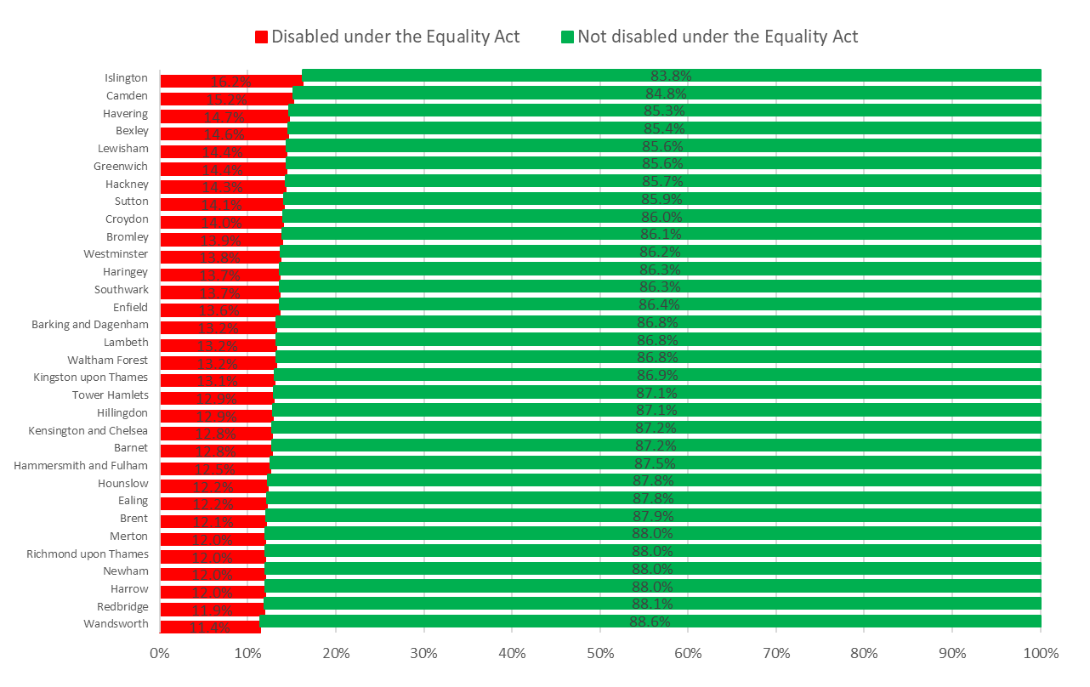
Disability – Across London
Islington has the highest proportion (16.2%) of residents in London who are classified as Disabled under the Equality Act.
Wandsworth has the lowest proportion (11.4%) of residents in London who are classified as Disabled under the Equality Act.
In Croydon 14.0% of residents are Disabled under the Equality Act.
Source: ONS Census 2021
Edmund Fallon, Census 2021

Slide 13
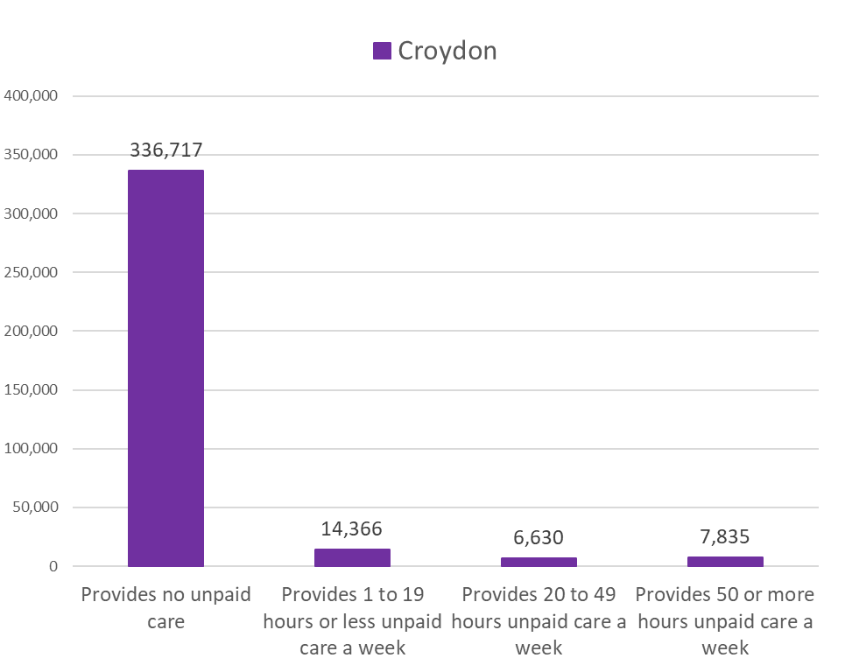
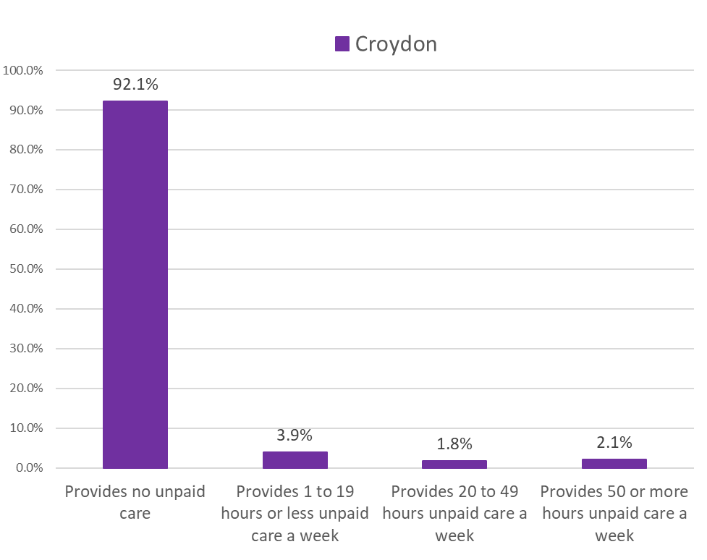
Provision of unpaid Care – Numbers & Percentages
Source: ONS Census 2021
Edmund Fallon, Census 2021

Slide 14
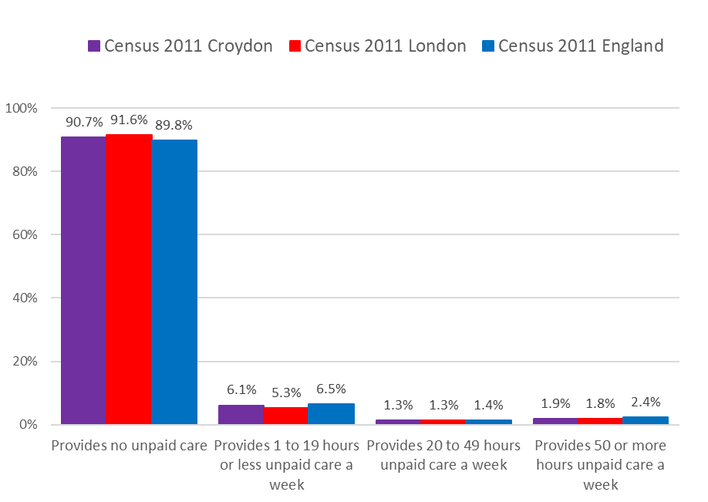
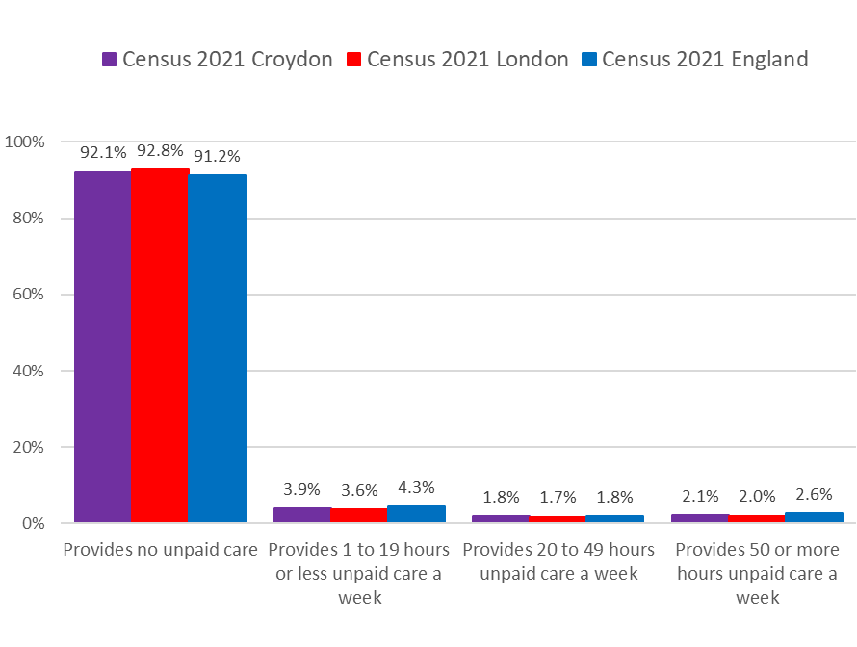
Provision of unpaid Care – Croydon 2011 vs Croydon 2021
Over the 10 years from 2011 to 2021, there has been an increase in the proportion of people who provide 20 or more hours of unpaid care in Croydon, London and England but the proportion of people who provide no unpaid care has increased slightly.
Source: ONS Census 2011
Source: ONS Census 2021
Edmund Fallon, Census 2021

Slide 15
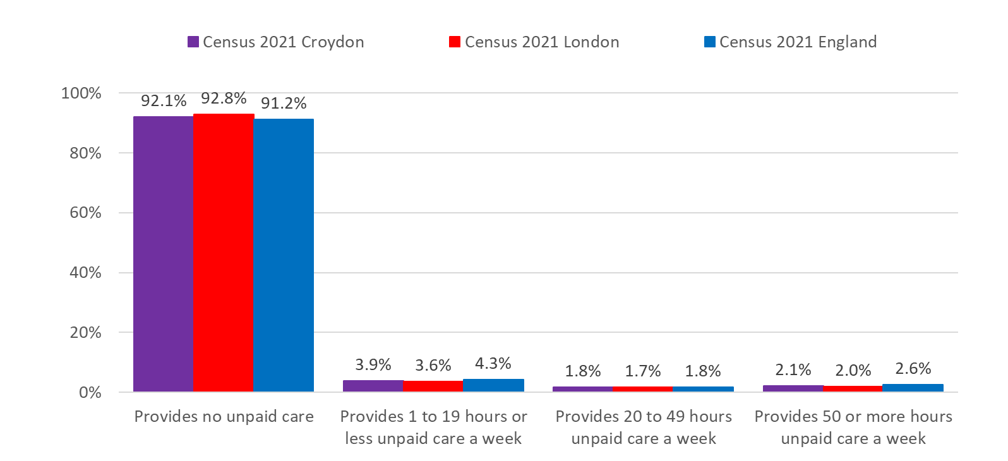
Provision of unpaid Care – Croydon vs London vs Enland
Source: ONS Census 2021
Edmund Fallon, Census 2021

Slide 16
Business Intelligence, P DD
19 Jan. 2023

Slide 17
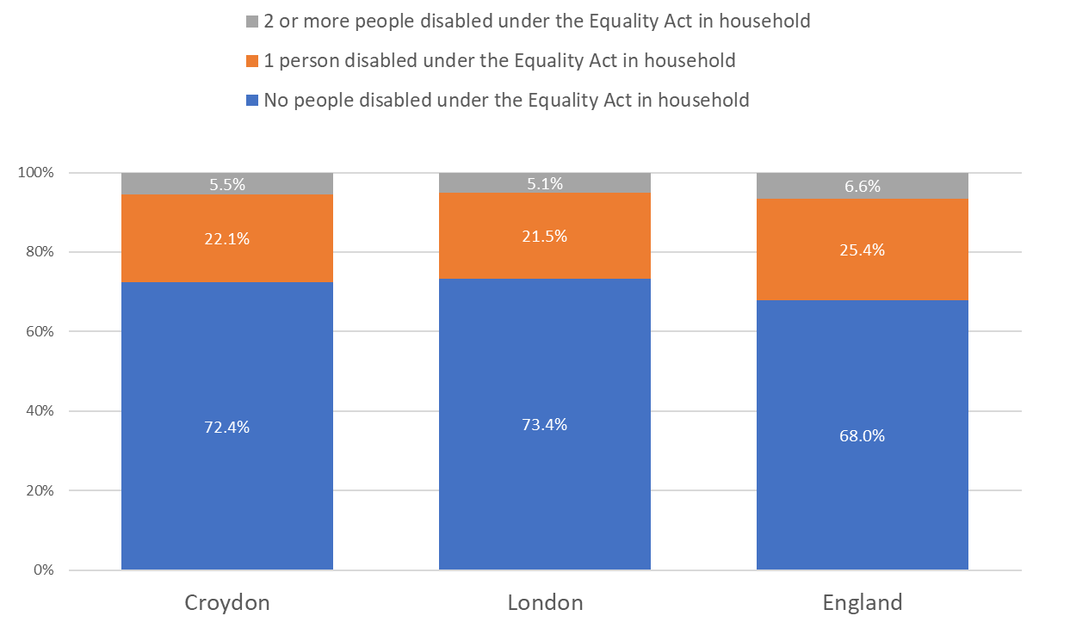
Number of Disabled people in the household – Croydon vs London vs England
In Croydon, 22.1% of households have one person disabled under the Equality Act. This is similar to London (21.5%) but lower than in England (25.4%).
5.5% of Croydon households have 2 or more people disabled persons under the Equality Act. This is similar to London (5.1%) but lower than in England (6.6%).
2022 local authorities: district | Total: All households | No people disabled under the Equality Act in household | 1 person disabled under the Equality Act in household | 2 or more people disabled under the Equality Act in household
Croydon | 152,945 | 110,761 | 33,725 | 8,459
Source: ONS Census 2021
Edmund Fallon, Census 2021

Slide 18
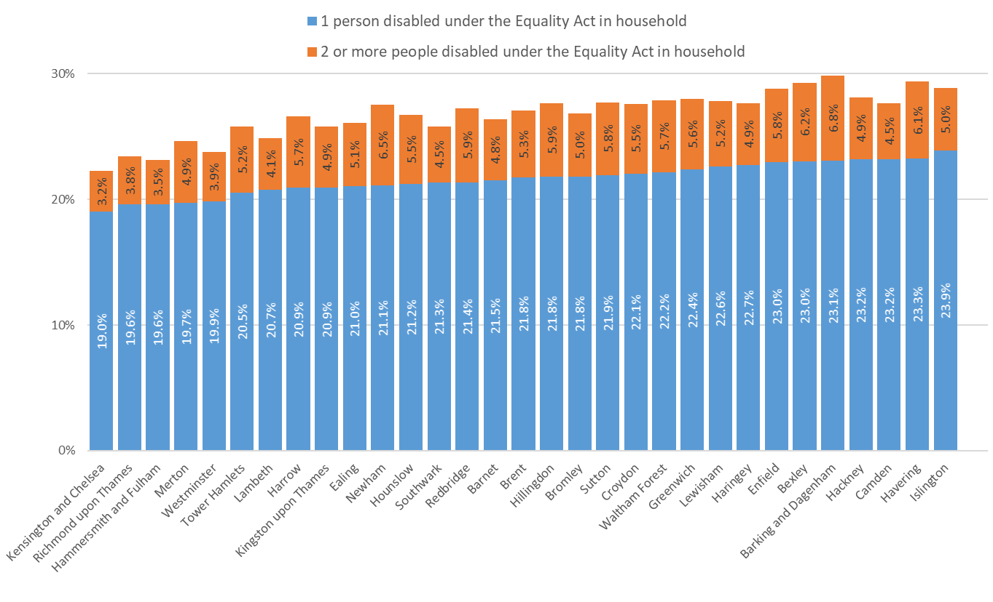
Number of Disabled people in the household – Across London
Islington has the highest proportion of households with 1 person disabled (23.9%) in London.
Kensington & Chelsea has the lowest proportion of households with 1 person disabled (19.0%) and the lowest proportion of households with 2 persons or more disabled (3.2%) in London.
Barking & Dagenham has the highest proportion of households with 2 persons or more disabled (6.8%) in London.
Source: ONS Census 2021
Edmund Fallon, Census 2021

