Slide 1
Business Intelligence, P Census 2021 & Improvement Service
10. Jan. 2023

Slide 2
Business Intelligence, P Education Census 2021Service
10. Jan. 2023

Slide 3
Bus TS067 - Highest level of qualification TS068 - Schoolchildren and full-time students s Intelligence, P
10. Jan. 2023

Slide 4
Business Intelligence, P DD
10 Jan. 2023

Slide 5
Highest Level of Qualification
Highest level of qualification | Croydon | (%) | London | (%) | England | (%)
Total: All usual residents aged 16 years and over | 310,397 | 100.0% | 7,103,985 | 100.0% | 46,006,955 | 100.0%
No qualifications | 49,877 | 16.1% | 1,151,250 | 16.2% | 8,317,789 | 18.1%
Level 1 and entry level qualifications | 28,370 | 9.1% | 545,269 | 7.7% | 4,456,198 | 9.7%
Level 2 qualifications | 38,241 | 12.3% | 707,518 | 10.0% | 6,126,130 | 13.3%
Apprenticeship | 11,786 | 3.8% | 227,622 | 3.2% | 2,446,935 | 5.3%
Level 3 qualifications | 45,535 | 14.7% | 937,875 | 13.2% | 7,784,977 | 16.9%
Level 4 qualifications and above | 127,342 | 41.0% | 3,316,829 | 46.7% | 15,606,458 | 33.9%
Other qualifications | 9,246 | 3.0% | 217,622 | 3.1% | 1,268,468 | 2.8%
Only 16.1% of Croydon residents aged 16 years and over have no qualifications. This is a lower proportion compared to London (16.2%) and England (18.1%).
The proportion of Croydon residents aged 16 years and over undertaking an apprenticeship is 3.8% which is higher than the regional proportion (3.2%) but lower than the national proportion (5.3%).
77.2% of Croydon residents aged 16 years and over have qualifications ranging from level 1 to level 4. This proportion is similar to the Regional average (77.5%) but higher than the National average (73.8%).
Source: ONS Census 2021
Edmund Fallon, Census 2021

Slide 6
Highest Level of Qualification
(Residents aged 16 years and over)
Source: ONS Census 2021
Edmund Fallon, Census 2021

Slide 7
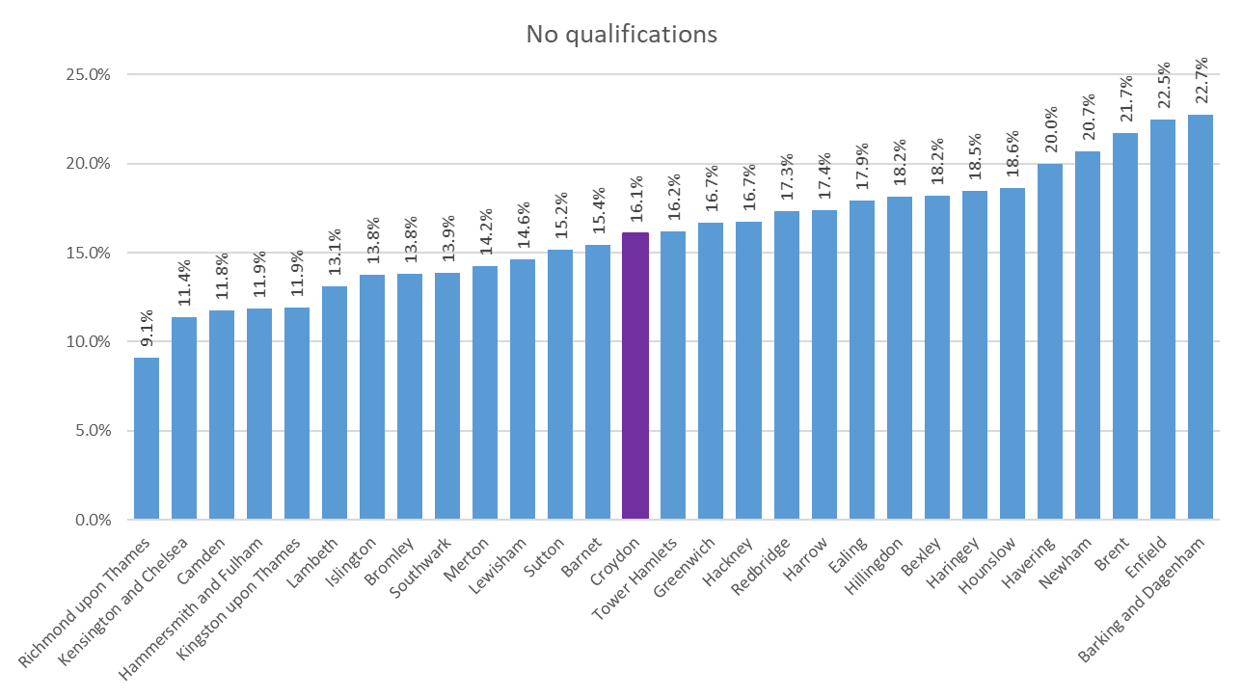
No Qualifications – Across London
(Residents aged 16 years and over)
16.1% of Croydon residents aged 16 years and over have no qualifications.
The average for London is 16.0%.
Source: ONS Census 2021
Edmund Fallon, Census 2021

Slide 8
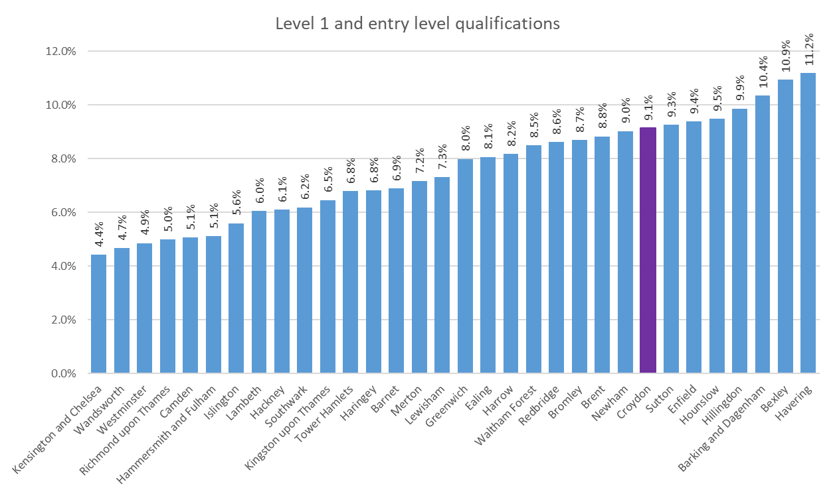
Level 1 Qualifications – Across London
(Residents aged 16 years and over)
9.1% of Croydon residents aged 16 years and over have level 1 and entry level qualifications.
The average for London is 7.6%.
Source: ONS Census 2021
Edmund Fallon, Census 2021

Slide 9
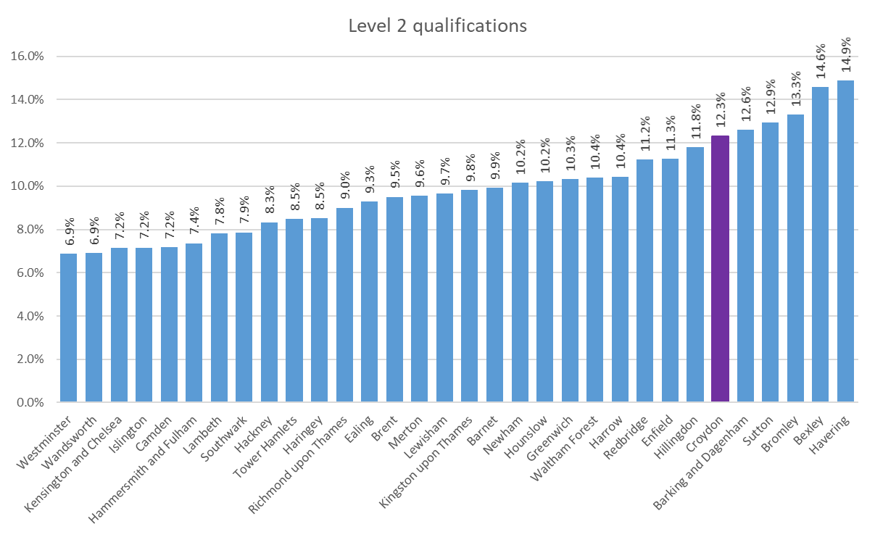
Level 2 Qualifications – Across London
(Residents aged 16 years and over)
12.3% of Croydon residents aged 16 years and over have level 2 qualifications.
The average for London is 9.9%.
Source: ONS Census 2021
Edmund Fallon, Census 2021

Slide 10
Apprenticeships – Across London
(Residents aged 16 years and over)
3.8% of Croydon residents aged 16 years and over have apprenticeships.
The average for London is 3.2%.
Source: ONS Census 2021
Edmund Fallon, Census 2021

Slide 11
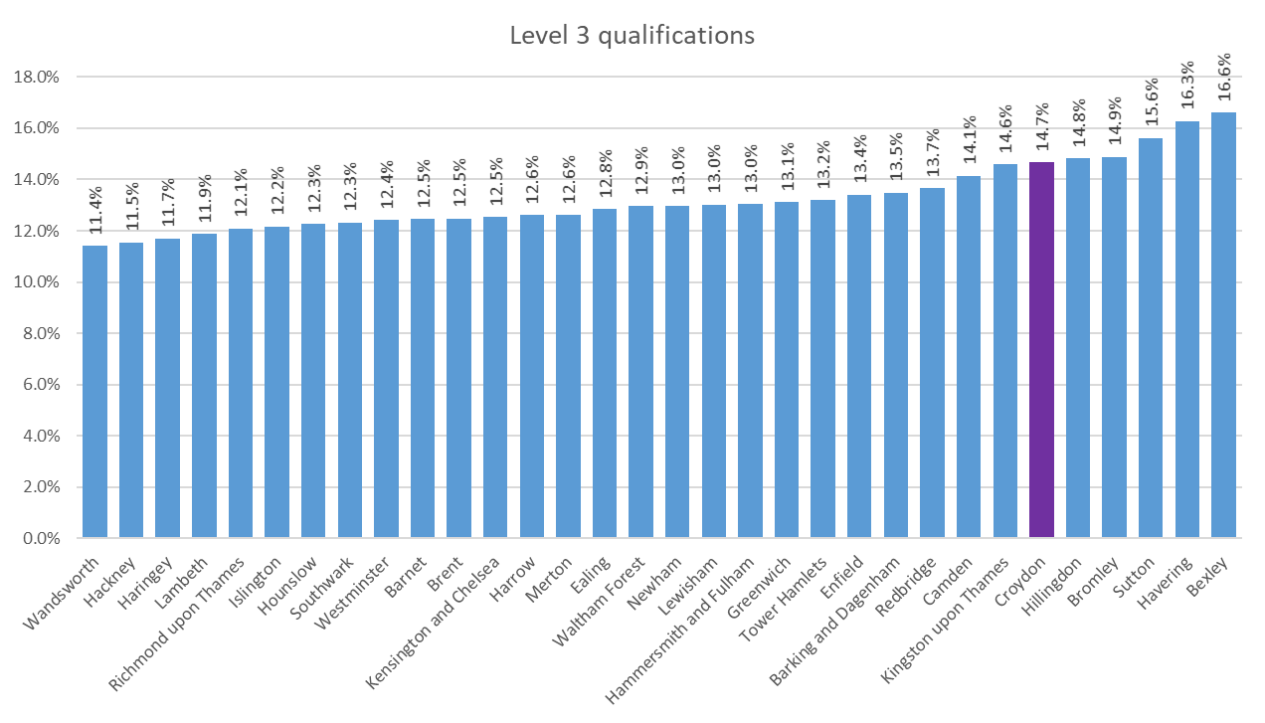
Level 3 Qualifications – Across London
(Residents aged 16 years and over)
14.7% of Croydon residents aged 16 years and over have level 3 qualifications.
The average for London is 13.2%.
Source: ONS Census 2021
Edmund Fallon, Census 2021

Slide 12
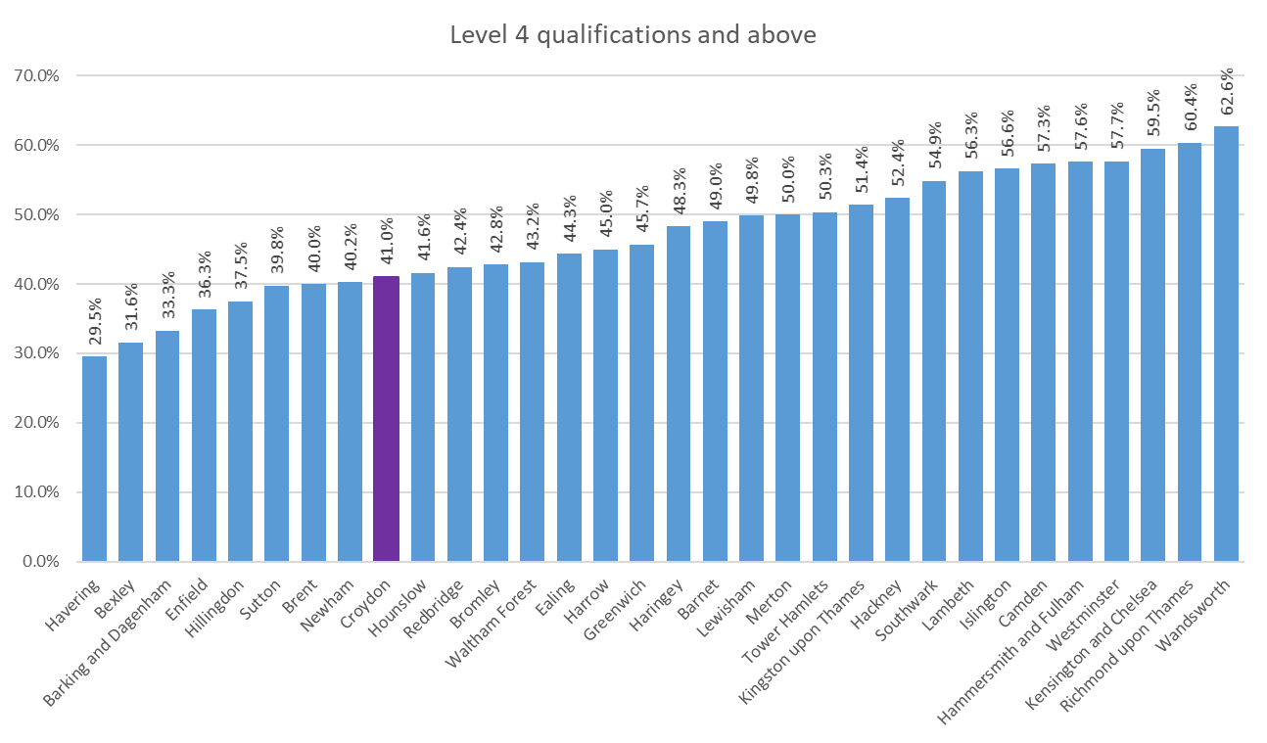
Level 4 Qualifications – Across London
(Residents aged 16 years and over)
41.0% of Croydon residents aged 16 years and over have level 4 and above qualifications.
The average for London is 47.1%.
Source: ONS Census 2021
Edmund Fallon, Census 2021

Slide 13
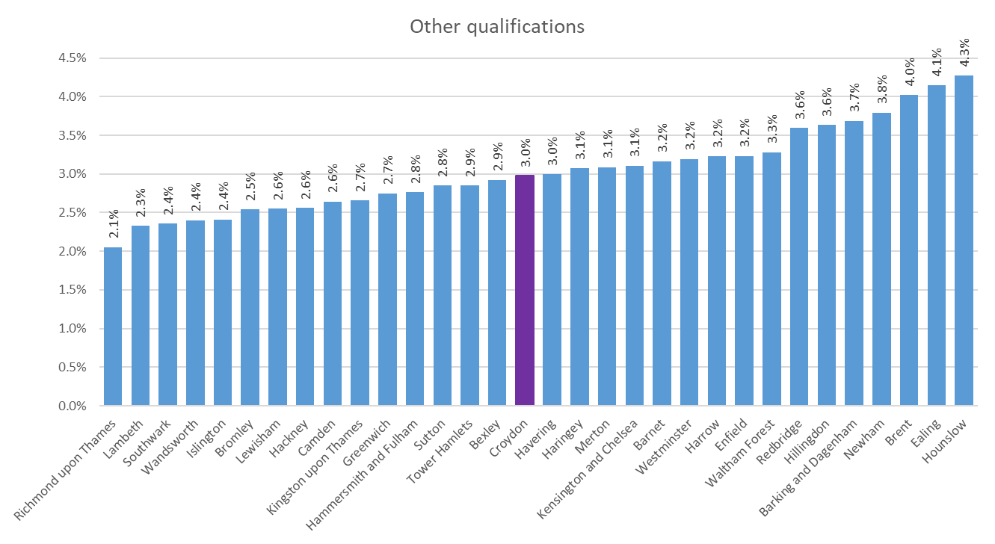
Other Qualifications – Across London
(Residents aged 16 years and over)
3.0% of Croydon residents aged 16 years and over have other qualifications.
The average for London is also 3.0%.
Source: ONS Census 2021
Edmund Fallon, Census 2021

Slide 14
Schoolchildren and full-time students
(All residents aged 5 years and over)
 | Croydon | London | England
Total | 365,548 | 8,270,772 | 53,413,097
Student | 79,478 | 1,835,065 | 10,920,505
Not a student | 286,070 | 6,435,707 | 42,492,592
 | Croydon | London | England
Total | 100.0% | 100.0% | 100.0%
Student | 21.7% | 22.2% | 20.4%
Not a student | 78.3% | 77.8% | 79.6%
The proportions of Students to Non students, based on residents aged 5 years and over, do not vary very much at all in Croydon, London and England.
Source: ONS Census 2021
Edmund Fallon, Census 2021

Slide 15
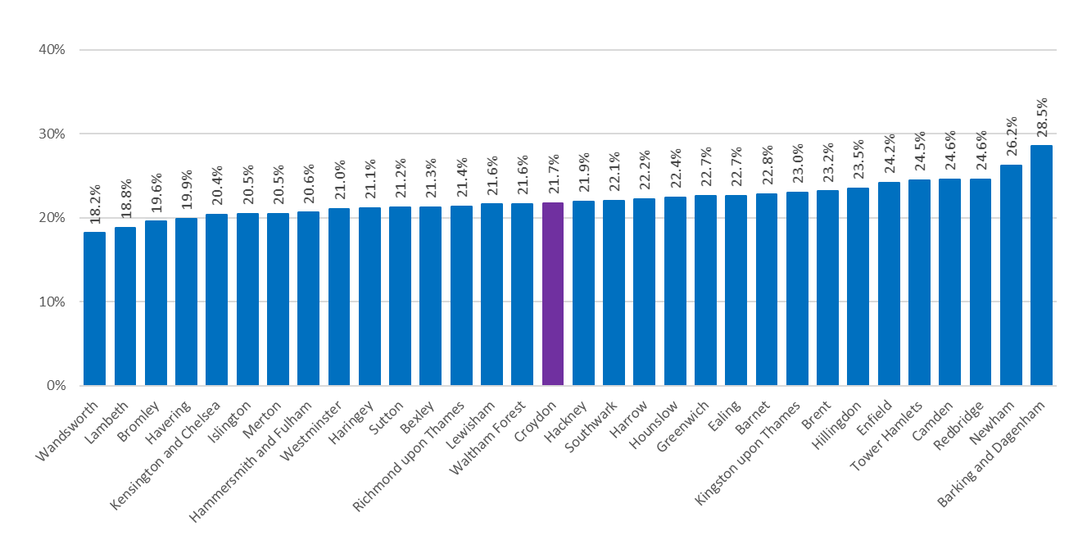
Schoolchildren and full-time students
(All residents aged 5 years and over)
The proportion of students across London
One in 5 (21.6%) of Croydon residents aged 5 years or older are schoolchildren or full-time students.
The average across London is 22.1% so Croydon is close to this.
Wandsworth has the lowest proportion of schoolchildren and full-time students in London with 18.2% and Barking & Dagenham has the highest with 28.5%.
Source: ONS Census 2021
Edmund Fallon, Census 2021

