Slide 1
Business Intelligence, P Census 2021 & Improvement Service
5. Jan. 2023

Slide 2
Business Intelligence, P Housing Census 2021Service
5. Jan. 2023

Slide 3
5. Jan. 2023

Slide 4
Business Intelligence, P DD
5 Jan. 2023

Slide 5
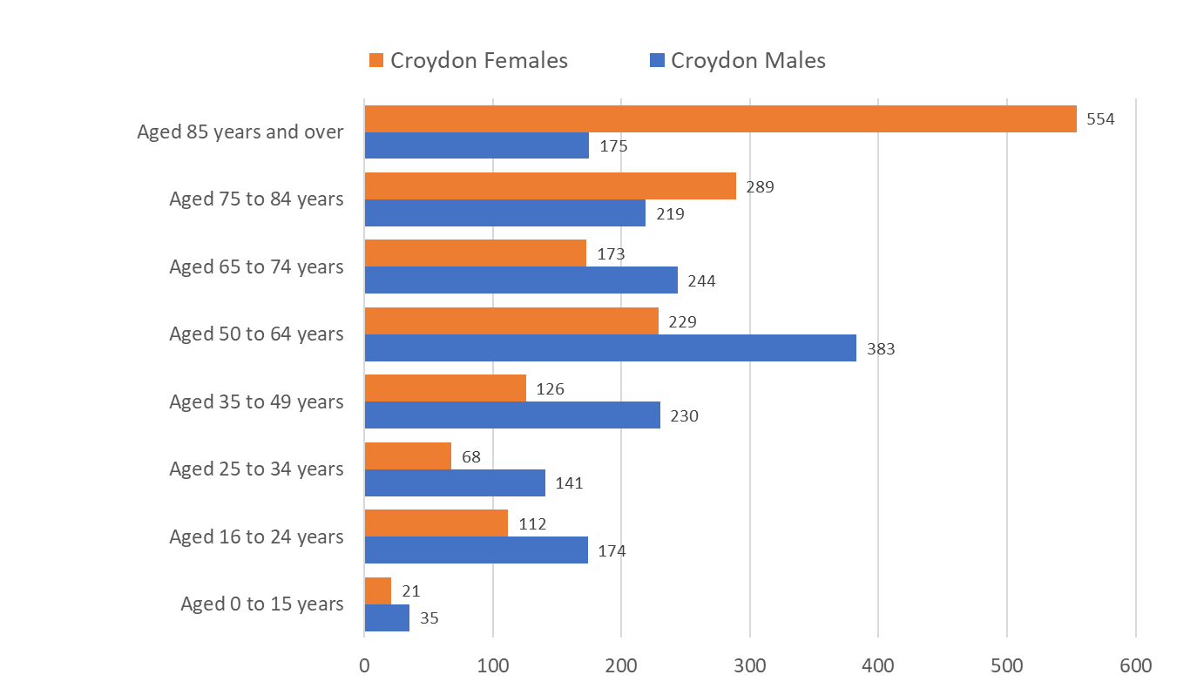
Communal Establishment residents by age & sex
There were only 1,601 males and 1,572 females in communal establishments on Census day, in March 2021.
Three quarters (75.4%) of males were aged 0-74 years compared to 46.4% of females in the same age band.
A higher promotion of females (53.6%) were aged 75 and over compared to males in the same age range (24.6%).
Croydon has the 14th highest number of residents in communal establishments in London which does seem particularly low considering Croydon is the most highly populated London borough.
Source: ONS Census 2021
Edmund Fallon, Census 2021

Slide 6
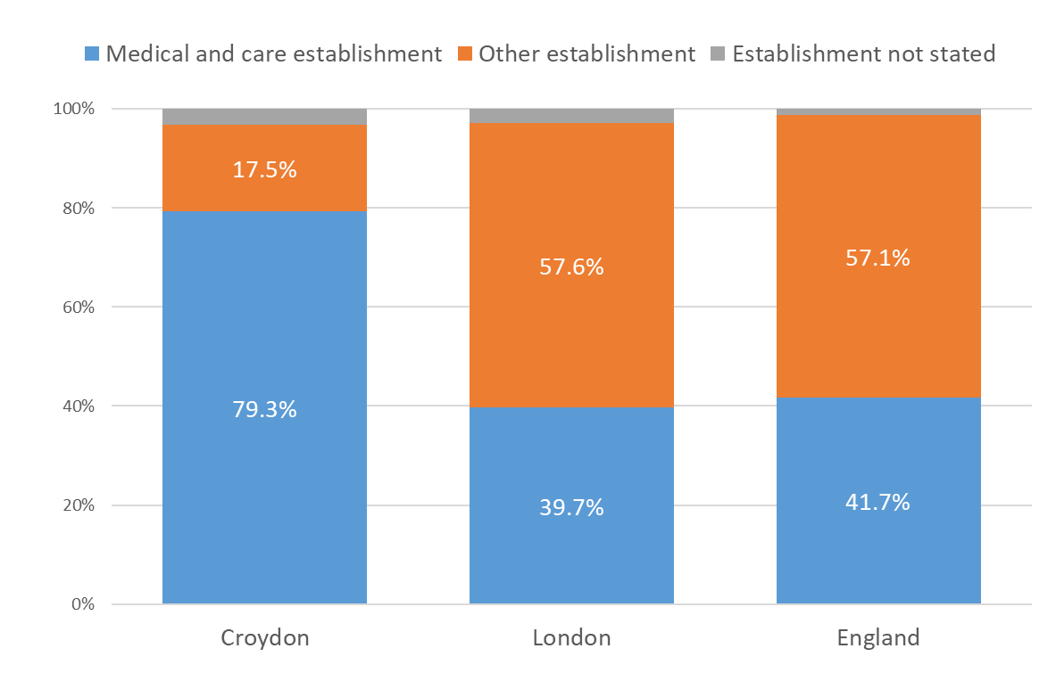
Communal Establishment management & type
Nearly 8 in 10 (79.3%) of Croydon residents in communal establishments are in medical or care establishments. This proportion is far greater than in London and England.
London and England have a higher proportion of residents in “Other” establishments which would include the following:
Defence
Prison service
Approved premises (probation or bail hostel)
Detention centres and other detention
Education
Hotel, guest house, B&B or youth hostel
Hostel or temporary shelter for the homeless
Holiday accommodation
Other travel or temporary accommodation
Religious
Staff or worker accommodation or Other
Other establishment: Staff or worker accommodation or Other
Source: ONS Census 2021
Edmund Fallon, Census 2021

Slide 7
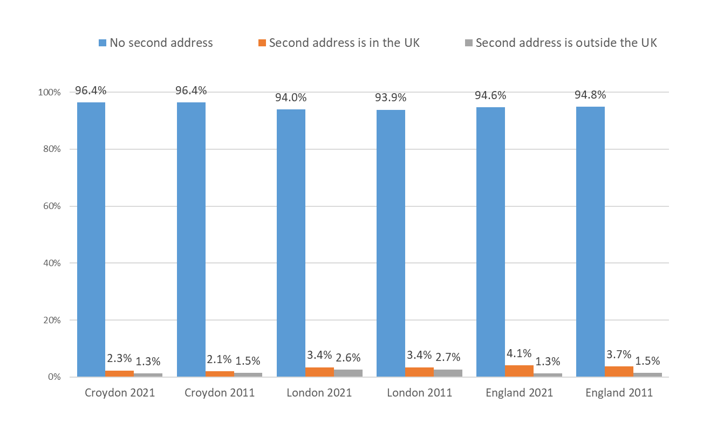
Second Address indicator
96.4% of Croydon residents did not have a second address in 2021 which is the same proportion as in Census 2011, 10 years earlier.
In London and England, the proportion of residents with no second address has not changed much in 10 years.
In London there has been a 1% increase, from 2011 to 2021, in the proportion of residents with a second home outside the UK.
In England the proportion of residents with a second home in the UK or outside the UK has increased from 5.2% to 5.4%.
Source: ONS Census 2021, ONS Census 2011
Edmund Fallon, Census 2021

Slide 8
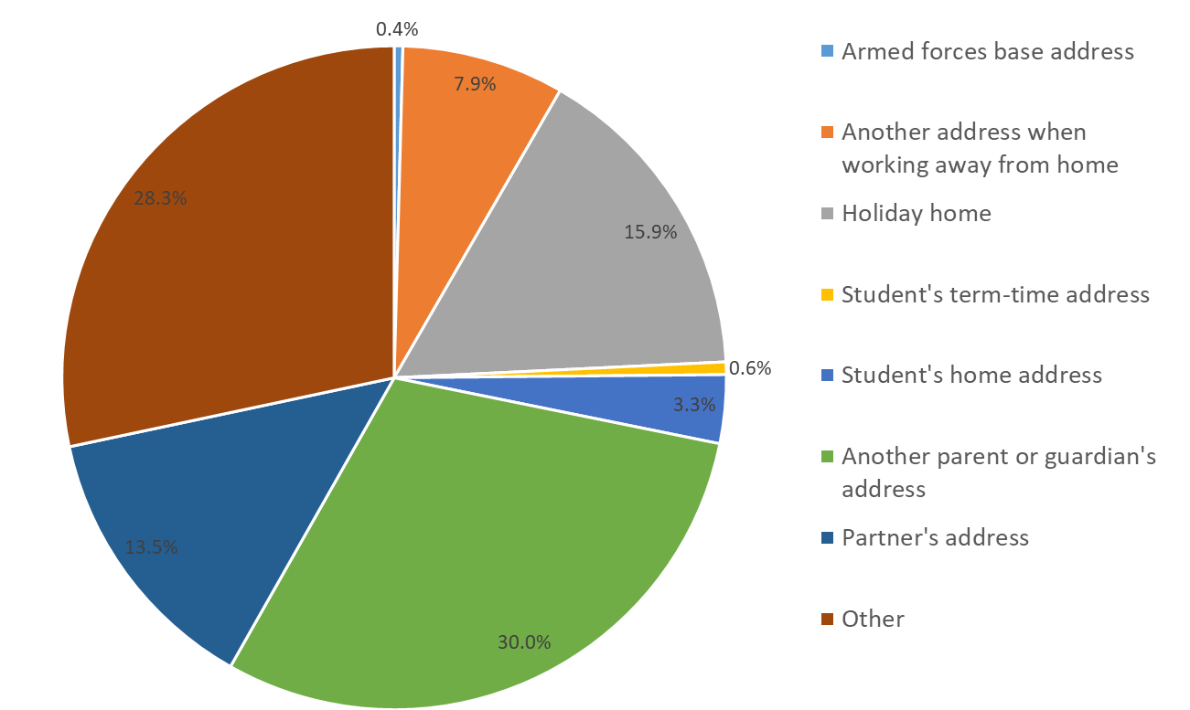
Purpose of Second Address
30% of second addresses for Croydon residents are another parent or guardian’s address.
15.9% are holiday homes.
13.5% are a partner’s address.
7.9% are another address when working away from home.
28.3% are other second addresses.
Source: ONS Census 2021
Edmund Fallon, Census 2021

Slide 9
Business Intelligence, P DD
5 Jan. 2023

Slide 10
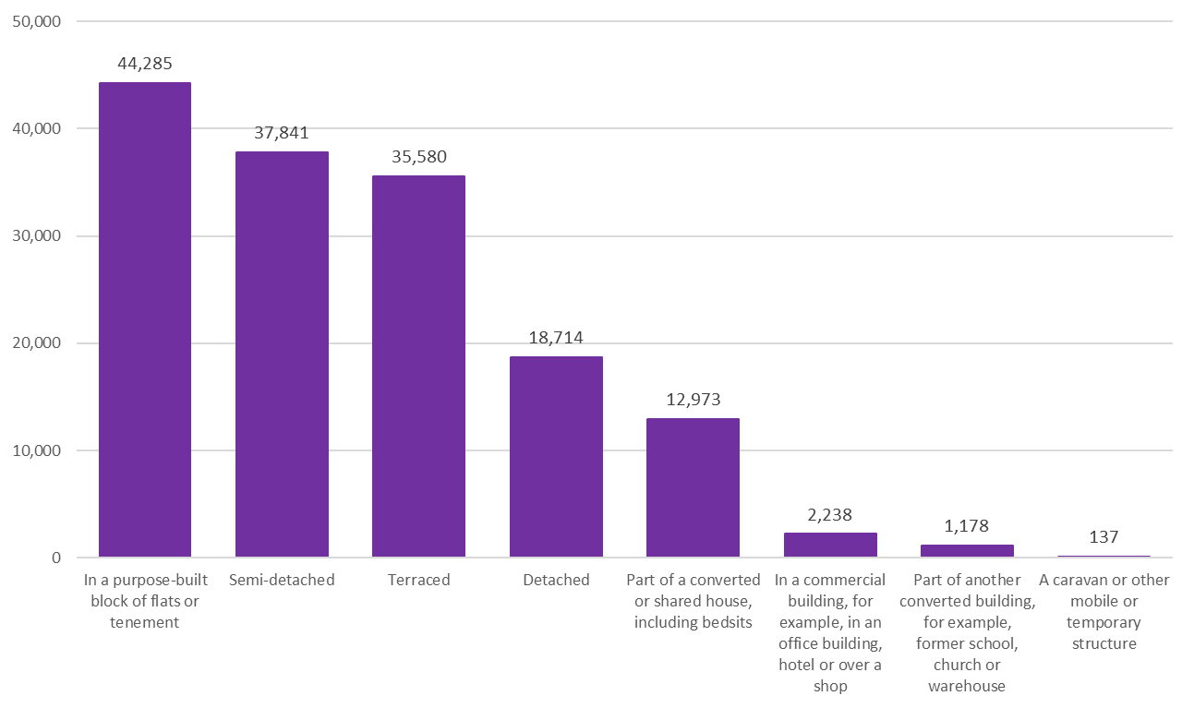
Accommodation Type
Roughly 3 in 10 (29%) of Croydon residents are living in a purpose-built block of flats or tenement.
Nearly 1 in 4 (24.7%) live in semi-detached properties.
Nearly 1 in 4 (23.3%) live in terraced properties.
1 in 8 (12.2%) live in detached properties.
About 1 in 12 (8.5%) live in part of a converted or shared house, including bedsits.
2.3% live in other types of accommodation.
Source: ONS Census 2021
Edmund Fallon, Census 2021

Slide 11
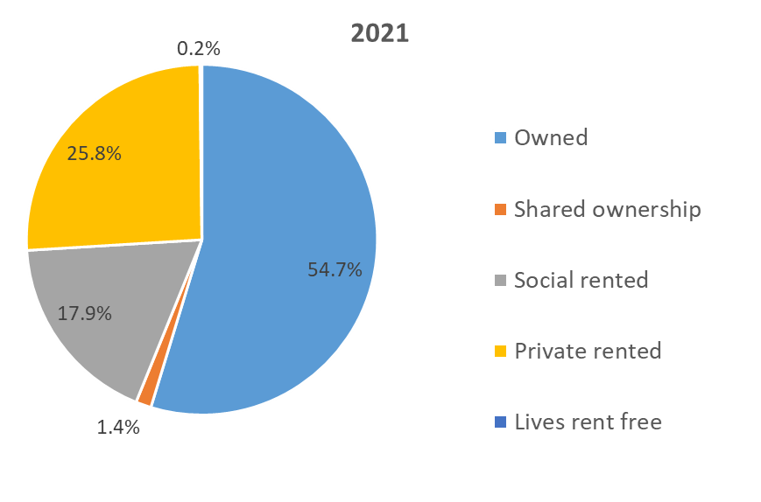
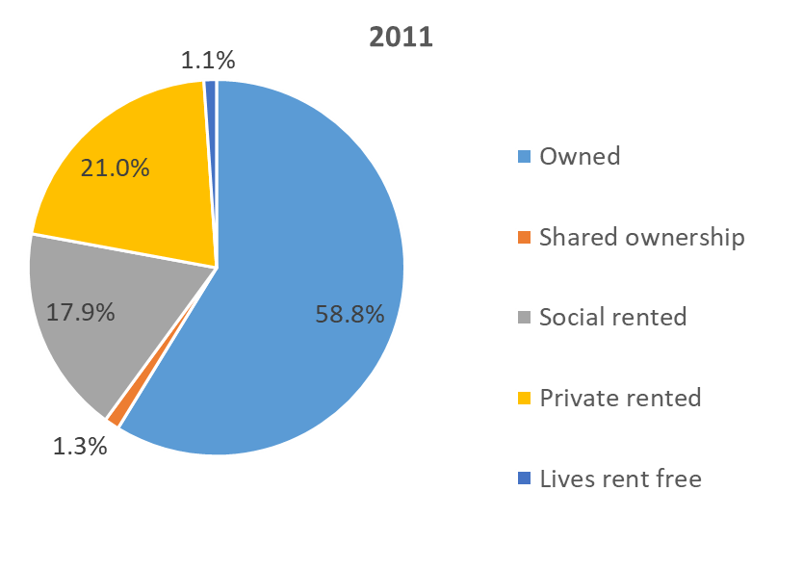
Tenure in Croydon
Source: ONS Census 2021
Source: ONS Census 2011
The proportion of Croydon residents who own their own homes has dropped from 58.8% in 2011 to 54.7% in 2021.
Private renting in Croydon has increased by 4.8% from 21.0% to 25.8%.
The proportion of social rented housing has stayed the same at 17.9% from 2011 to 2021.
The proportion of those living rent free has gone down from 1.1% in 2011 to 0.2% in 2021.
Shared ownership has not changed much over 10 years (1.4% in 2021 compared to 1.3% in 2011).
Edmund Fallon, Census 2021

Slide 12
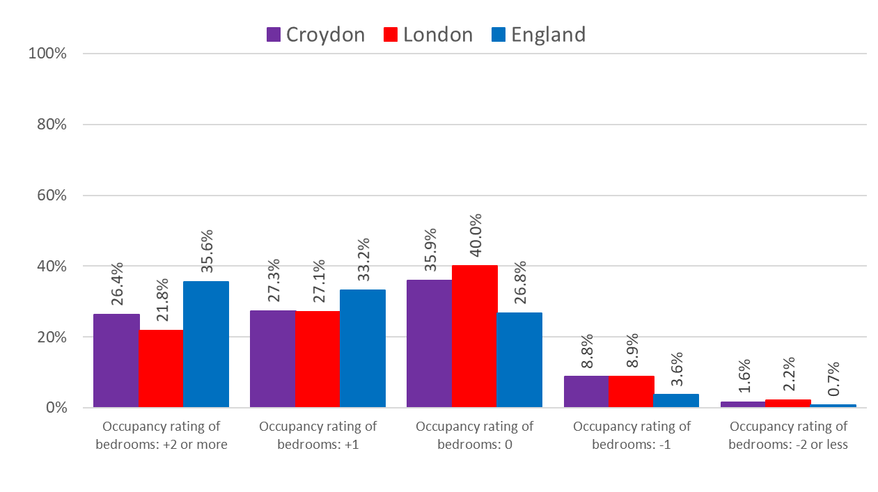
Occupancy rating (bedrooms)
Occupancy rating is a measure for under- or over- crowding.
10.4% of Croydon households have fewer bedrooms than required (overcrowded).
53.7% of Croydon households have more bedrooms than required (under-occupied).
35.9% of Croydon households have an ideal number of bedrooms.
Source: ONS Census 2021
Edmund Fallon, Census 2021

Slide 13
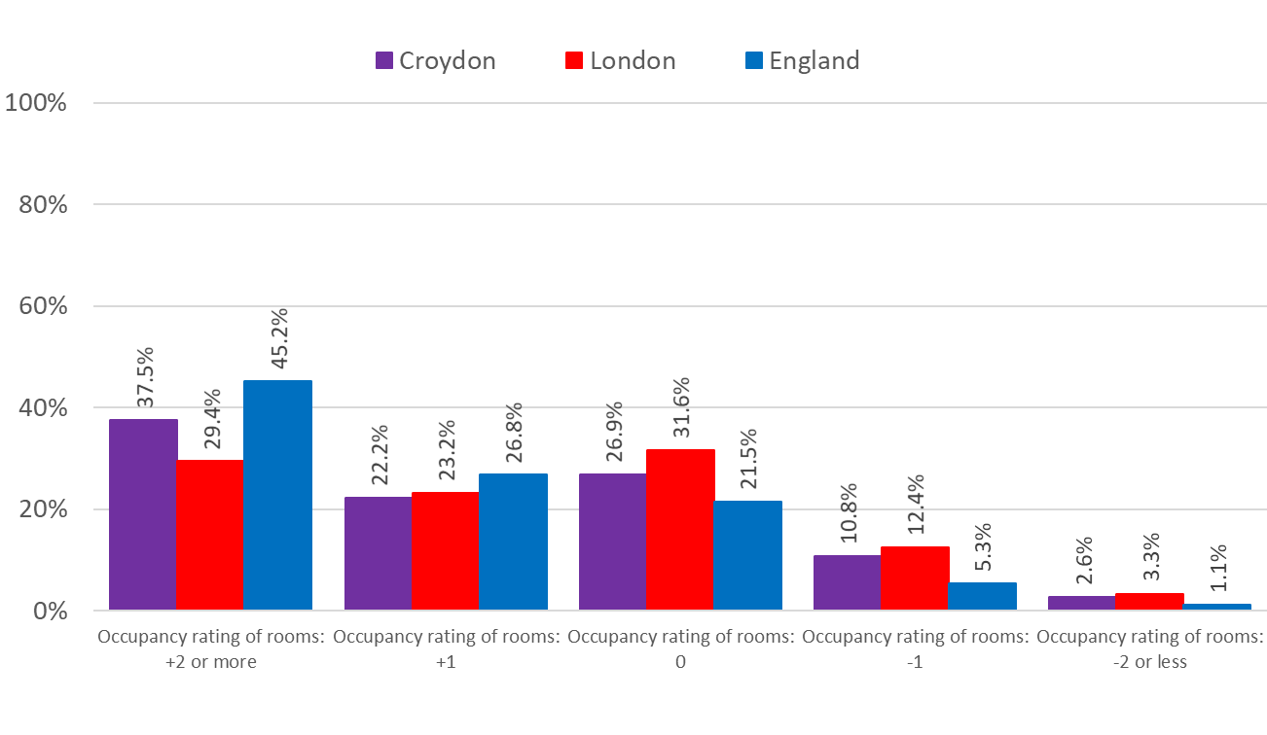
Occupancy rating (Rooms)
Occupancy rating is a measure for under- or over- crowding.
13.4% of Croydon households have fewer rooms than required (overcrowded).
59.7% of Croydon households have more rooms than required (under-occupied).
26.9% of Croydon households have an ideal number of rooms.
Source: ONS Census 2021
Edmund Fallon, Census 2021

Slide 14
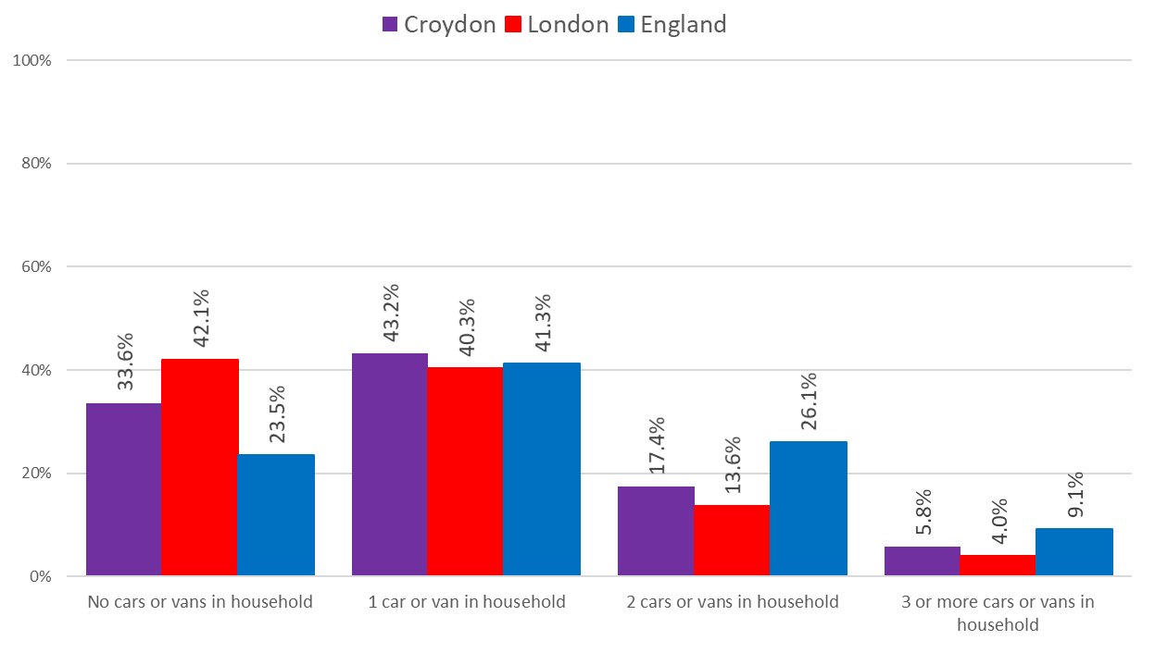
Car or Van availability
One in 3 (33.6%) of households in Croydon have no car or van. This is a higher proportion than England (23.5%) but lower than in London (42.1%).
Similar proportions (around 4 in 10) of households in Croydon, London and England have 1 car or van in their household.
In England 1 in 4 (26.1%) of households have 2 cars or vans in their households. This is a higher proportion than in Croydon (17.4%) and London (13.6%).
Source: ONS Census 2021
Edmund Fallon, Census 2021

Slide 15
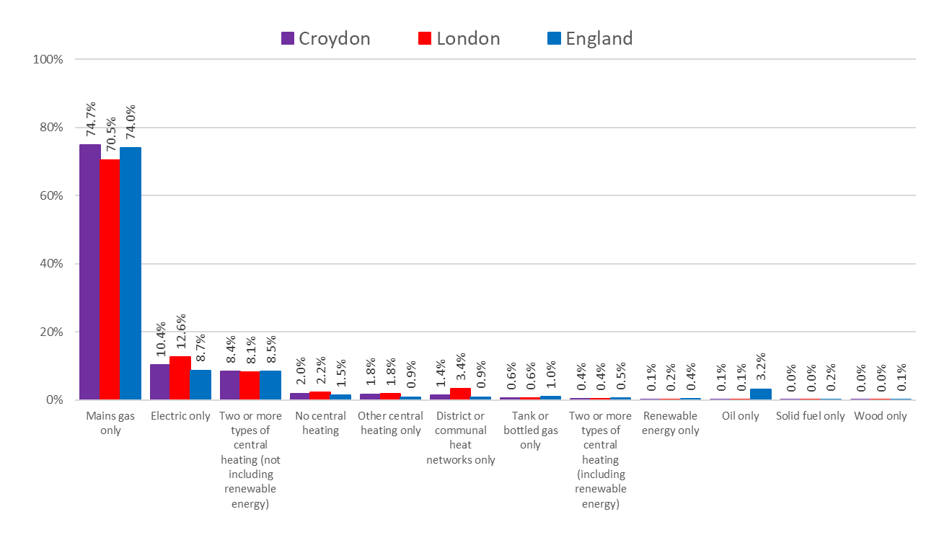
Central Heating
In Croydon, three quarters (74.7%) of households have central heating via the main gas only. This is a slightly higher rate than both London and England.
In Croydon 1 in 10 (10.4%) of households heat their homes with electric only. This is higher than in England (8.7%) but lower than in London (12.6%).
Just over 8% of households in Croydon, London and England have 2 or more types of central heating.
2.0% of households in Croydon have no central heating.
Source: ONS Census 2021
Edmund Fallon, Census 2021

Slide 16
Source: ONS Census 2021
Edmund Fallon, Census 2021

Slide 17
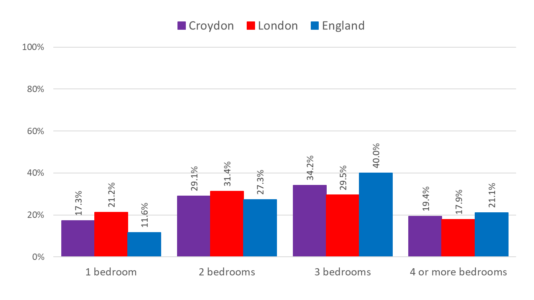
Number of Bedrooms
3 bedroom properties in Croydon make up the highest proportion (34.2%) of number of bedroom properties in the borough.
Nearly 1 in 5 (19.4%) of properties in Croydon have 4 or more bedrooms.
Nearly 3 in 10 properties (29.1%) of properties in Croydon have 2 bedrooms.
There are 17.3% of households in Croydon which have only 1 bedroom.
Source: ONS Census 2021
Edmund Fallon, Census 2021

Slide 18
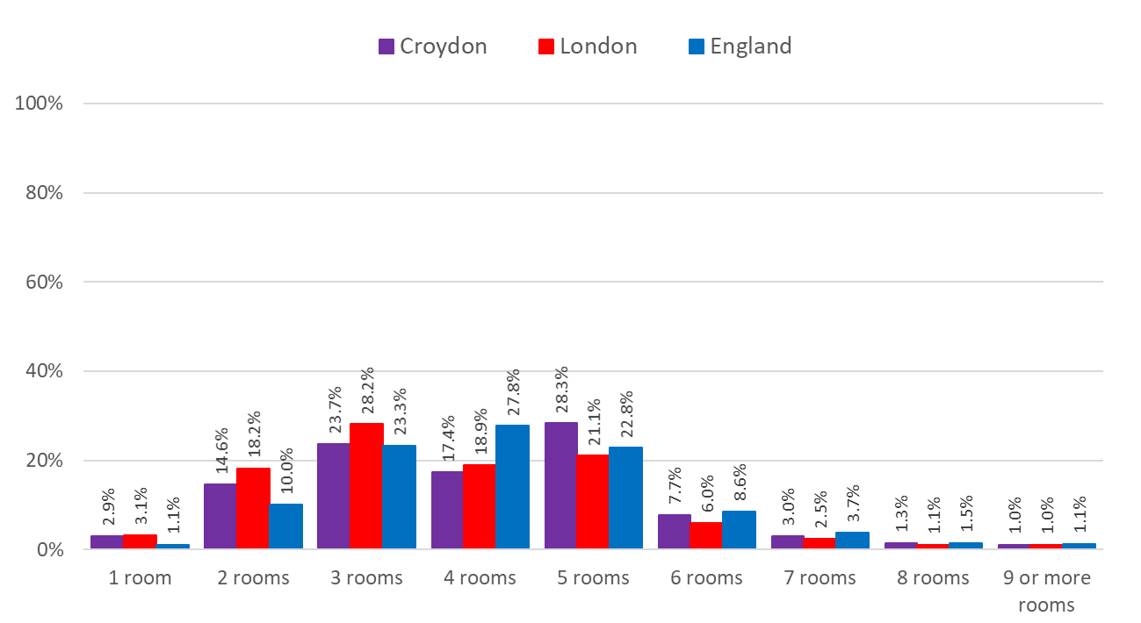
Number of Rooms
(Excludes bathrooms, toilets, halls or landings, kitchens, conservatories or utility rooms.)
Croydon has 41.4% of households living in properties with 5 or more rooms. In London the proportion is 31.7% and in England it is 37.7%.
Households with between 3 and 5 rooms make up 69.4% of all Croydon households. This contrasts with 68.1% for London and 74.0% for England.
Households with 7 or more rooms make up 5.3% of all households in Croydon compared with 4.6% in London and 6.3% in England.
Source: ONS Census 2021
Edmund Fallon, Census 2021

