Slide 1
Business Intelligence, P Census 2021 & Improvement Service
8. Dec. 2022

Slide 2
Business Intelligence, P Labour Market and Travel to Work Census 2021Service
8. Dec. 2022

Slide 3
Business Intelligence, P DD
8 Dec. 2022

Slide 4
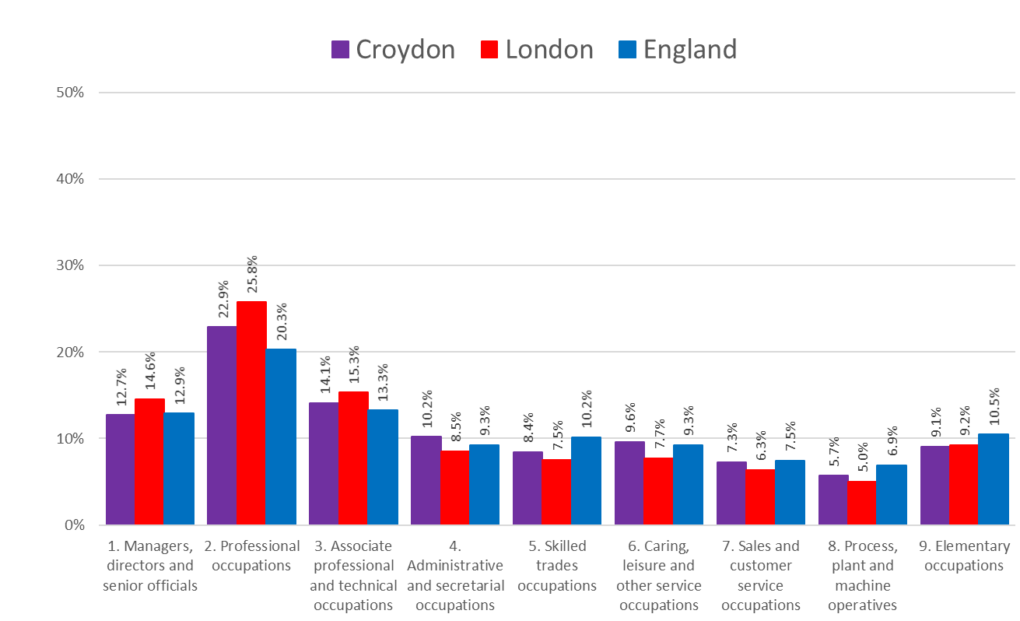
Occupation
About 1 in 8 (12.7%) of Croydon’s workforce are managers, directors or senior officials. This is slightly lower than in London and England.
Nearly 4 in 10 (37.0%) work in professional, Associate professional and technical occupations.
One in 10 (10.2%) work in administrative or secretarial occupations which is a slightly higher proportion compared to London and England.
One in 10 (9.6%) also work in the caring, leisure and other service industry which is a slightly higher proportion than in London and England.
Source: ONS Census 2021
Edmund Fallon, Census 2021

Slide 5
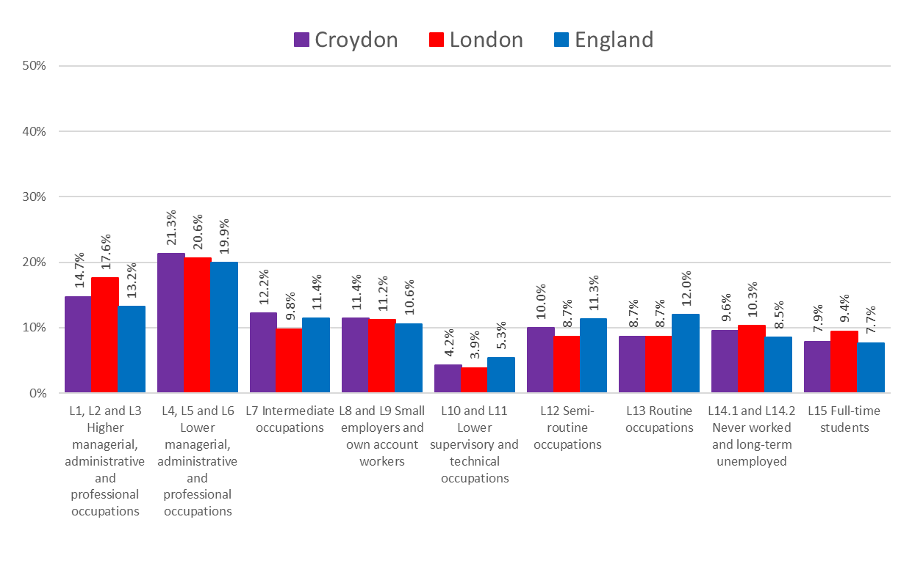
Occupational Social Class (NS-SEC)
One in 3 (36%) of Croydon’s working residents are in managerial, administrative and professional occupations.
Nearly 1 in 5 (18.7%) are doing semi-routine or routine jobs.
Nearly 1 in 10 (9.6%) have never worked or have been long-term unemployed.
Source: ONS Census 2021
Edmund Fallon, Census 2021

Slide 6
Industry
INDUSTRY | Croydon | London | England
A: Agriculture, Forestry and fishing | 0.1% | 0.1% | 0.8%
B: Mining and quarrying | 0.1% | 0.1% | 0.2%
C: Manufacturing | 2.6% | 3.0% | 7.3%
D: Electricity, gas, steam and air conditioning supply | 0.3% | 0.3% | 0.6%
E: Water supply; Sewerage, Waste management and Remediation activities | 0.3% | 0.3% | 0.7%
F: Construction | 8.6% | 7.8% | 8.7%
G: Wholesale and retail trade; repair of motor vehicles and motorcycles | 13.1% | 12.2% | 15.0%
H: Transport and storage | 5.3% | 4.7% | 5.0%
I: Accommodation and food service activities | 4.6% | 5.5% | 4.9%
J: Information and communication | 5.9% | 7.6% | 4.7%
K: Financial and insurance activities | 5.8% | 6.6% | 3.8%
L: Real estate activities | 2.0% | 2.1% | 1.6%
M: Professional, scientific and technical activities | 7.7% | 10.5% | 6.7%
N: Administrative and support service activities | 6.3% | 6.0% | 5.3%
O: Public administration and defence; compulsory social security | 6.9% | 4.8% | 5.8%
P: Education | 9.9% | 9.6% | 9.9%
Q: Human health and social work activities | 15.7% | 12.9% | 14.6%
R, S, T, U Other | 4.9% | 5.8% | 4.6%
Total: All usual residents aged 16 years and over in employment the week before the census | 100% | 100% | 100%
Croydon has a smaller proportion of workers in the manufacturing industry and accommodation and food services industry compared to both London and England.
Croydon has a higher proportion of workers compared to both London and England in the following industries :
Transport and storage
Financial and insurance
Administrative and support services
Public administration and support services
Human health and social work
Source: ONS Census 2021
Edmund Fallon, Census 2021

Slide 7
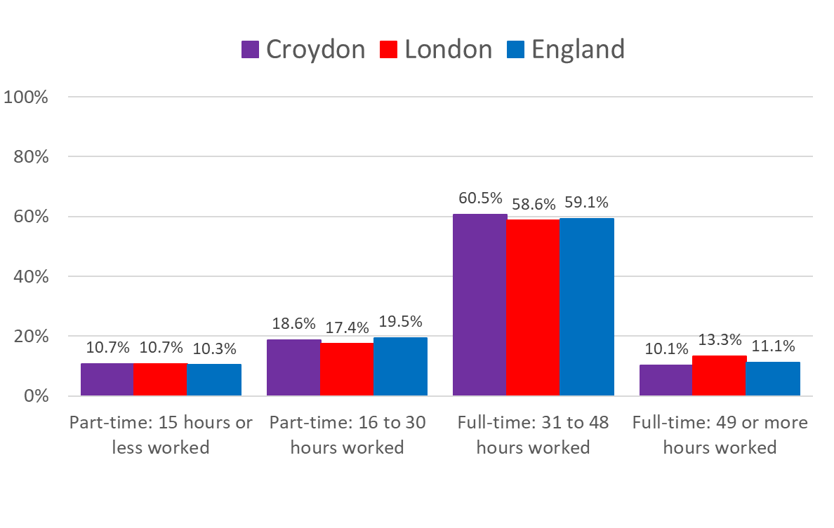
Individuals – Hours Worked
70.6% of the Croydon workforce work full-time for a minimum of 31 hours a week and some of this group work in excess of 49 hours a week.
This proportion is similar to the England average (70.2%) but slightly lower than the London average (72.0%).
29.3% of the Croydon workforce were working 30 hours or less a week in part-time jobs around the Census date.
Source: ONS Census 2021
Edmund Fallon, Census 2021

Slide 8
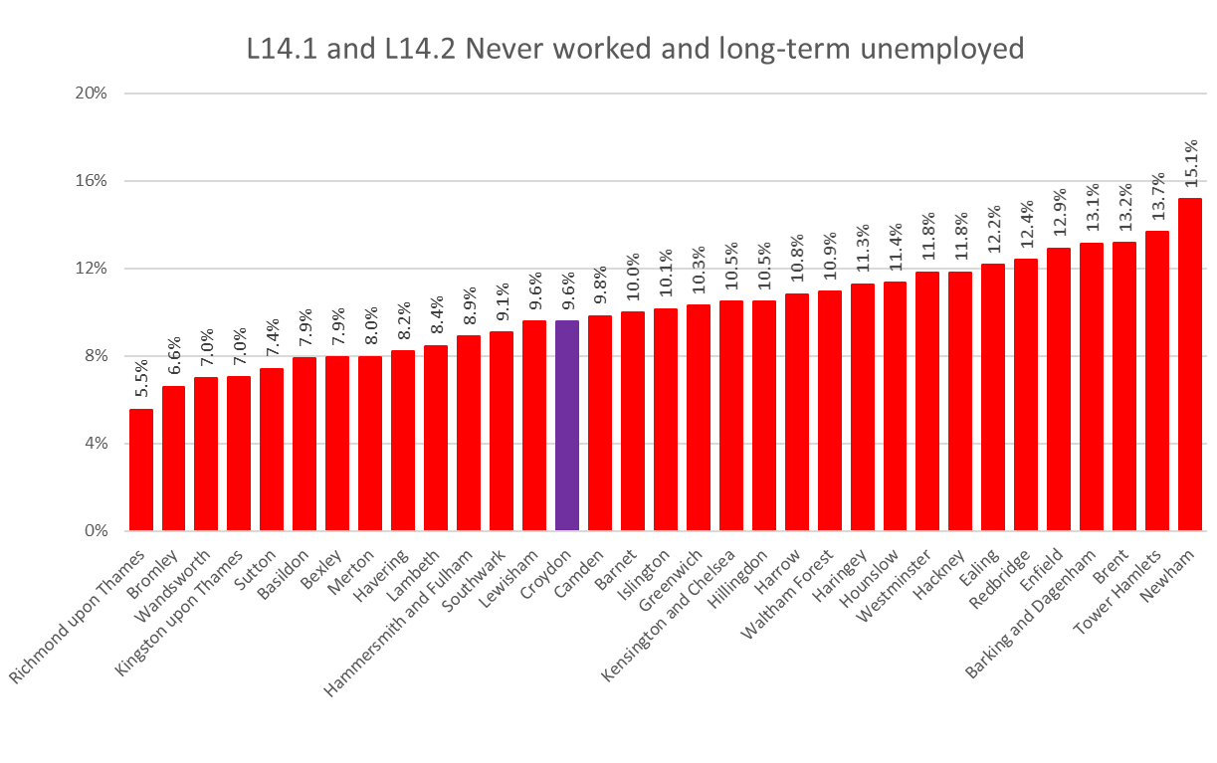
Never worked or long-term Unemployed across London (S-SEC)
9.6% of Croydon’s working age population have never worked or have been long-term unemployed.
Croydon’s proportion of this cohort of residents is slightly smaller than the London average of 10.1%
Richmond upon Thames has the smallest proportion of never worked or long-term unemployed at 5.5%.
Newham has the biggest proportion of never worked or long-term unemployed at 15.1%.
Source: ONS Census 2021
Edmund Fallon, Census 2021

Slide 9
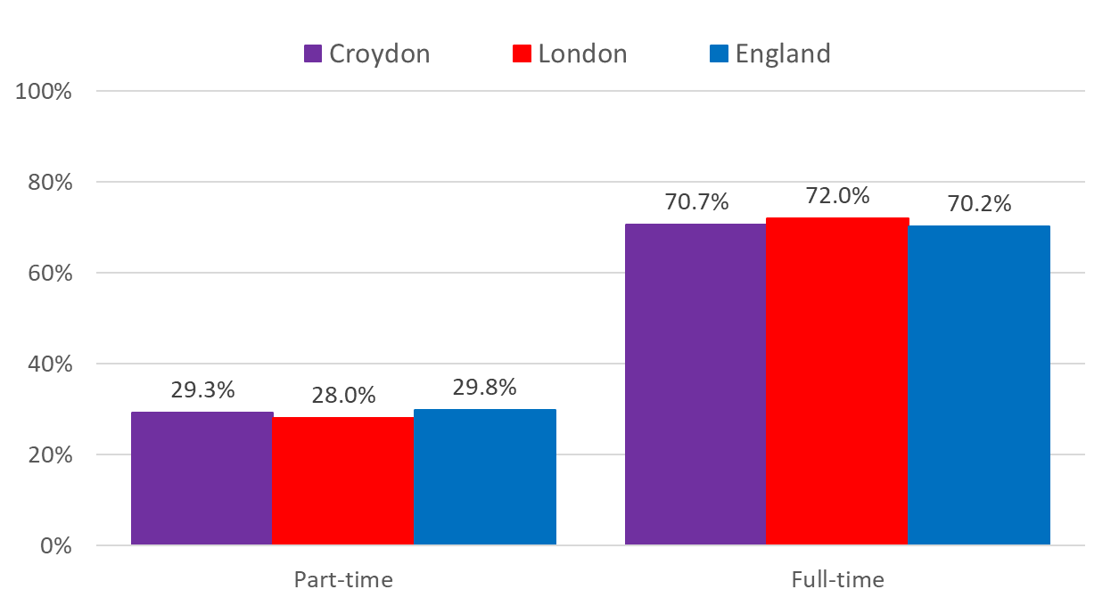
Individuals – Part-time and Full-time split
The proportions of part-time to full-time workers in Croydon, London and England is virtually the same.
Wandsworth had 20.3% part-time workers – the lowest in London.
Enfield has 35.3% pat-time workers – the highest in London.
Source: ONS Census 2021
Edmund Fallon, Census 2021

Slide 10
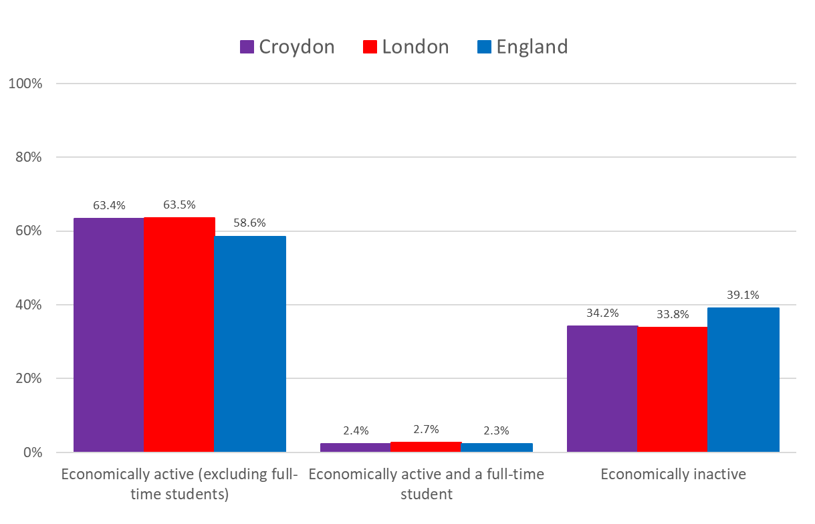
Individuals – Economic Activity
In terms of Economic activity status, Croydon has a similar profile to London.
Both in Croydon and in London, the proportion of economically active people is higher than at the national level.
Source: ONS Census 2021
Edmund Fallon, Census 2021

Slide 11
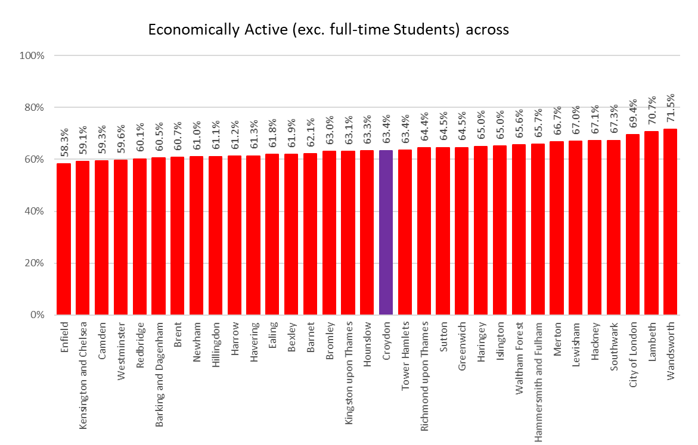
Individuals – Economically Active across London
The proportion of economically active in London ranges from 58.3% in Enfield to 71.5% in Wandsworth.
Croydon is virtually the same as the London average (63.5%).
Source: ONS Census 2021
Edmund Fallon, Census 2021

Slide 12
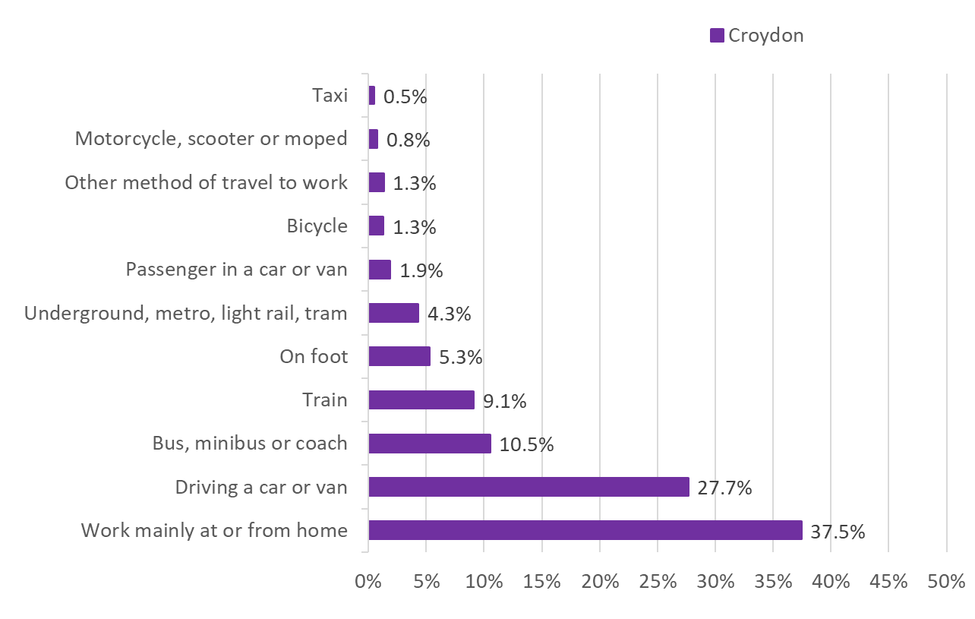
Individuals – Method of Travel to Work
37.5% of Croydon’s were mainly working from home around the time of the Census.
63.3% of its residents are 18-64 years compared to the average for London of 66.6%.
13.6% of its residents are 65 years or over compared to the average for London of 11.9%.
Source: ONS Census 2021
Edmund Fallon, Census 2021

Slide 13
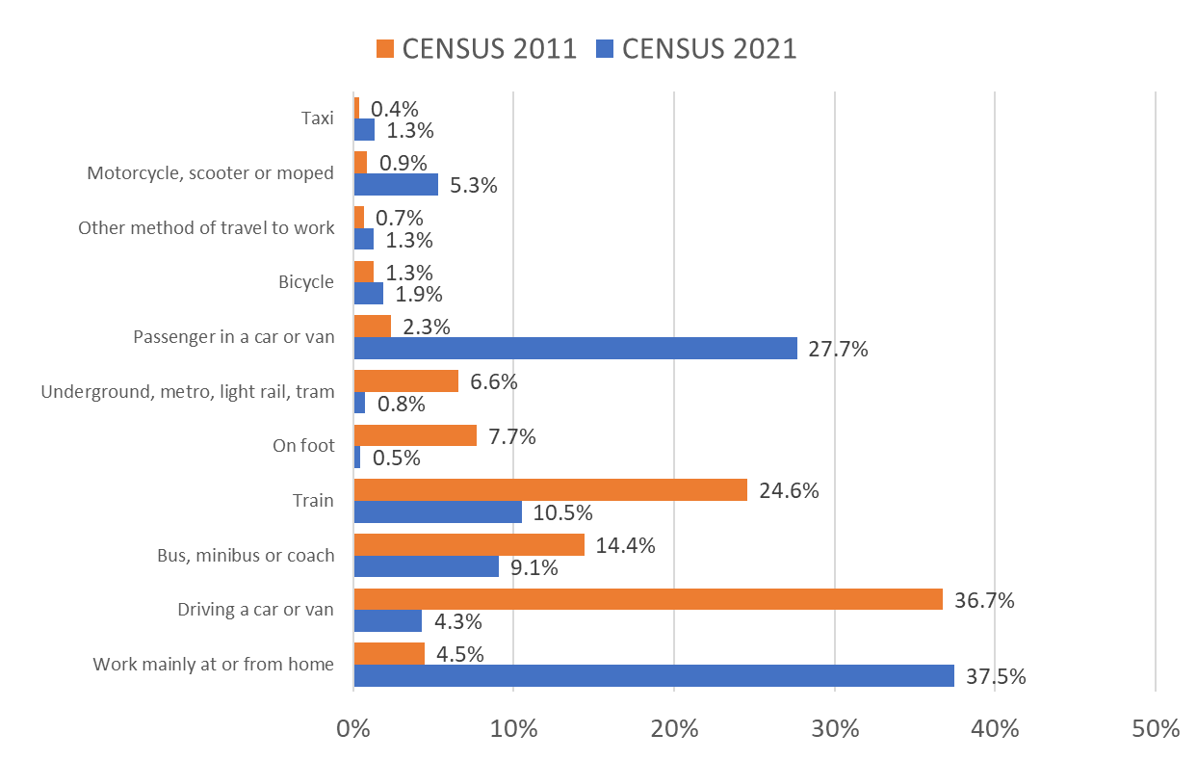
Individuals – Method of Travel to Work
33.0% more people were working from home in 2021 compared to 10 years ago, no doubt as a result of the new working world in response to the Covid pandemic of 2020.
36.7% of commuters drove a car or van into work in 2011. In 2021, this reduced to 4.3%.
There was a higher proportion of passengers in a car or a van in 2021 (27.7%) compared to 2011 (2.3%).
A higher percentage of commuters(24.6%) travelled by train in 2011 compared to 2021 (10.5%).
Source: ONS Census 2021
Edmund Fallon, Census 2021

Slide 14
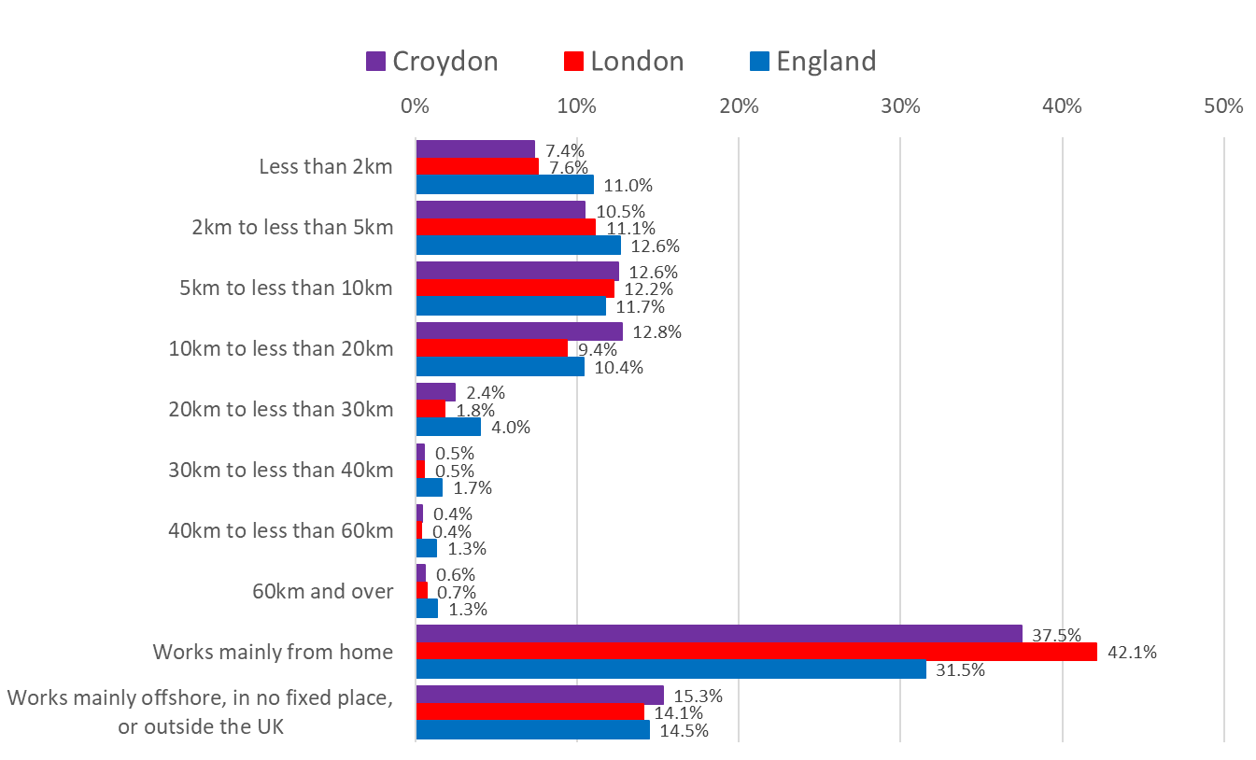
Individuals – Distance Travelled to Work
37.5% of the working residents of Croydon were working mainly from home on the week before Census Day. This was a higher proportion than in England (31.5%) but lower than in London (42.1%).
30.4% worked less than 10km from their work place.
15.2% worked between 10km and 30 km from the work place.
Only 1.6% worked further away than 30km.
15.3% worked offshore, in no fixed place or outside the UK.
Source: ONS Census 2021
Edmund Fallon, Census 2021

