Slide 1

Business Intelligence, P
Census 2021
& Improvement Service
10 Nov. 2022

Slide 2
Business Intelligence, P
Ethnic Group, National identity, language and Religion
Census 2021Service
29 Nov. 2022

Slide 3
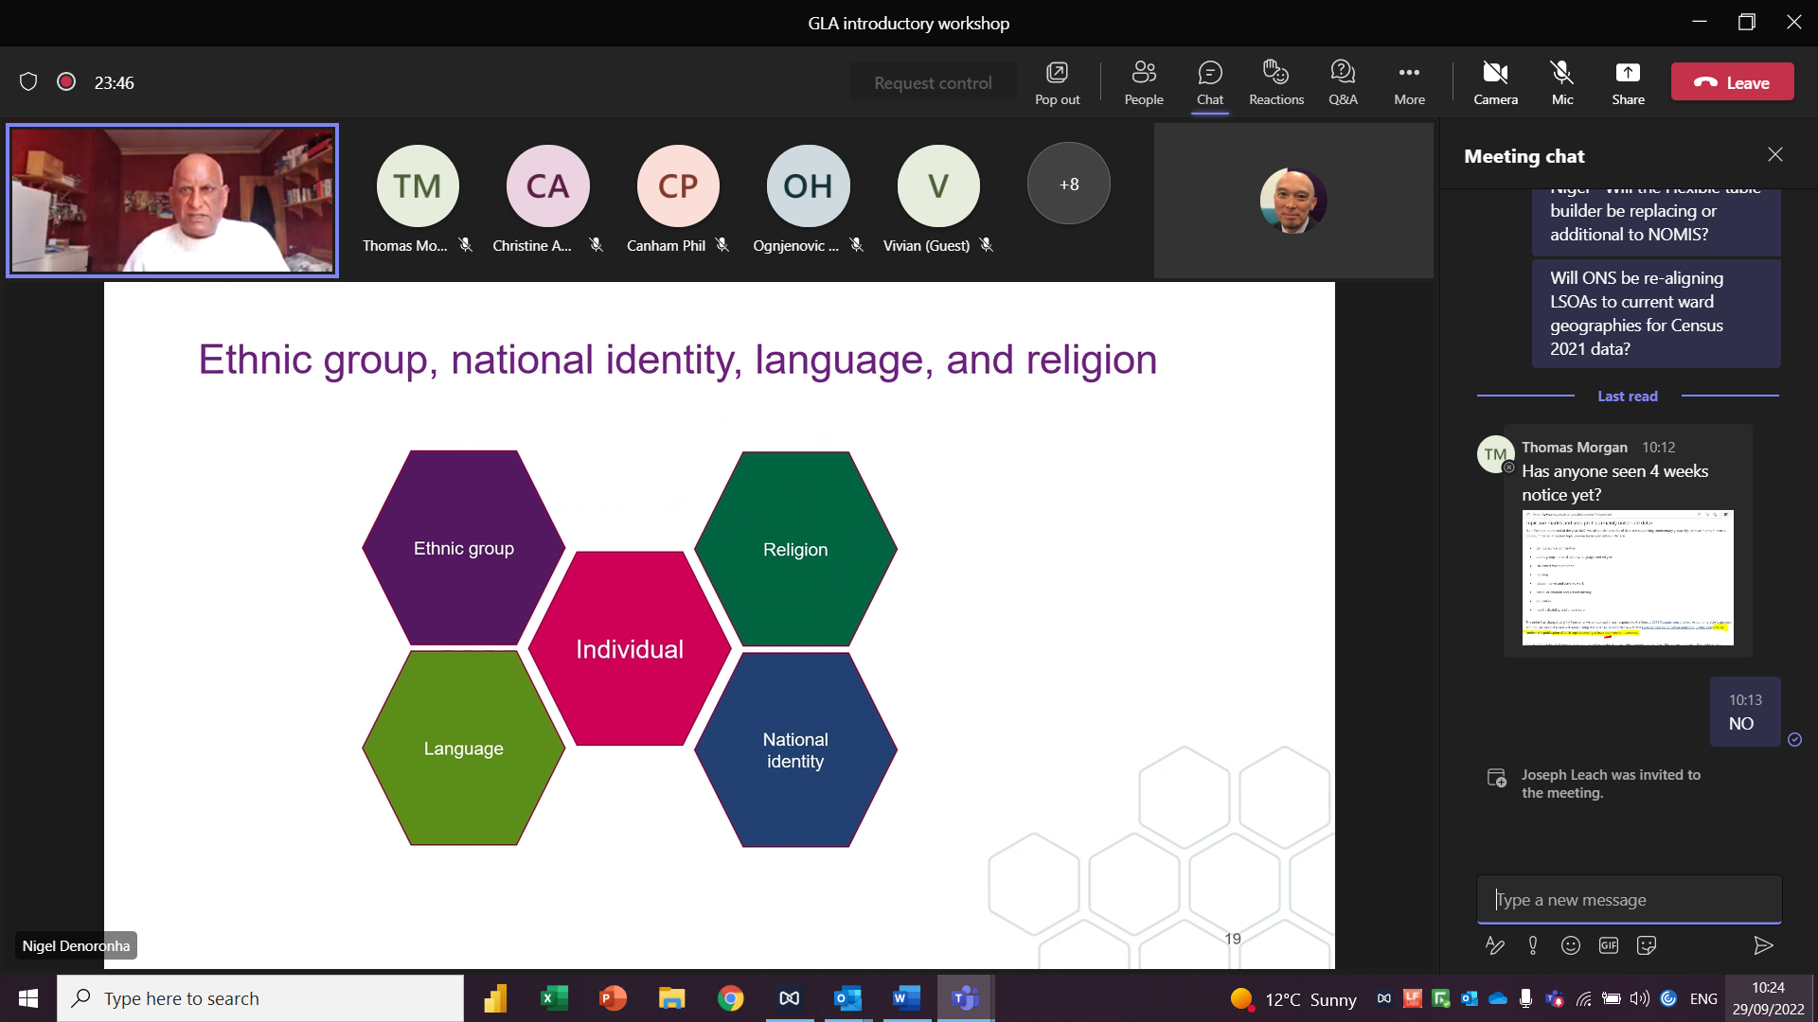
Business Intelligence, P
DD
29 Nov. 2022

Slide 4
Broad Ethnic Groups – Croydon vs London vs England
Less than half of the Croydon population is made up of residents from the White communities.
The proportion of people from the Black and Mixed communities in Croydon is greater than in London and England.
There is a much higher proportion of people from the White communities at the national level than in London and Croydon.
Source: ONS Census 2021
Edmund Fallon, Census 2021

Slide 5
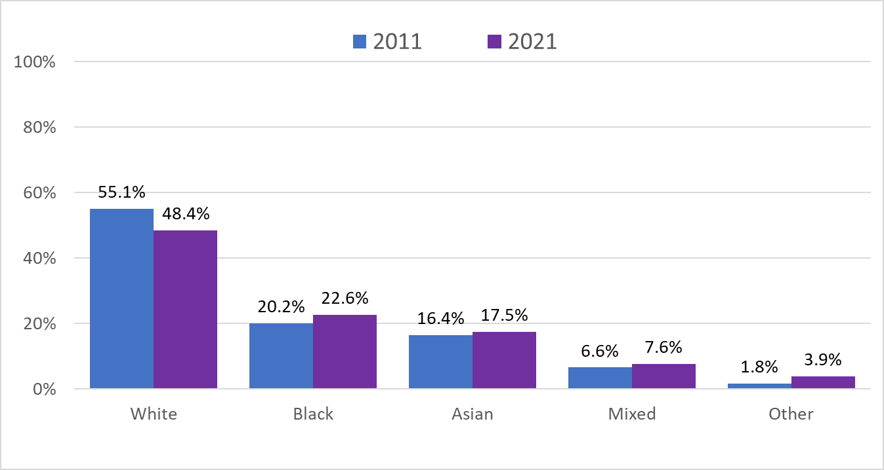
Broad Ethnic Groups – Croydon 2021 vs Croydon 2011
Over the 10 year period from 2011 to 2021, only the proportion of people from the White communities in Croydon has got smaller.
The number of residents from the Black communities has increased by 2.4%.
The number of residents from the Asian communities has increased by 1.1%.
Source: ONS Census 2021
Edmund Fallon, Census 2021

Slide 6
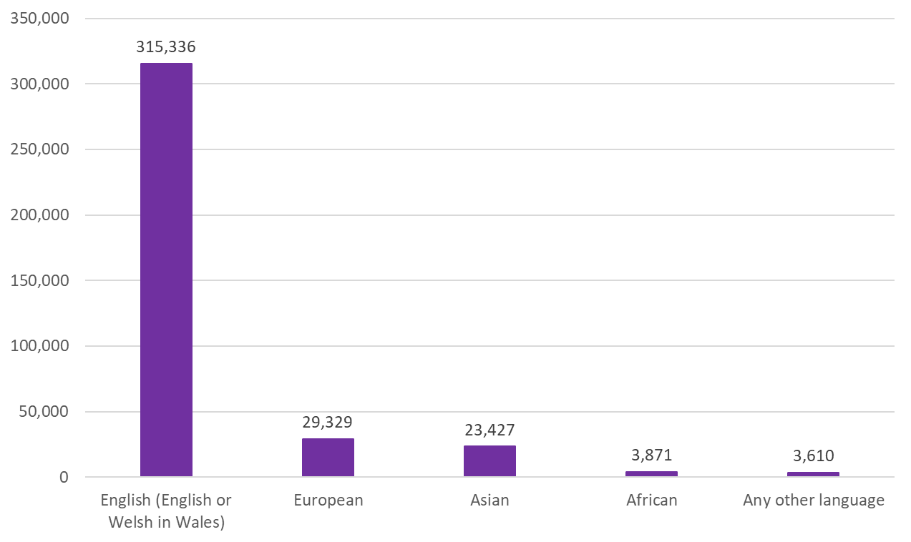
Main Languages in Croydon
A little more than 8 in 10 of Croydon residents have English as their main language.
Nearly 8% speak a European language as their main language.
6.2% have an Asian language as their main one.
1% speak and African language and 1% speak any other language as a preference.
Source: ONS Census 2021
Edmund Fallon, Census 2021

Slide 7
The Multiple Languages in Croydon
Main language (detailed) | 2021 | %
English (English or Welsh in Wales) | 315,336 | 84.0%
Welsh or Cymraeg (in England only) | 40 | 0.0%
Other UK language | 30 | 0.0%
French | 1,795 | 0.5%
Portuguese | 4,876 | 1.3%
Spanish | 3,813 | 1.0%
Other European language (EU) | 17,642 | 4.7%
Other European language (non EU) | 1,076 | 0.3%
Other European language (EU and non-EU) | 126 | 0.0%
Other European language (non-national) | 1 | 0.0%
Russian | 666 | 0.2%
Turkish | 1,264 | 0.3%
Arabic | 1,142 | 0.3%
West or Central Asian language | 2,717 | 0.7%
South Asian language | 17,871 | 4.8%
East Asian language | 2,839 | 0.8%
Oceanic or Australian language | 2 | 0.0%
North or South American language | 4 | 0.0%
Caribbean Creole | 74 | 0.0%
African language | 3,871 | 1.0%
Sign language | 224 | 0.1%
Other language | 164 | 0.0%
Total: All usual residents aged 3 years and over | 375,573 | 100%
Source: ONS Census 2021
Edmund Fallon, Census 2021

Slide 8
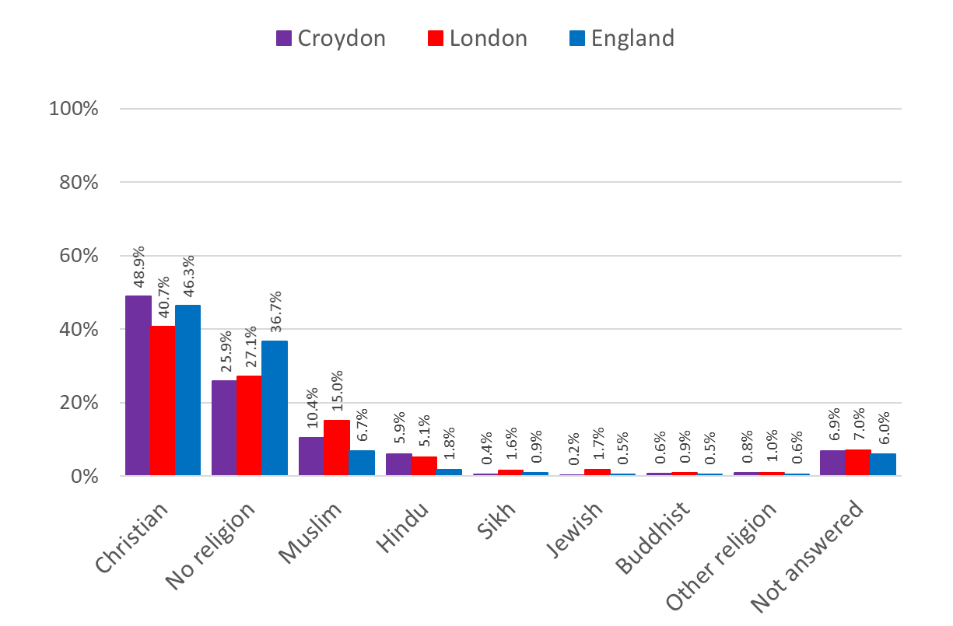
Religions in Croydon compared to London and England
 | Census 2021 | Census 2011 | Change
Christian | 48.9% | 56.4% | -7.5%
No religion | 25.9% | 20.0% | 5.9%
Muslim | 10.4% | 8.1% | 2.3%
Hindu | 5.9% | 6.0% | -0.1%
Sikh/Jewish/Other | 1.4% | 1.2% | 0.2%
Buddhist | 0.6% | 0.7% | -0.1%
Not answered | 6.9% | 7.6% | -0.7%
TOTAL | 100% | 100%
Source: ONS Census 2021
Edmund Fallon, Census 2021

Slide 9
Religions in Croydon
Total: All Usual Residents | 390,723
Christian | 190,880 |  | Other religion: Confucianist | 1 |  | Other religion: Satanism | 16
Buddhist | 2,371 |  | Other religion: Deist | 4 |  | Other religion: Scientology | 15
Hindu | 23,145 |  | Other religion: Druid | 8 |  | Other religion: Shamanism | 10
Jewish | 609 |  | Other religion: Druze | 0 |  | Other religion: Shintoism | 13
Muslim | 40,717 |  | Other religion: Eckankar | 12 |  | Other religion: Spiritual | 321
Sikh | 1,654 |  | Other religion: Heathen | 15 |  | Other religion: Spiritualist | 229
No religion: Agnostic | 212 |  | Other religion: Jain | 863 |  | Other religion: Taoist | 27
No religion: Atheist | 74 |  | Other religion: Mixed Religion | 131 |  | Other religion: Theism | 6
No religion: Free Thinker | 3 |  | Other religion: Mysticism | 1 |  | Other religion: Thelemite | 0
No religion: Humanist | 58 |  | Other religion: Native American Church | 0 |  | Other religion: Traditional African Religion | 24
No religion: No religion | 100,773 |  | Other religion: New Age | 2 |  | Other religion: Unification Church | 19
No religion: Realist | 0 |  | Other religion: Occult | 0 |  | Other religion: Universalist | 3
Other religion: Alevi | 106 |  | Other religion: Other religions | 764 |  | Other religion: Valmiki | 0
Other religion: Animism | 2 |  | Other religion: Own Belief System | 18 |  | Other religion: Vodun | 4
Other religion: Baha'i | 22 |  | Other religion: Pagan | 236 |  | Other religion: Wicca | 54
Other religion: Believe in God | 42 |  | Other religion: Pantheism | 9 |  | Other religion: Witchcraft | 5
Other religion: Brahma Kumari | 0 |  | Other religion: Rastafarian | 138 |  | Other religion: Yazidi | 17
Other religion: Chinese Religion | 0 |  | Other religion: Ravidassia | 1 |  | Other religion: Zoroastrian | 47
Other religion: Church of All Religion | 0 |  | Other religion: Reconstructionist | 7 |  | Religion not stated | 27,035
Source: ONS Census 2021
Edmund Fallon, Census 2021

Slide 10
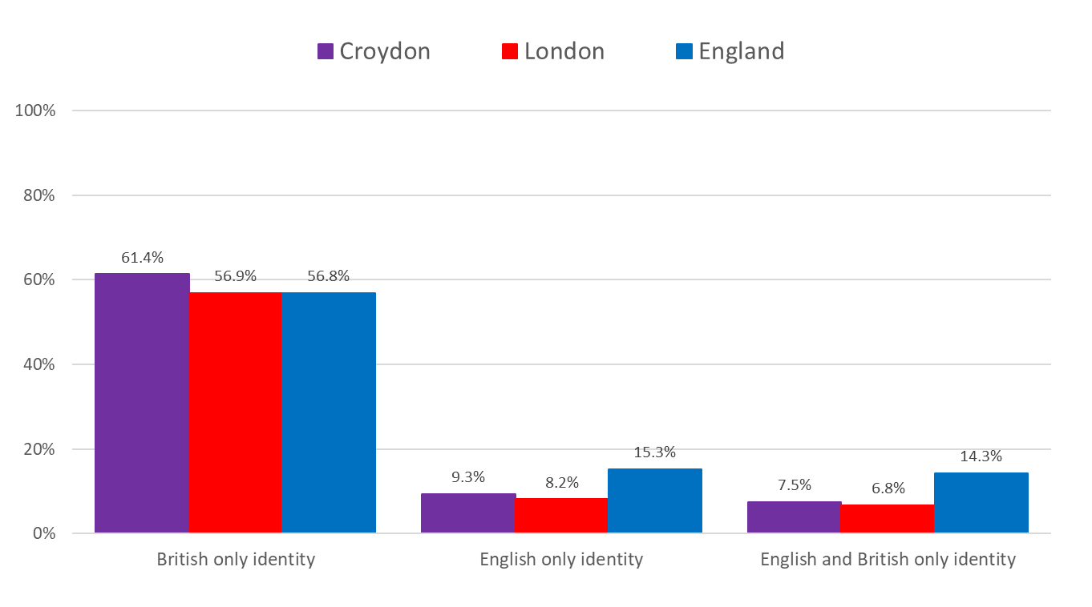
National Identity – Croydon vs London vs England
17.4% of the Croydon Population have a non-UK identity.
78.2% have a British of English identity.
Source: ONS Census 2021
Edmund Fallon, Census 2021

Slide 11
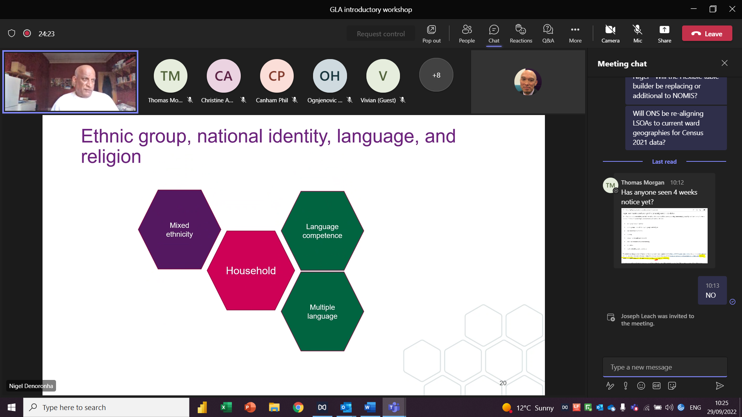
Business Intelligence, P
DD
29 Nov. 2022

Slide 12
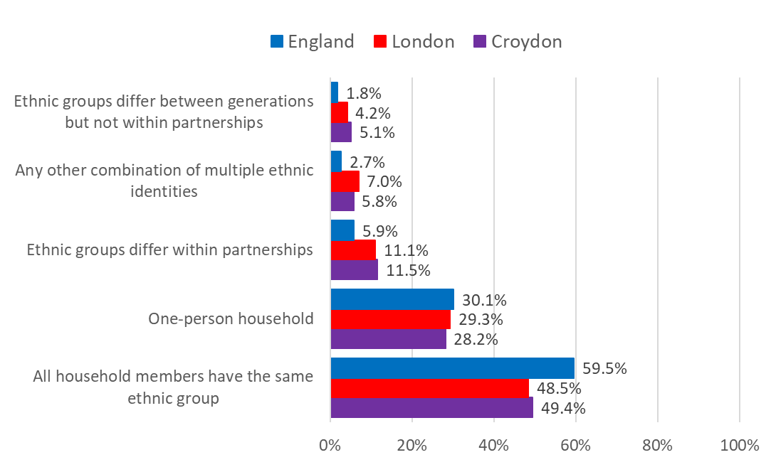
Household Mixed Ethnicity – Croydon vs London vs England
Half (49.4%) of the Croydon households have all members of the same ethnic group.
About 3 in 10 (28.2%) are one-person households only which is a similar proportion to London and England.
About 1 in 9 (11.5%) of its households have partners from different ethnic groups.
Source: ONS Census 2021
Edmund Fallon, Census 2021

Slide 13
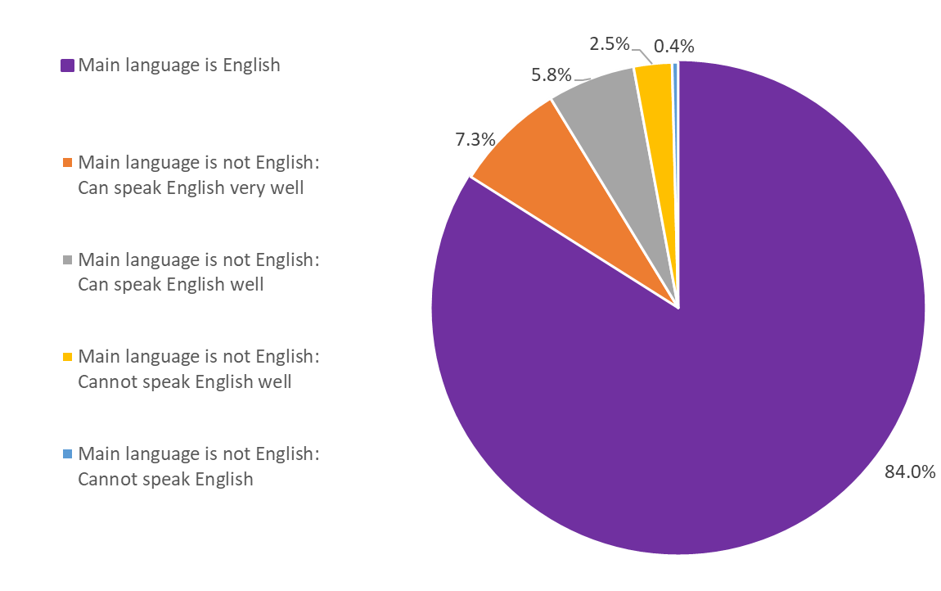
Language Competence in Croydon
84% of Croydon residents have English as their main language.
13.1% of residents whose first language is not English can speak English very well or well.
Less than 3% of the speaking residents either cannot speak English well or not speak English at all.
Source: ONS Census 2021
Edmund Fallon, Census 2021

Slide 14
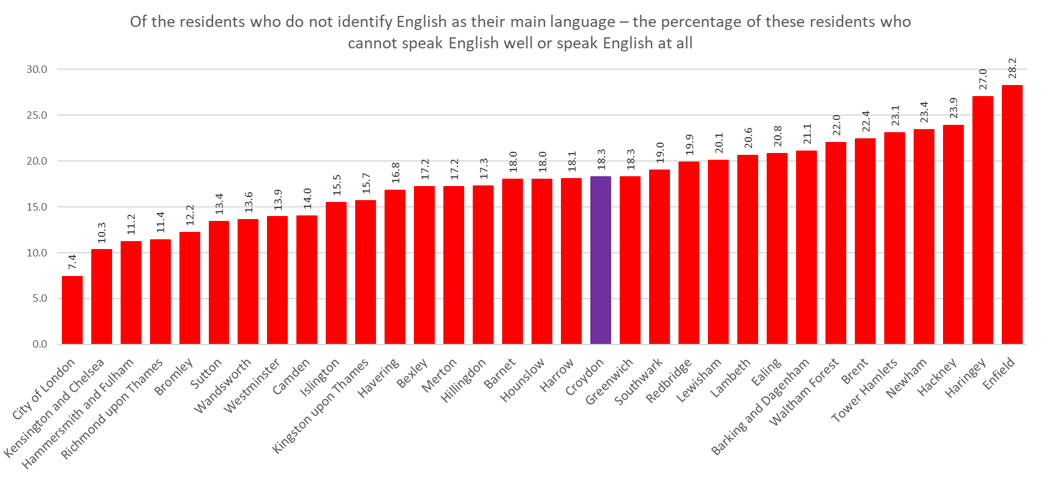
Language Competence – Croydon vs London vs England
Source: ONS Census 2021
Edmund Fallon, Census 2021

