Slide 1
Business Intelligence, P Census 2021 & Improvement Service
28 June 2022

Slide 2
Croydon response to Census 2021 survey
Croydon saw an increase in responses to the Census survey for 2021 to 96%, compared to the 2011 census where the response rate was 90%.
Measure for area | Croydon, 2021 | Croydon, 2011 | London, 2021 | London, 2011 | England & Wales, 2021 | England & Wales, 2011
Census estimate* of usual residents | 390,800 | 363,400 | 8,799,800 | 8,173,900 | 59,597,300 | 56,075,900
Census count of usual residents | 376,000 | 327,400 | 8,378,700 | 7,391,900 | 57,788,000 | 52,637,700
Response rate for usual residents | 96% | 90% | 95% | 90% | 97% | 94%
*takes into account council tax data for properties where there was no response
Source: ONS Census 2011 and ONS Census 2021
Caroline Bruce Census 2021

Slide 3
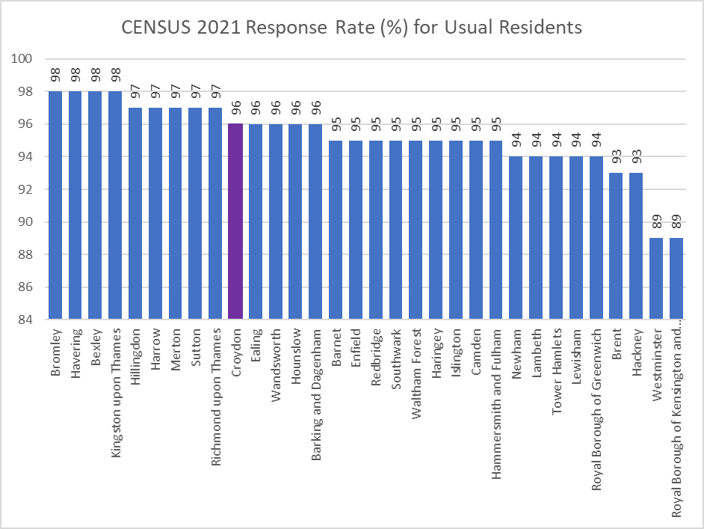
Response Rates across LA’s for Census 2021 survey
The average response rate for London was 95.2%. Croydon had a higher than average response rate to the survey of 96%
Source: ONS Census 2021
Caroline Bruce Census 2021

Slide 4
Croydon Population
The total Croydon population is published at 390,800 (rounded to nearest hundred).
This means that Croydon is now the largest of the 32 London boroughs in terms of population.
This is a 7.5% increase from the 2011 census population - the tenth smallest increase in London (7.7%).
This is higher than the overall increase for England (6.6%), where the population grew by nearly 3.5 million to 56,489,800.
Increases are different depending on age group with the 65+ years increasing by 19.6%,
15-64 year olds increasing by 7%
children under 15 increasing by 1.9%.
Caroline Bruce Census 2021

Slide 5
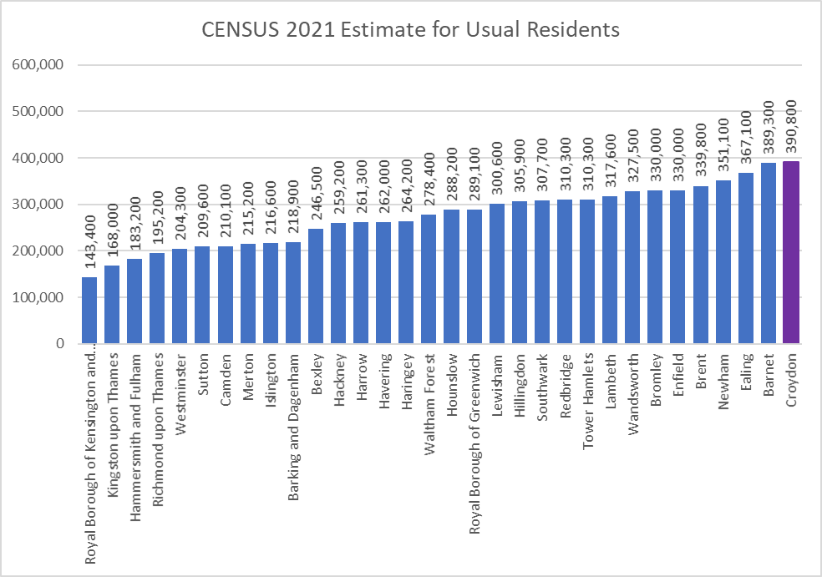
Croydon Population compared to rest of London LA’s
Source: ONS Census 2021
Caroline Bruce Census 2021

Slide 6
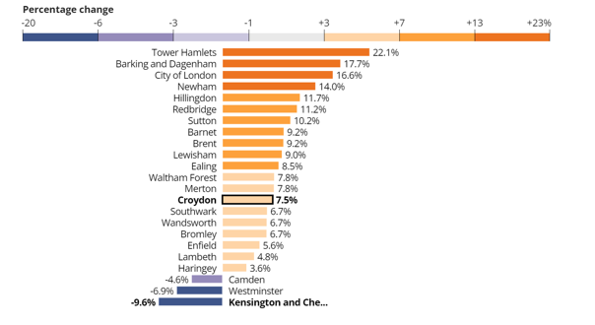
Population change of selected London LA’s between 2011-2021
Caroline Bruce Census 2021

Slide 7
Croydon population by residents and households
Source: ONS Census 2011 and ONS Census 2021
Source: ONS Census 2011 and ONS Census 2021
Caroline Bruce Census 2021

Slide 8
Croydon population by sex
Source: ONS Census 2011 and ONS Census 2021
Caroline Bruce Census 2021

Slide 9
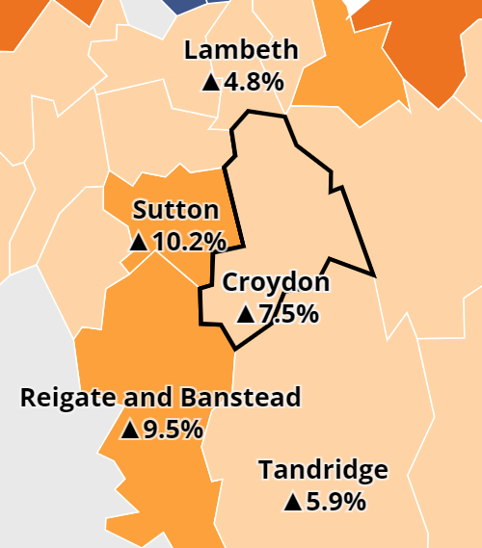
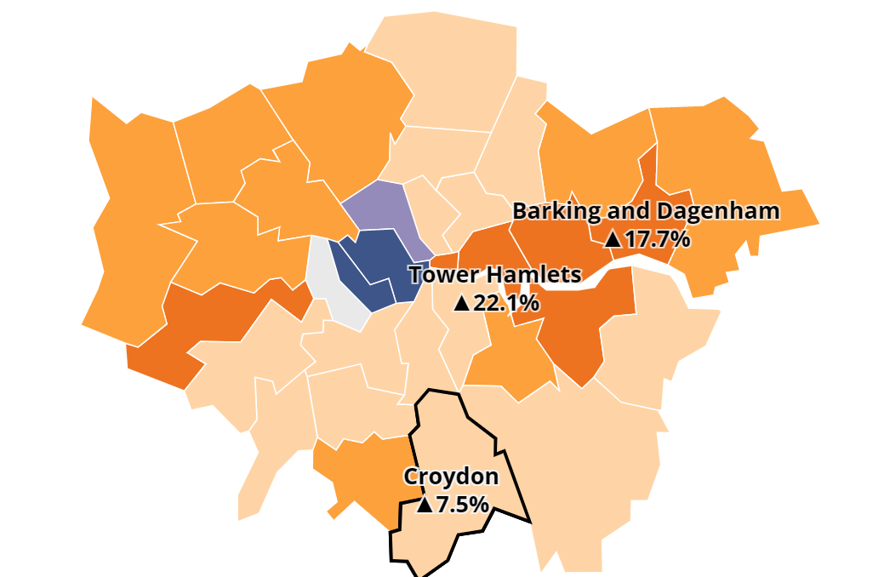
Population – Neighbouring boroughs
The largest population increases in London have been seen in Tower Hamlets and Barking & Dagenham, where the populations have grown by 22.1% and 17.7%, respectively.
Nearby areas like Sutton and Reigate and Banstead have seen their populations increase by around 10.2% and 9.5%, respectively, while others such as Tandridge saw an increase of 5.9% and Lambeth saw smaller growth (4.8%).
Caroline Bruce Census 2021

Slide 10
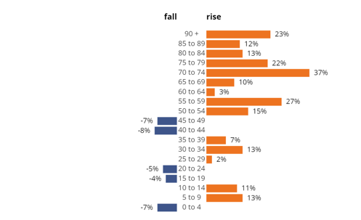
Population change (%) by age group in England 2011-21
Overall, in England, there has been an increase of 20.1% in people aged 65 years and over, an increase of 3.6% in people aged 15 to 64 years, and an increase of 5.0% in children aged under 15 years.
Caroline Bruce Census 2021

Slide 11
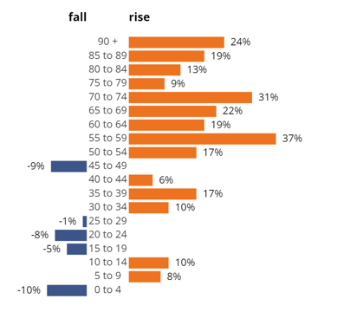
Population change (%) by age group in Croydon 2011-2021
This is how Croydon compares. There has been an increase of 19.7% in people aged 65 years and over, an increase of 7.0% in people aged 15 to 64 years, and an increase of 1.9% in children aged under 15 years.
Caroline Bruce Census 2021

Slide 12
Population change (No’s) by age group in Croydon 2011-2021
All persons, of ages: | Croydon All Residents 2021 Census estimate | Croydon All Residents 2011 Census estimate | Difference: 2021 vs 2011 | Actual percentages calculated to 1 decimal places | Previous slide with percentages ROUNDED
0-4 | 25,200 | 28,000 | -2800 | -10.0% | -10
5-9 | 25,000 | 23,100 | 1900 | 8.2% | 8
10-14 | 25,400 | 23,100 | 2300 | 10.0% | 10
15-19 | 22,300 | 23,600 | -1300 | -5.5% | -5
20-24 | 21,600 | 23,600 | -2000 | -8.5% | -8
25-29 | 27,500 | 27,700 | -200 | -0.7% | -1
30-34 | 31,600 | 28,600 | 3000 | 10.5% | 10
35-39 | 31,200 | 26,700 | 4500 | 16.9% | 17
40-44 | 28,600 | 27,100 | 1500 | 5.5% | 6
45-49 | 26,000 | 28,500 | -2500 | -8.8% | -9
50-54 | 27,100 | 23,100 | 4000 | 17.3% | 17
55-59 | 25,800 | 18,900 | 6900 | 36.5% | 37
60-64 | 20,300 | 17,000 | 3300 | 19.4% | 19
65-69 | 15,300 | 12,600 | 2700 | 21.4% | 22
70-74 | 13,800 | 10,600 | 3200 | 30.2% | 30
75-79 | 9,700 | 8,900 | 800 | 9.0% | 9
80-84 | 7,200 | 6,400 | 800 | 12.5% | 13
85-89 | 4,600 | 3,900 | 700 | 17.9% | 19
90+ | 2,500 | 2,000 | 500 | 25.0% | 24
All persons | 390,800 | 363,400 | 27400 | 7.5%
Caroline Bruce – Census 2021

Slide 13
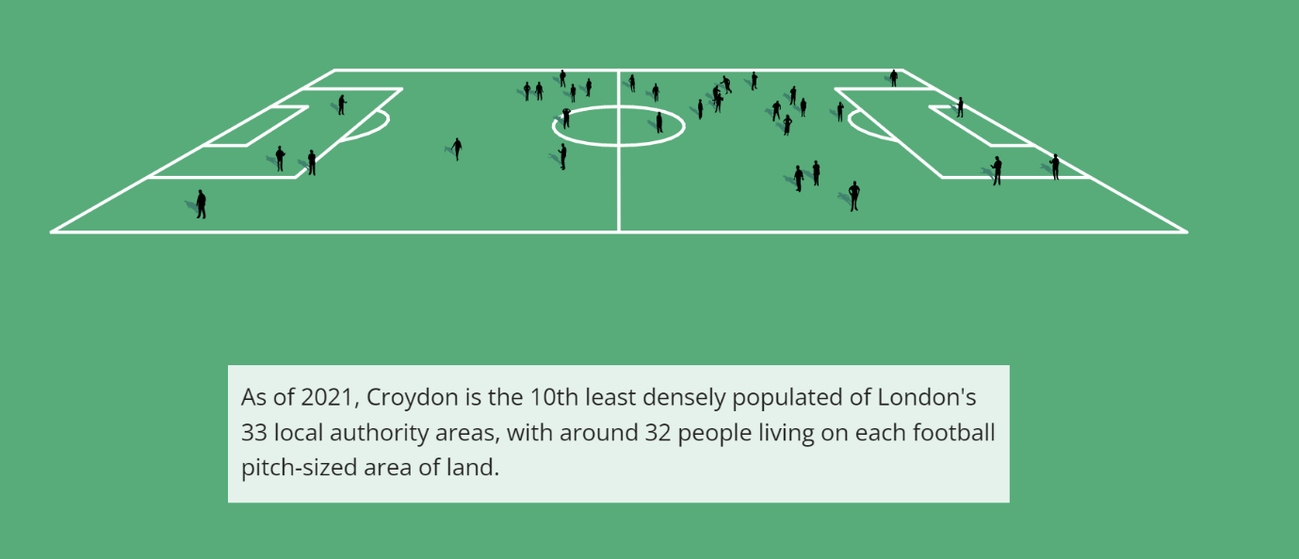
Density
Caroline Bruce Census 2021

Slide 14
Data release dates
From October to the end of the year 2022, ONS publish a series of data and supporting commentary groups by a similar theme, known as topic summaries.
Proposed topic summaries in publication order are:
demography and migration
ethnic group, national identity, language, and religion
UK armed forces veterans
housing
labour market and travel to work
sexual orientation and gender identity
education
health, disability, and unpaid care
Release plans - Office for National Statistics (ons.gov.uk)
Caroline Bruce Census 2021

